Slide 1
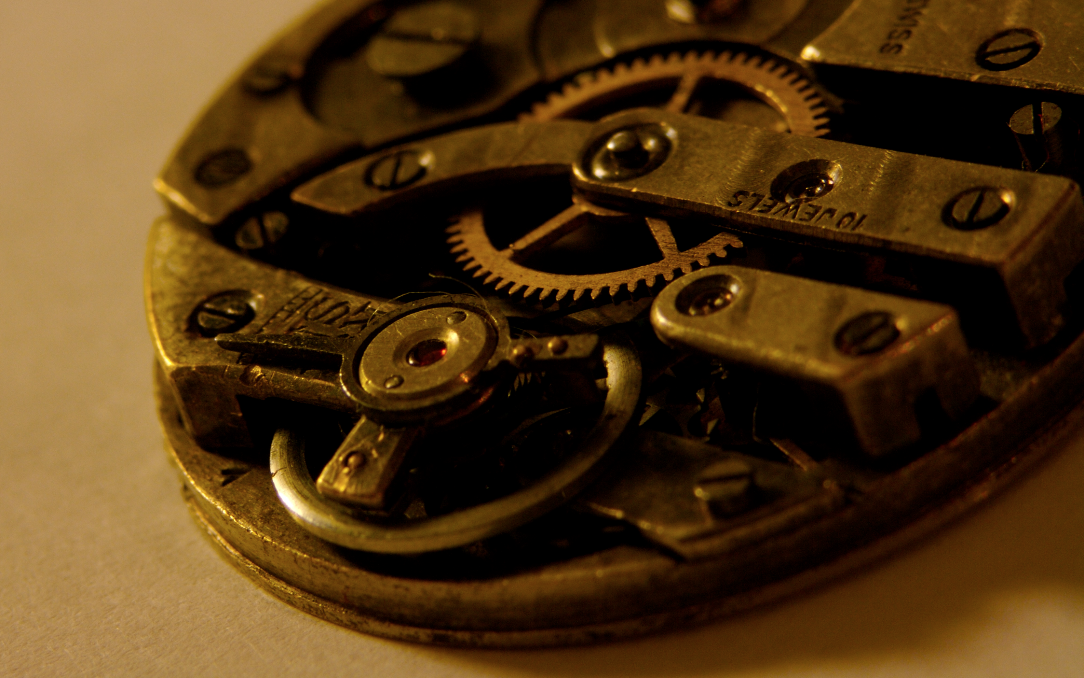
https://flic.kr/p/ue7tL
Design Patterns

Slide 2
Patterns, patterns everywhere
You need to decorate a room…
  What patterns do you use?
You need to write a term paper…
  What patterns do you use?

Slide 3
Design Patterns
Design patterns (DPs) are…
  Strategies for your “toolkit of ideas”
  Templates for solutions
  Codified best practices
Design patterns are not…
  Architectural styles (DPs are too low level)
  Code libraries (DPs are ideas, not code)

Slide 4
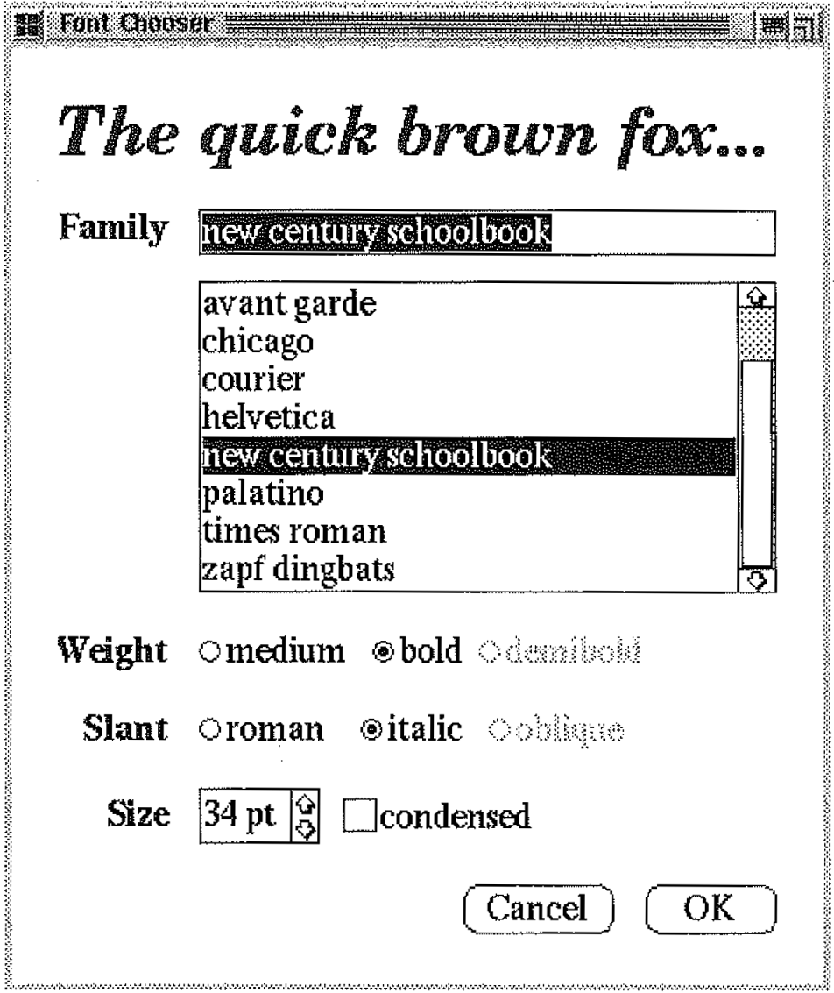
Example problem: Complex interconnections
?

Slide 5
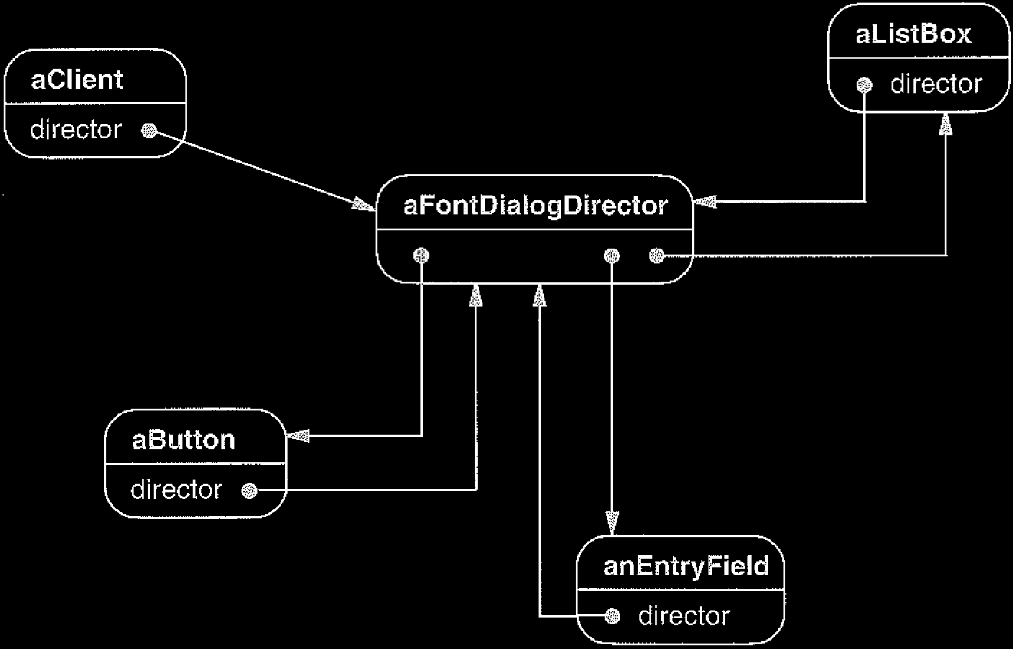
Example solution: Mediator Pattern
From Design Patterns: Elements of Reusable Object-Oriented Software (Gamma et al., 1995)

Slide 6
Software Design Patterns
Primary goals of software DPs
  To aid maintainability, flexibility, other quality attributes
  To help system designers make good decisions
There are a few dozen very common OO patterns
  Patterns exist for other kinds of non-OO systems.
  Patterns are recognizable based on their
  structure and their purpose.

Slide 7
Two Key Design Properties:
Coupling and Cohesion

Slide 8
Design Terms
Component: A routine or module
  Routine: A function, procedure, or method
  Module: A collection of routines and data (e.g., a class)
Data: Variables or constants

Slide 9
Coupling
Defn: Degree to which components are related
  From tightly (worse) to loosely (better)
Tight coupling drawbacks:
  Spaghetti code
  Assembling components takes longer
  Components less reusable
  Increased likelihood that a change to one component forces a change to another

Slide 10
Compare font-chooser designs WRT coupling

Slide 11
Compare font-chooser designs WRT coupling
GUI objects have looser coupling with mediator

Slide 12
Cohesion
Defn: Degree to which internal parts of a component are related
  From low (worse) to high (better)
Low cohesion drawbacks:
  Spaghetti code (things get wild within the component)
  Poor reusability
  Changes to component require inspecting/modifying more code
  Performance suffers

Slide 13
Compare font-chooser designs WRT cohesion

Slide 14
Compare font-chooser designs WRT cohesion
GUI objects have higher cohesion with mediator

Slide 15
General Relationship:
With looser coupling comes higher cohesion

Slide 16
Software Design Patterns
Primary goals of software DPs
  To aid maintainability, flexibility, other quality attributes
  To help system designers make good decisions
There are a few dozen very common OO patterns
  Patterns exist for other kinds of non-OO systems.
  Patterns are recognizable based on their
  structure and their purpose.

Slide 17
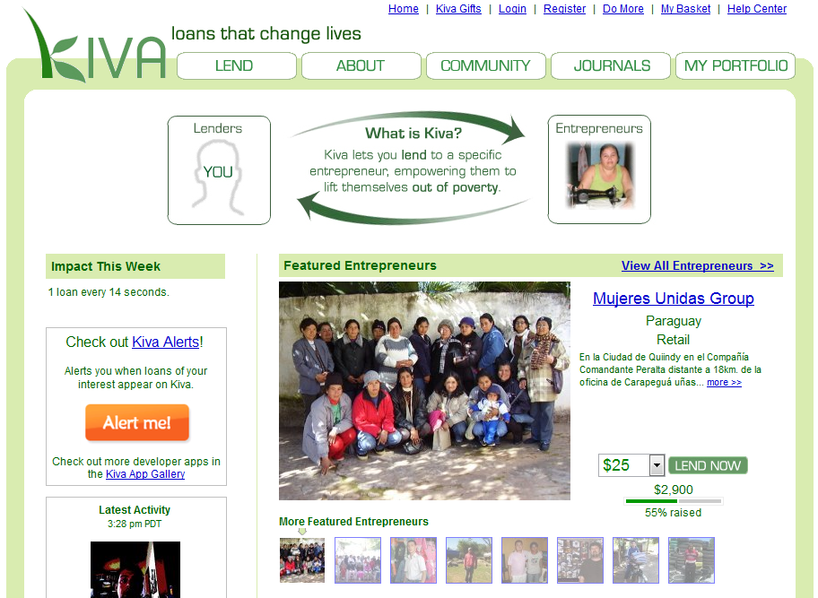
Example system
Kiva system to connect lenders with borrowers
How could we use
DPs to implement
Kiva?
How could we use
DPs to implement
a better Kiva???

Slide 18
Builder
TeamReviewScreenBuilder
+generateHtml()
Knows how to create a complex object
Use when instantiating an object requires filling it with parts or otherwise lengthy configuration
TeamReviewScreen
SearchSection
CategoryFilterSection
TeamTable
TeamHeading
TeamRow
+ image
+ name
+ creation date
+ # members
+ # loans
+ total loaned
+ Join button
TeamInfo
+ link
+ category

Slide 19
Adapter
PaymentProcessor
+ pay($ amount)
Converts one interface to another by wrapping
Use to overcome incompatibility
CreditCardPaymentAdapter
+ pay($ amount)
.netCharge component
+ issueCharge($ amount, timeout)
Remote credit card gateway

Slide 20
Facade
PaymentProcessor
+ pay($ amount)
Object that provides a unified, high-level interface to a subsystem
Use when calling a subsystem requires a frequent series of complex lines of code
CreditCardPaymentAdapter
+ pay($ amount)
???
.netCharge component
+ issueCharge($ amount, timeout)
ComponentLicense
GatewayProxy
GatewayRequest
Remote server
RequestConfiguration
+ timeout
+ URL
+ HTTP client certificate

Slide 21
Memento
Encapsulate state in an object
Use if you might want to return to a certain state later
BlogEntryEditor
UndoRedoManager
BlogEntry
+ StoreToHtmlMemento()
+ ReloadFromHtmlMemento()
HtmlMemento
+ html

Slide 22
Interpreter
Parses and acts on instructions written in a certain syntax
Use to add scriptability
LoanRequestServer
+ listAll()
+ makeLoan()
AutoLoanInterpreter
+ interpret(script)
AutoLoanScript
+ instructions

Slide 23
Observer
Loan
+ RegisterForRepayEvent()
+ RegisterForDefaultEvent()
+ UnregisterForRepayEvent()
+ UnregisterForDefaultEvent()
FireRepayEvent()
FireDefaultEvent()
Watching for another object to change state
Use in any event-driven design
LoanListener
+ OnRepayEvent()
+ OnDefaultEvent()
LoanRequestServer
+ listAll()
+ makeLoan()
AutoLoanInterpreter
+ interpret(script)
+ OnRepayEvent()
+ OnDefaultEvent()
AutoLoanScript
+ instructions

Slide 24
Which pattern
would you use?
You are building a cool 3D game. Your company licenses a big, ugly library that implements the 3D mathematics.
Builder | Memento
Adapter | Interpreter
Façade | Observer

Slide 25
Which pattern
would you use?
Your application might crash at any time. You want your application to save its state so that if it crashes, then it can auto-recover.
Builder | Memento
Adapter | Interpreter
Façade | Observer

Slide 26
Which pattern
would you use?
Your application should run after any student uploads a homework to Blackboard.
Builder | Memento
Adapter | Interpreter
Façade | Observer

Slide 27
Which pattern
would you use?
Your application needs to generate PDF files (from scratch).
Builder | Memento
Adapter | Interpreter
Façade | Observer

Slide 28
Which pattern
would you use?
You want to let users create and run macros inside your application.
Builder | Memento
Adapter | Interpreter
Façade | Observer

Slide 29
Which pattern
would you use?
Your company already implemented a component that almost implements the interface that you need, but not quite.
Builder | Memento
Adapter | Interpreter
Façade | Observer

Slide 30
Which pattern
would you use?
Your program must support switching among several different tax-calculator libraries, but each one has a slightly different interface.
Builder | Memento
Adapter | Interpreter
Façade | Observer

Slide 31
Which pattern
would you use?
Your program has to create some big, ugly record objects before inserting them into a database.
Builder | Memento
Adapter | Interpreter
Façade | Observer

Slide 32
Which pattern
would you use?
Your program has to support replication. You need a way for the program to save its state so the program can be copied to other servers.
Builder | Memento
Adapter | Interpreter
Façade | Observer

Slide 33
Which pattern
would you use?
Your program generates various outputs. You need a way to notify Facebook users when certain outputs are generated.
Builder | Memento
Adapter | Interpreter
Façade | Observer

Slide 34
Which pattern
would you use?
Sending a message to Facebook requires lots of big, ugly code.
Builder | Memento
Adapter | Interpreter
Façade | Observer

Slide 35
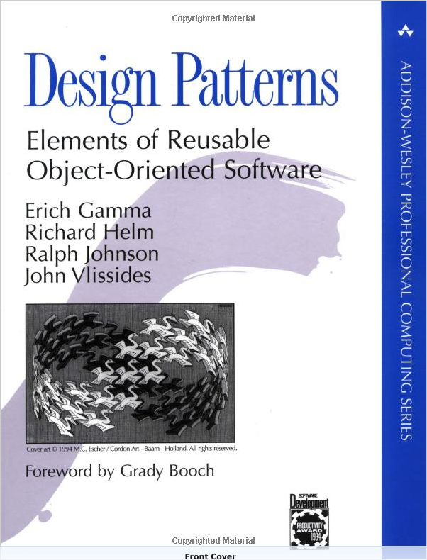
For more info…
See the “gang of four” or “GoF” book
  Template method
  Factory method
  Strategy
  Decorator
  Observer
  Composite
  Visitor

Slide 36
Copyright (c) Christopher Scaffidi 2009 All rights reserved.
Redistribution and use in source and binary forms, with or without modification, are permitted provided that the following conditions are met:
Redistributions of source code must retain the above copyright notice, this list of conditions and the following disclaimer.
Redistributions in binary form must reproduce the above copyright notice, this list of conditions and the following disclaimer in the documentation and/or other materials provided with the distribution.
Neither the name of Oregon State University nor the names of its contributors may be used to endorse or promote products derived from this software without specific prior written permission.
THIS SOFTWARE IS PROVIDED BY THE COPYRIGHT HOLDERS AND CONTRIBUTORS "AS IS" AND ANY EXPRESS OR IMPLIED WARRANTIES, INCLUDING, BUT NOT LIMITED TO, THE IMPLIED WARRANTIES OF MERCHANTABILITY AND FITNESS FOR A PARTICULAR PURPOSE ARE DISCLAIMED. IN NO EVENT SHALL THE COPYRIGHT OWNER OR CONTRIBUTORS BE LIABLE FOR ANY DIRECT, INDIRECT, INCIDENTAL, SPECIAL, EXEMPLARY, OR CONSEQUENTIAL DAMAGES (INCLUDING, BUT NOT LIMITED TO, PROCUREMENT OF SUBSTITUTE GOODS OR SERVICES; LOSS OF USE, DATA, OR PROFITS; OR BUSINESS INTERRUPTION) HOWEVER CAUSED AND ON ANY THEORY OF LIABILITY, WHETHER IN CONTRACT, STRICT LIABILITY, OR TORT (INCLUDING NEGLIGENCE OR OTHERWISE) ARISING IN ANY WAY OUT OF THE USE OF THIS SOFTWARE, EVEN IF ADVISED OF THE POSSIBILITY OF SUCH DAMAGE.
Modified by Scott D. Fleming <Scott.Fleming@memphis.edu> 2014.

