Slide 1
https://flic.kr/p/9AWLK
White-Box Testing

Slide 2
Recall: Approaches to choose test cases
Blackbox testing: Choose based on module’s possible inputs and outputs
Do not use code
Often test boundary cases
White-box testing: Uses internal logic to choose tests
Different levels of code coverage
Aka glass box testing, clear box testing

Slide 3
Code Coverage
Degree to which source code of a program is tested by a test suite
Examples:
Statement coverage
Condition coverage
Path coverage
But first…
Notes:
There are more types of coverages

Slide 4
Control Flow Graphs
def create
@profile = profile.new(params)
if @profile.save
redirect_to show_prof_url(@profile)
else
render ‘new’
end
end
}
Basic blocks: straight-line pieces of code without any jumps or jump targets

Slide 5
Control Flow Graphs
def create
end
@profile = profile.new(params)
if @profile.save
TRUE
FALSE
redirect_to show_prof_url(@profile)
else
render ‘new’
end
Jumps: control branches

Slide 6
Code Coverage Levels
Statement coverage
Condition coverage
Path coverage

Slide 7
Statement Coverage
Set of test cases such that… Each program statement (line or basic block) is executed at least once

Slide 8
Define a test suite that provides statement coverage
Control Flow Graph
def foo(x, y)
@z = 0
if x > 0 && y > 0
@z = x
end
return @z
end
@z = 0
if x > 0 && y > 0
@z = x
return @z
✔
true
✔
false
input |  | expected
x | y
✔
1 1 1

Slide 9
QUIZ!

Slide 10
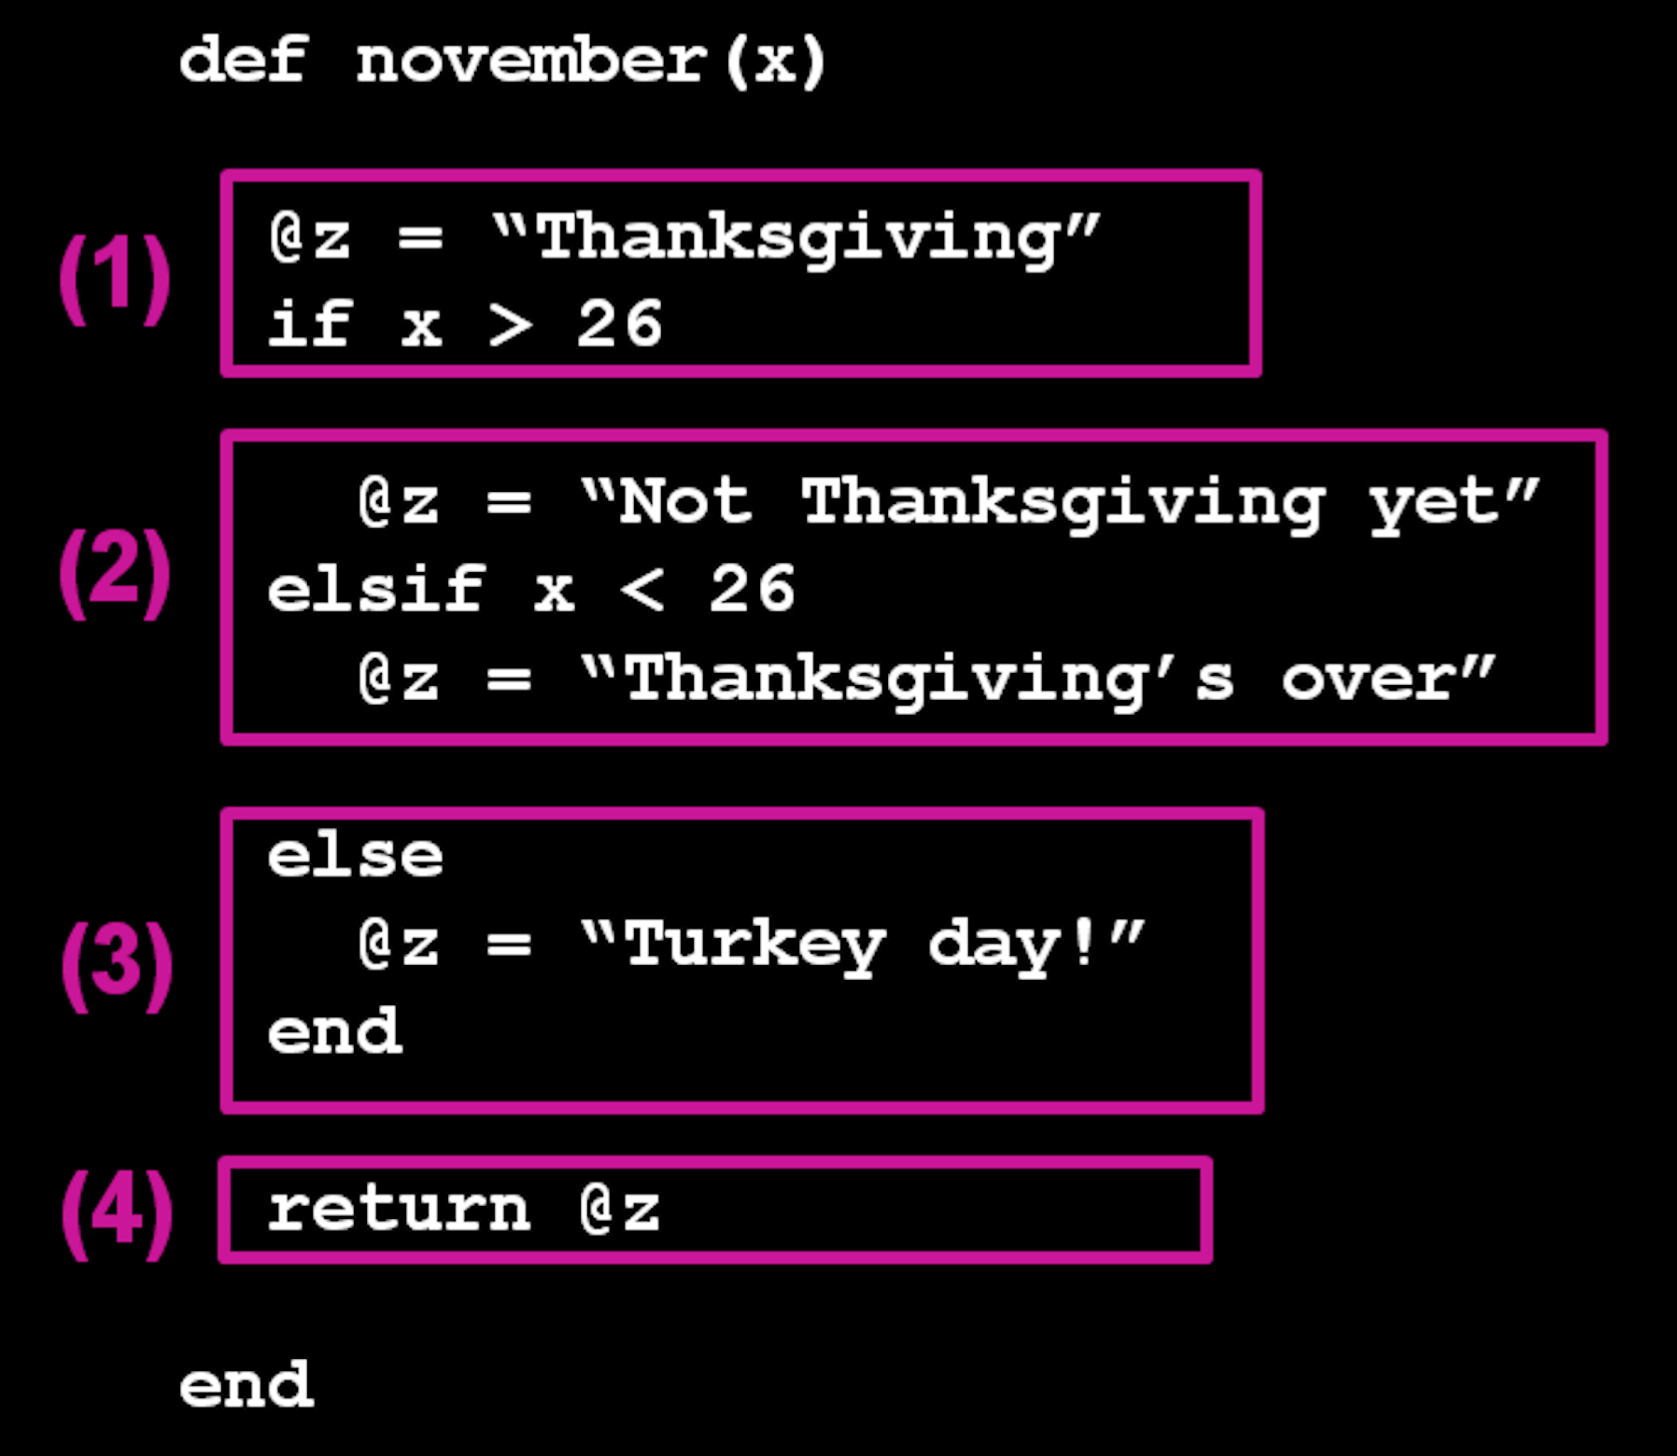
In the control flow graph given, which of the following is not a basic block? (Hint: Basic block = no jumps)
Option 1: 1
Option 2: 2
Option 3: 3
Option 4: 4

Slide 11
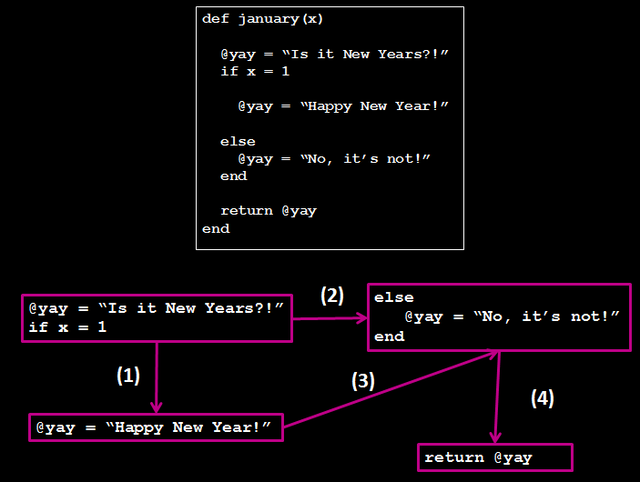
2. Which of the execution arrows is not in the correct place for this control flow graph?
Option 1: 1
Option 2: 2
Option 3: 3
Option 4: 4

Slide 12
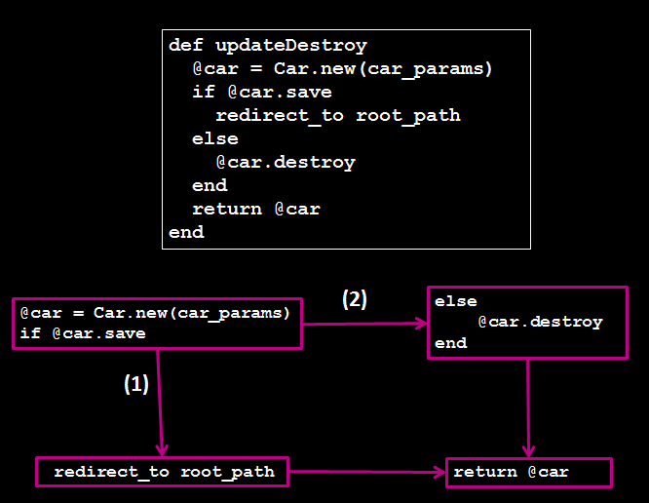
3. Which of the following will execute the correct jumps for (1) and (2)?
Option 1: (1):true, (2):true
Option 2: (1):true, (2):false
Option 3: (1):false, (2):false
Option 4: (1):false, (2):true

Slide 13
Answers
Option 2: 2
Option 3: 3
Option 2: (1):true, (2):false

Slide 14
1. Fill in the blank: The test suite for statement coverage means that each _______ is executed at least once.
Option 1: Conditions
Option 2: Jump
Option 3: Basic Block
Option 4: None of the above

Slide 15
True or False? All the statements in the CFG is covered with this array of inputs: { (x,y): (40,4), (40,30) }.

Slide 16
3. Which of the following input array will provide full statement coverage for the image?
Option 1: { (x,y): (10,10), (10,18) }
Option 2: { (x,y): (20,10), (20,21) }
Option 3: { (x,y): (30,10) }
Option 4: { (x,y): (23,8), (10,21) }

Slide 17
Answers
Option 3: Basic Block
True; if you trace with the inputs, it hits all the statements
Option 2: { (x,y): (20,10), (20,21) }

Slide 18
Code Coverage Levels
Statement coverage
Condition coverage
Path coverage

Slide 19
Condition Coverage
Set of test cases such that… Each boolean expression (in control structures) evaluates to true at least once and to false at least once

Slide 20
Define a test suite that provides condition coverage
Control Flow Graph
def foo(x, y)
@z = 0
if x > 0 && y > 0
@z = x
end
return @z
end
@z = 0
if x > 0 && y > 0
@z = x
return @z
✔
true
✔
false
input |  | expected
x | y
1 1 1
0 0 0

Slide 21
Code Coverage Levels
Statement coverage
Condition coverage
Path coverage

Slide 22
Path Coverage
Set of test cases such that… Each possible path through a program’s control flow graph is taken at least once

Slide 23
Define a test suite that provides path coverage
Control Flow Graph
def foo(x, y)
@z = 0
if x > 0 && y > 0
@z = x
end
return @z
end
@z = 0
if x > 0 && y > 0
@z = x
return @z
true
(a)
(c)
false
input |  | expected
x | y
(b)
1 1 1
Paths:
a, b
c
0 0 0
✔
✔

Slide 24
QUIZ!

Slide 25
1. Explain why { (x,y): (23,4), (10,20) } may or may not achieve condition coverage for this CFG.

Slide 26
2. This table is incomplete for the control flow graph given. Which input would help achieve condition coverage?
Option 1: 10, 10
Option 2: 20, 20
Option 3: 10, 30
Option 4: None of the above
input
x | y
40 | 30
? | ?

Slide 27
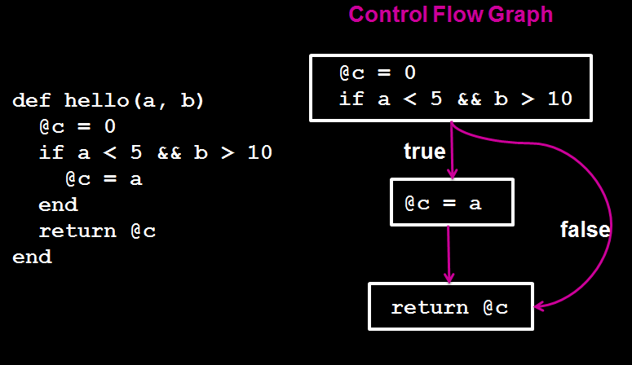
3. True or False? The following inputs will provide condition coverage for the code = {(a,b):(4,11),(4,20)}

Slide 28
Answers
The inputs will never reach the true condition right above “break;”
Option 1: 10, 10
False, the inputs will never reach the false condition

Slide 29
1. Which of the following is not a possible path of the control flow graph?
Option 1: a, f, h
Option 2: b, c, a, g, i
Option 3: b, d, e, g, h
Option 4: a, g, i

Slide 30
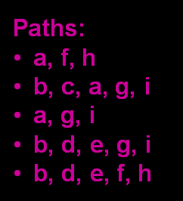
2. Given the possible paths, which one is missing? Use previous cfg.
Option 1: a, g, h
Option 2: b, d, e, g
Option 3: b, c, a, f, h
Option 4: None of the above

Slide 31
3. What inputs will cover the a, g, i path?
Option 1: {(x,y): (6,5)}
Option 2: {(x,y): (6,21)}
Option 3: {(x,y): (5,5)}
Option 4: None of the above
4. What inputs will cover the b, c, a, f,h path?
Option 1: {(x,y): (12,8)}
Option 2: {(x,y): (11,25)}
Option 3: {(x,y): (12,10)}
Option 4: {(x,y): (20,8)}

Slide 32
Answers
Option 3: b, d, e, g, h
Option 3: b, c, a, f, h
Option 1: {(x,y): (6,5)}
Option 2: {(x,y): (11,25)}

Slide 33
Think, Pair, Share
def bar(x)
@result=0;
if (x < 69)
if (x % 2 == 0)
@result = x/2;
else
@result = x*2;
end
else
x = 6969;
end
return @result;
end
Control Flow Graph
@result=0;
@result = x*2;
(a)
(f)
F
T
x < 69
x % 2 == 0
(h)
(e)
(g)
T
F
@result = x/2;
(b)
(i)
x = 6969
return @result;
(d)

Slide 34
1. Given the CFG, provide the minimum inputs to achieve statement coverage. Answer format should look like this: (input, next input,…).
2. Use the same image to provide the minimum inputs and expected output to achieve condition coverage. Again, the answer format should look like this: (input, output); (input,output)…etc.
3. For path coverage, list the possible paths and provide the minimum inputs/outputs that will cover the paths. Here is the format you should use: Path=(a,b,c),(c,d,e)… / I/O=(43,3),(34,3)…
(No answer provided…)

Slide 35
Recap
White-box testing
Control Flow Graph (CFG)
Code Coverage
Statement
Condition
Path

