Slide 1
Lecture 2
Recap of lecture 1
Bad Smells
Refactoring
Duplicate code
Long method
Extract Method
Pull up method

Slide 2
Pre Lecture Review Quiz
Please log in to aziza for quiz
Url: utopia.cs.memphis.edu:3000
Username: UM Mail Address
(ex. venkawu@memphis.edu)
Password: software

Slide 3
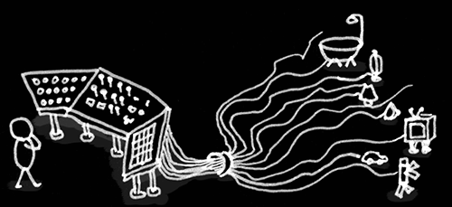
Case Statements
Code Smell
You have a complex switch statement or sequence of if statements
Notes:
May remove

Slide 4
Case Statements
Code Smell
Duplication
Adding a new case difficult
Does not apply OO

Slide 5
Case Statement
Code Smell
You want the method or class that hosts the typecode value.
Notes:
So use Extract Method to extract the case statement and then Move
Method to get it onto the class where the polymorphism is needed

Slide 6
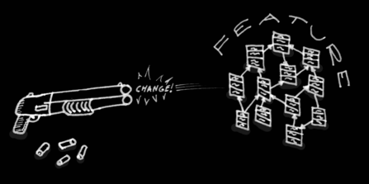
Shotgun Surgery
Code Smell
Make one change here, make many changes in other classes

Slide 7
Shotgun Surgery
Code Smell
Changes all over the place
Hard to find
Could miss an important change
Notes:
Use move method or move field to put all the changes into a single class

Slide 8
How do we resolve this code smell?

Slide 9
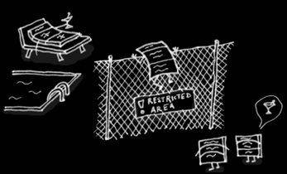
Feature Envy
Code Smell
A method that is more interested in a class other than the one it is actually on
Example
Invoking too many getters of another class
Notes:
Often times invoking so many getters to make a calculation

Slide 10
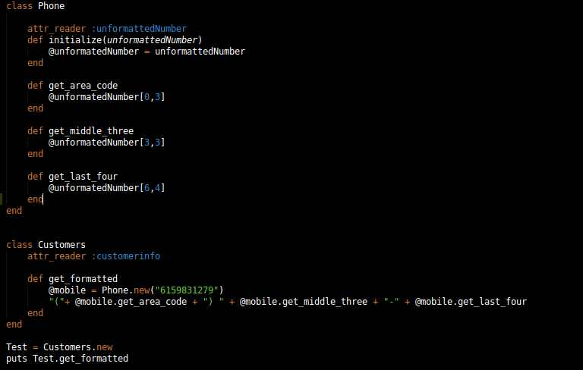
Code Smell

Slide 11
How do we resolve this code smell?
Notes:
In this case you want to use Move Method and Move Field to put all the changes into a single class.

Slide 12
Part 3: Move Method
Move Method
Use move method when a method is, or will be, using or used by more features of another class than the class on which it is defined.

Slide 13
Move Method
Move Method
Classes have too much behavior
Classes are collaborating too much
Classes are too highly coupled
Make class simpler with well defined set of responsibilities
Notes:
I usually look through the methods on a class to find a method that seems to reference another object more than the object it lives on.

Slide 14
Move Method
Move Method
Class 1
a_method
Class 1
Class 2
Class 2
aMethod
Notes:
create a new method with a similar body in the class it uses most. Either turn the old method into a simple delegation or remove it altogether

Slide 15
Move Method: Mechanics
Move Method
Examine all features of source method in source class
Sub and super-class of source class for other definitions?
Define method in target class
Copy code to target and make adjustments
Compile/Test
Determine how to reference correct target object
Turn source method into delegation
Compile/Test
Decide whether to remove method or not
Compile/Test
Notes:
If there are any other definitions, you may not be able to make the move, unless the polymorphism can also be expressed on the target.

Slide 16
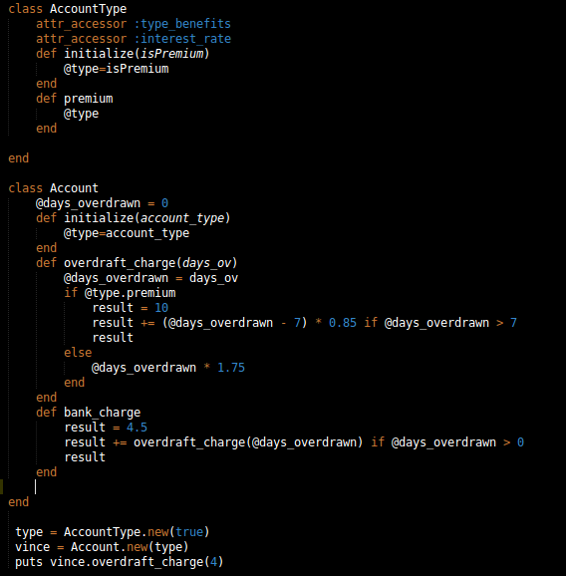
Move Method

Slide 17
Move Method: Mechanics
Move Method
Examine all features of source method in source class
Sub and super-class of source class for other definitions?
Notes:
If there are any other definitions, you may not be able to make the move, unless the polymorphism can also be expressed on the target.

Slide 18
Move Method
Assume there will be several types of Accounts for new accounts each with unique calculation for overdraft charge

Slide 19
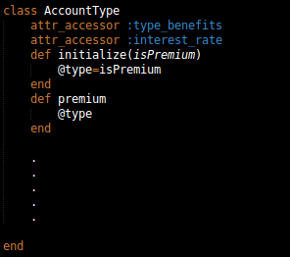
Move Method
We want to move the overdraft_charge method to AccountType class.
Notes:
If there are any other definitions, you may not be able to make the move, unless the polymorphism can also be expressed on the target.

Slide 20
Move Method: Mechanics
Move Method
Examine all features of source method in source class
Sub and super-class of source class for other definitions?
Define method in target class
Copy code to target and make adjustments
Notes:
If there are any other definitions, you may not be able to make the move, unless the polymorphism can also be expressed on the target.

Slide 21
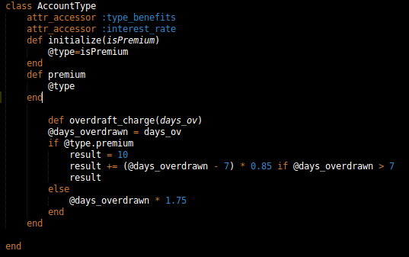
Move Method
#target class
declare method in target class by simply copying the code and making some minor adjustments to make it fit. Passing @days_overdrawn as a parameter

Slide 22
Move Method: Mechanics
Move Method
Examine all features of source method in source class
Sub and super-class of source class for other definitions?
Define method in target class
Copy code to target and make adjustments
Compile/Test
Notes:
If there are any other definitions, you may not be able to make the move, unless the polymorphism can also be expressed on the target.

Slide 23
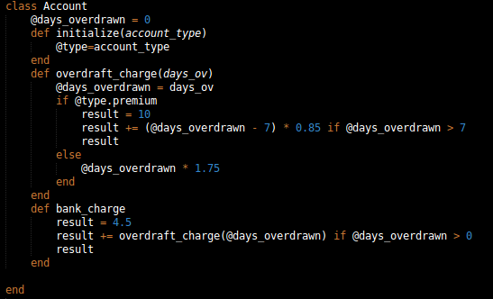
#Source class
Move Method
How do we deal with these features associated with overdraft_charge method

Slide 24
Move Method: Mechanics
Move Method
Examine all features of source method in source class
Sub and super-class of source class for other definitions?
Define method in target class
Copy code to target and make adjustments
Compile/Test
Determine how to reference correct target object
Notes:
If there are any other definitions, you may not be able to make the move, unless the polymorphism can also be expressed on the target.

Slide 25
Move Method: Making it fit
Move Method
Using a feature of the source class:
move this feature to the target class as well
create a reference from the target to the source
pass the source object as a parameter to the method
if the feature is a variable, pass it as a parameter

Slide 26
#Source class
Move Method
In our case it makes more sense to leave @days_overdrawn in source class

Slide 27
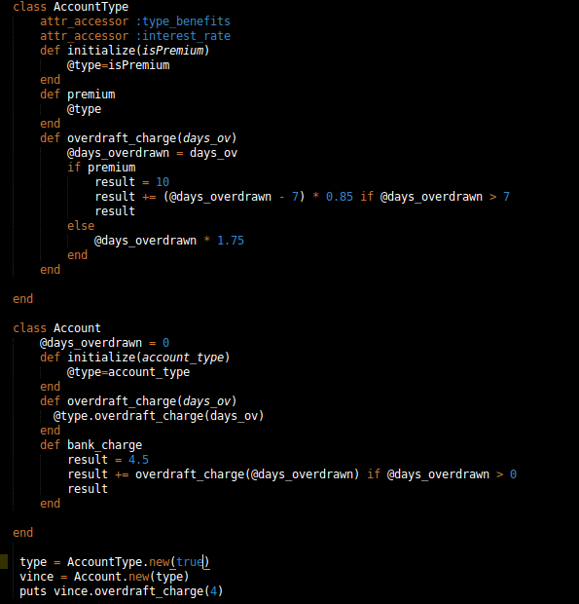
Move Method
Let us analyze what happened here

Slide 28
Move Method: Mechanics
Move Method
Examine all features of source method in source class
Sub and super-class of source class for other definitions?
Define method in target class
Copy code to target and make adjustments
Compile/Test
Determine how to reference correct target object
Turn source method into delegation
Compile/Test
Notes:
If there are any other definitions, you may not be able to make the move, unless the polymorphism can also be expressed on the target.

Slide 29
Move Method
Move Method
Now let us revisit our source class and look at changes made

Slide 30
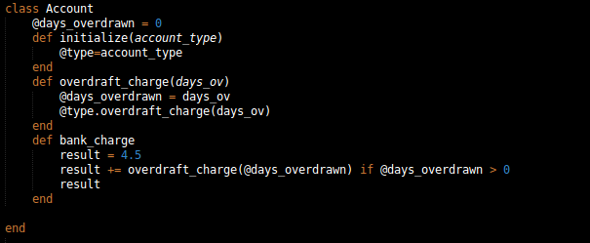
Move Method
This is referred to as a delegation. The entire method can be removed however.

Slide 31
Move Method: Mechanics
Examine all features of source method in source class
Sub and super-class of source class for other definitions?
Define method in target class
Copy code to target and make adjustments
Compile/Test
Determine how to reference correct target object
Turn source method to delegation
Compile/Test
Decide whether to remove method or not
Notes:
If there are any other definitions, you may not be able to make the move, unless the polymorphism can also be expressed on the target.

Slide 32
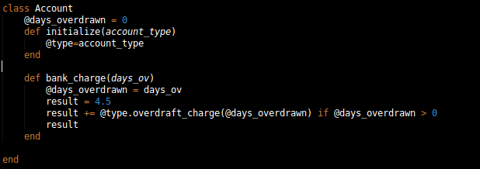
Move Method
if entire method is removed then, all callers of the method need to be redirected to the call in the target method

Slide 33
Move Method: Mechanics
Examine all features of source method
Check sub and super-class of source class
Declare method in target class
Copy code to target and make adjustments
Compile/Test
Determine how to reference correct target object
Turn source method
Compile/Test
Decide whether to remove method or not
Compile/Test

Slide 34
Interactive Activity 2
Refactor the code below

Slide 35
Class Activity 2
Hint:
Arrange your code blocks in the same order as the original and make the moved method the last method in Phone class

Slide 36
Parallel Inheritance Hierarchies
Code Smell
Parallel inheritance hierarchies is really a special case of shotgun surgery.

Slide 37
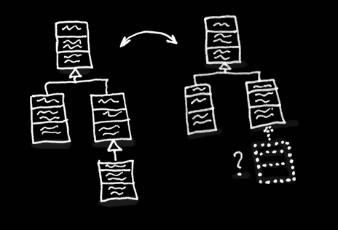
Parallel Inheritance Hierarchy
Code Smell
Whenever you create a subclass for a class, you find yourself needing to create a subclass for another class.

Slide 38
How do we resolve this code smell?

Slide 39
Parallel Inheritance Hierarchies
Code Smell
The general strategy for eliminating the duplication is to make sure that instances of one hierarchy refer to instances of the other. If you use Move Method and Move Field, the hierarchy on the referring class disappears.

Slide 40
Tease Apart Inheritance
Refactoring
You have an inheritance hierarchy that is doing two jobs at once.

Slide 41
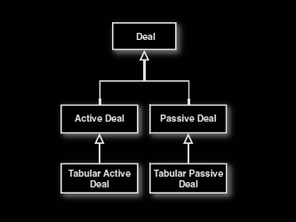
Tease Apart Inheritance
Refactoring
Tangled inheritance leads to code duplication

Slide 42
Tease Apart Inheritance
Refactoring
Makes changes difficult
Strategies for a solution are spread around
Resulting code is hard to understand

Slide 43
Tease Apart Inheritance
Refactoring
Every class at a certain level in the hierarchy has subclasses beginning with the same adjective

Slide 44
Tease Apart Inheritance - Mechanics
Refactoring
Identify the different jobs being done by the hierarchy.
Create a 2-D (or 3-D or 4-D) and label the axes with the different jobs.
2. Decide which job is more important and which is to be retained

Slide 45
Tease Apart Inheritance - Mechanics
Refactoring
3. Create an object for each of the subclasses in the original hierarchy.
4. Add an instance variable on the superclass to hold the new object.

Slide 46
Tease Apart Inheritance - Mechanics
Refactoring
5. Extract a module to house the common code that will be shared between the new classes.
6. Use Move method on each subclasses to move relevant behavior to extracted objects.

Slide 47
Tease Apart Inheritance - Mechanics
Refactoring
7. When the subclass has no more code, eliminate it.
8. Continue until all subsidiary subclasses are gone.

Slide 48
Tease Apart Inheritance
Refactoring
Let us take a closer look at our example of a tangled hierarchy

Slide 49
Tease Apart Inheritance
Refactoring
Deal originally used to display a single deal
Display a table of deals - new feature
Active Deal
Ohh how about table of Passive Deal
2 months later, code becomes complicated
Adding a new kind of deal is hard
Deal logic tangled with presentation logic

Slide 50
Tease Apart Inheritance - Mechanics
Refactoring
Identify the different jobs being done by the hierarchy.
Create a 2-D (or 3-D or 4-D) and label the axes with the different jobs.

Slide 51
Tease Apart Inheritance
One job capturing variation according to type of deal
Another job is capturing variation according to presentation style

Slide 52
Tease Apart Inheritance - Mechanics
Refactoring
2. Decide which job is more important and which is to be retained

Slide 53
Tease Apart Inheritance
Deal is far more important than the presentation
So we leave deal alone and extract the presentation style to its own hierarchy
Practically you want to leave the code with the most code so there is less move

Slide 54
Tease Apart Inheritance - Mechanics
Refactoring
3. Create an object for each of the subclasses in the original hierarchy.
4. Add an instance variable on the superclass to hold the new object.

Slide 55
Tease Apart Inheritance
Next we will extract the portion of the code associated with presentation style for each subclass

Slide 56
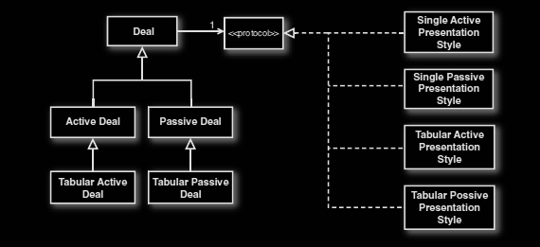
Tease Apart Inheritance
Refactoring
Adding a presentation style, to create an object for each of the subclasses in the original hierarchy

Slide 57
Tease Apart Inheritance - Mechanics
Refactoring
3. Create an object for each of the subclasses in the original hierarchy.
4. Add an instance variable on the superclass to hold the new object.

Slide 58
Tease Apart Inheritance
class ActiveDeal
def initialize
….
@presentation = singleActivePresentationStyle.new

Slide 59
Tease Apart Inheritance - Mechanics
Refactoring
5. Extract a module to house the common code that will be shared between the new classes.
6. Use Move method on each subclasses to move relevant behavior to extracted objects.

Slide 60
Tease Apart Inheritance
Refactoring

Slide 61
Tease Apart Inheritance - Mechanics
Refactoring
5. Extract a module to house the common code that will be shared between the new classes.
6. Use Move method on each subclasses to move relevant behavior to extracted objects.

Slide 62
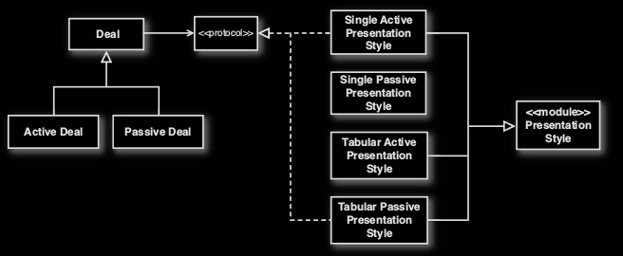
Tease Apart Inheritance
eliminated Subclasses

Slide 63
Tease Apart Inheritance - Mechanics
Refactoring
7. When the subclass has no more code, eliminate it.
8. Continue until all subsidiary subclasses are gone.

Slide 64
Tease Apart Inheritance
Refactoring
Further simplify the presentation style

Slide 65
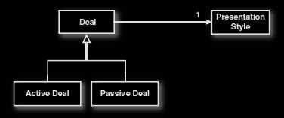
Tease Apart Inheritance
Refactoring
Ultimately if possible one could even eliminate the module hierarchy, by using values to capture distinction between singular and tabular

