Slide 1
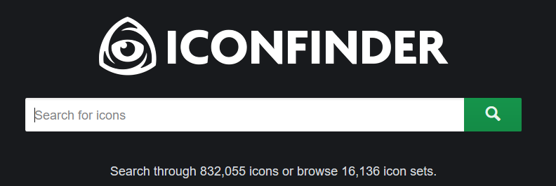
ICONFINDER
www.iconfinder.com
Notes:
Iconfinder is the largest collection of premium icons in the world. Create your own icons and make them premium. 70% is paid out to the icon designer. Danish company (Copenhagen, Denmark).

Slide 2
ICONFINDER
Huge Refactoring
2014
Django based web application
PostgreSQL
Elasticsearch
Amazon Elastic Compute cloud
2012
LAMP stack
xcache for php bytecode caching
Mod_pagespeed
1 virtual machine 16GB RAM 16 core
2007-2012
2007
Founded
Notes:
Chnage color from purple to something lighter, also the green color could be lighter, trajenta

Slide 3
Why change existing code?
Notes:
Opportunity to interact with students
Changes were made internally that didn’t affect the external behavior of the web application. Almost hald of the code base running Iconfinder has been swapped out for completely new structure.
statement method in Customer class does far too much
Many of what it does should really be done by other classes
Compiler doesn’t care whether code is ugly or not
But when we change system there is a human involved
The human cares
Poorly designed code is hard to change (expensive)
Hard to figure out where the changes are needed
As a result, prone to introduction of new bug

Slide 4
Money
Business perspective
Save resources save money

Slide 5
User Experience
If you improve performance you are likely to improve user experience
Fun Fact
Amazon, Google and Bing reported to losing 1% of revenue for every tenth of a second slower their site gets.
Notes:
http://highscalability.com/latency-everywhere-and-it-costs-you-sales-how-crush-it
Google revenue: 75 billion - 1%: 700 million$

Slide 6
Technical Debt
Intentionally cut corners to complete software
Code that is sub par and hard to maintain
Causing difficulties for extending the code base
Get rid of technical debt - save time
Notes:
More maintainable code means less time spent keeping existing features working and more time spent working on adding value to the business.

Slide 7
A better solution
New solutions
Better ways of doing things
What does not changing the solution mean?
Investing in the future?
If it ain’t broke don’t fix it!
Notes:
refactoring is an investment in future development. http://blog.iconfinder.com/justifying-spending-time-on-worthless-coding/
Without refactoring the design of the program will decay over time.
Sometimes a new framework is released or a new technique is found that
may replace a portion of your application. Developers are often eager to both
remove existing pain points and experiment with new solutions

Slide 8
Refactoring
Refactoring is the process of modifying a software system internally without altering the the external behavior of the code.
Goals
Improve internal structure
Ease of understanding
Notes:
Restructure definition to make shorter and highlight key words
Good code is easy to change, bad code can incrementally be made easier to change

Slide 9
Refactoring - When
When should you refactor?
When you add function
When you need to find a bug
As you do a code review
The rule of three (related to the DRY principle)
Notes:
When I talk about refactoring, I’m often asked about how it should be scheduled.
Should we allocate two weeks every couple of months to refactoring?
Refactoring is something programmers should do every time in little bursts.
You don’t decide to refactor, you refactor because you want to do something else and refactoring helps you do that other thing
Refactor for greater understanding
A senior developer once joined a team I was leading, halfway through the project.
When he joined he saw things that he didn’t agree with and suggested that
we refactor the code toward a better domain model. Anxious to learn from
the senior developer, I paired with him over the next few days while we made
various changes to the domain model. Unfortunately, many of the changes that
the senior developer suggested could not be implemented due to additional constraints
imposed by required features. In the end, the code was refactored to be
slightly better; however, the largest benefit was the deep understanding that the
senior developer gained from the refactoring.

Slide 10
Interactive Activity 1
Quiz 1
Show example of a code with smell and get them thinking about smell/refactoring to lead into lecture

Slide 11
class Print
def print_owing
outstanding = 0.0
# print banner
puts “************************”
puts “**Customer Owes ***”
puts “************************”
#calculate outstanding
@orders.each do |order|
outstanding += order.amount
end
#print details
puts(“name: #{@name})
puts(“amount: #{outstanding})
puts “************************”
puts “**Customer Owes ***”
puts “************************”
end
end
What can we find wrong in this code?
Notes:
Example:
Improving clarity
Short well named methods easier to understand
Good candidates for examples: duplicate code
In two methods, same class
Extract method
In two sibling subclasses
Extract method, Pull up method
Duplication in middle of method
Extract method, Extract surrounding method
Different algorithm, same thing
Substitute Algorithm

Slide 12
Code Smells
A code smell is a surface indication that usually corresponds to a deeper problem in the system
Notes:
Come up with better definition of code smells..
Bad smells are regions of software in need of refactoring

Slide 13
Code Smells
Duplicate code
Long Method
Long parameter list
Case statements
Large class
Shotgun surgery
Parallel inheritance hierarchies
…….

Slide 14
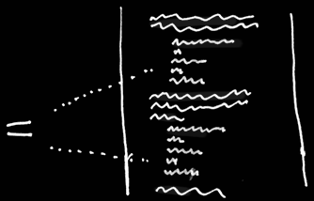
Duplicate Code
Code Smell
Duplicate code: two code fragments that look almost identical

Slide 15
Duplicate Code
Code Smell
In two methods, same class
In two sibling subclasses
Duplication in middle of method
Different algorithm, same thing
Notes:
In two methods, same class
Extract method
In two sibling subclasses
Extract method, Pull up method
Duplication in middle of method
Extract method, Extract surrounding method
Different algorithm, same thing
Substitute Algorithm

Slide 16
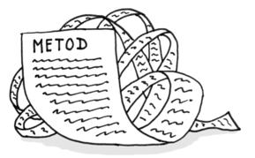
Long Method
Code Smell
The longer a procedure is the more difficult it is to understand.
Too long too hard to understand
Notes:
A heuristic we follow is that whenever we feel the need to comment something, we write a method instead
We do this even if the method call is longer than the code it replaces,
provided the method name explains the purpose of the code. The key here is not method length but the semantic distance between what the method does and how it does it.

Slide 17
Refactorings
Extract method
Pull up method
Extract surrounding method
Replace parameters with method
Move method
Extract class
Tease apart inheritance
Extract hierarchy
….
Notes:
Rid of figure
Important to build a solid set of tests for the section of code to refactor, just because as humans we can introduce bugs when making changes by making minor mistakes in the code.
Good programmers have spent at least some time cleaning up their code
We sometimes refactor without even knowing we are refactoring

Slide 18
Extract Method
Extract Method - Refactoring
Use extract method if you have a code fragment that can be grouped together, by turning the fragment into a method whose name explains purpose of the method

Slide 19
Extract Method
Extract Method - Refactoring
Most common refactoring
Improves usability of method
Easier to understand
Overriding is easier

Slide 20
Class Print
def print_owing
outstanding = 0.0
# print banner
puts “************************”
puts “**Customer Owes ***”
puts “************************”
#calculate outstanding
@orders.each do |order|
outstanding += order.amount
end
#print details
puts(“name: #{@name})
puts(“amount: #{outstanding})
puts “************************”
puts “**Customer Owes ***”
puts “************************”
end
end
Extract Method - Refactoring
What bad smells can we identify within this method and how do we refactor them?
Notes:
Example:
Improving clarity
Short well named methods easier to understand
Good candidates for examples: duplicate code
In two methods, same class
Extract method
In two sibling subclasses
Extract method, Pull up method
Duplication in middle of method
Extract method, Extract surrounding method
Different algorithm, same thing
Substitute Algorithm

Slide 21
Extract Method: Mechanics
Extract Method - Refactoring
Create new method, name after intention
Copy extracted code into target method
Notes:
Better to present these as we work through an example

Slide 22
class Print
def print_owing
outstanding = 0.0
print_banner
#calculate outstanding
@orders.each do |order|
outstanding += order.amount
end
#print details
puts(“name: #{@name})
puts(“amount: #{outstanding})
print_banner
end
# print banner
def print_banner
puts “************************”
puts “**Customer Owes ***”
puts “************************”
end
end
Extract Method - Refactoring
It is easy for us to extract the print banner segment because no local variables are affected
Notes:
No Local Variable
This may appear straight forward however, imagine a scenario whereby the printBanner

Slide 23
Extract Method: Mechanics
Extract Method - Refactoring
Create new method, name after intention
Copy extracted code into target method
Scan for references to variables local to source method
Notes:
Better to present these as we work through an example

Slide 24
class Print
def print_owing
outstanding = 0.0
print_banner
#calculate outstanding
@orders.each do |order|
outstanding += order.amount
end
#print details
puts(“name: #{@name})
puts(“amount: #{outstanding})
print_banner
end
def print_banner
# print banner
puts “************************”
puts “**Customer Owes ***”
puts “************************”
dnd
end
Extract Method - Refactoring
What happens when a local variables is referenced in the code you wish to extract.
Notes:
This may appear straight forward however, imagine a scenario whereby the printBanner

Slide 25
class Print
def print_owing
outstanding = 0.0
print_banner
#calculate outstanding
@orders.each do |order|
outstanding += order.amount
end
print_details (outstanding)
print_banner
end
def print_details(amount) #print details
puts(“name: #{@name})
puts(“amount: #{amount})
end
def print_banner # print banner
puts “************************”
puts “**Customer Owes ***”
puts “************************”
end
end
Extract Method - Refactoring
Local variable
read only vs manipulated

Slide 26
Extract Method: Mechanics
Extract Method - Refactoring
Create new method, name after intention
Copy extracted code into target method
Scan for references to variables local to source method
Look for temp variables
Is local variable modified by extracted method?
Notes:
Se whether temporary variables are used only within the extracted code. If so declare them in the target method as temp variables

Slide 27
class Print
def print_owing
outstanding = 0.0
print_banner
#calculate outstanding
@orders.each do |order|
outstanding += order.amount
end
print_details (outstanding)
print_banner
end
def print_details(outstanding) #print details
puts(“name: #{@name})
puts(“amount: #{outstanding})
end
def print_banner # print banner
puts “************************”
puts “**Customer Owes ***”
puts “************************”
end
end
Extract Method - Refactoring
temps
&
reassigning a local variable

Slide 28
def print_owing
printBanner
outstanding = get_outstanding()
print_details(outstanding)
printBanner
end
def get_outstanding #calculate outstanding
outstanding = 0.0
@orders.each do |order|
outstanding += order.amount
end
outstanding
end
def print_details(outstanding) #print details
puts(“name: #{_name})
puts(“amount: #{outstanding})
end
def print_banner # print banner
puts “************************”
puts “**Customer Owes ***”
puts “************************”
end
Extract Method - Refactoring
reassigning a local variables can be complicated.
Notes:
temps

Slide 29
Extract Method: Mechanics
Extract Method - Refactoring
Create new method, name after intention
Copy extracted code into target method
Scan for references to variables local to source method
Look for temp variables
Is local variable modified by extracted method?
Replace extracted code in source with a call to target
compile and test
Notes:
Better to present these as we work through an example

Slide 30
class Print
def print_owing
outstanding = 0.0
# print banner
puts “************************”
puts “**Customer Owes ***”
puts “************************”
#calculate outstanding
@orders.each do |order|
outstanding += order.amount
end
#print details
puts(“name: #{@name})
puts(“amount: #{outstanding})
puts “************************”
puts “**Customer Owes ***”
puts “************************”
end
end
Extract Method - Refactoring
Original Code with code smells
Notes:
Example:
Improving clarity
Short well named methods easier to understand
Good candidates for examples: duplicate code
In two methods, same class
Extract method
In two sibling subclasses
Extract method, Pull up method
Duplication in middle of method
Extract method, Extract surrounding method
Different algorithm, same thing
Substitute Algorithm

Slide 31
class Print
def print_owing
printBanner
outstanding = get_outstanding()
print_details(outstanding)
printBanner
end
def get_outstanding #calculate outstanding
outstanding = 0.0
@orders.each do |order|
outstanding += order.amount
end
outstanding
end
def print_details(amount) #print details
puts(“name: #{_name}”)
puts(“amount: #{amount}”)
end
def print_banner # print banner
puts “************************”
puts “**Customer Owes ***”
puts “************************”
end
end
Extract Method - Refactoring
Refactored
Notes:
temps

Slide 32
Interactive Exercise 2
Quiz 2
Refactor the code below

Slide 33
class Print
def tuition_owed(previousAmount)
balance = previousAmount * 1.2
#print banner
puts “*************************”
puts “**University of Memphis**”
puts ***************************
#print details
puts(“name: #{@name})
puts(“amount: #{balance})
#calculate balance
@courses.each do |course|
balance += course.amount
end
#print banner
puts “*************************”
puts “**University of Memphis**”
puts “*************************”
end
end
Extract Method - Refactoring

Slide 34
class Print
def tuition_owed(previousAmount)
balance = calculate_balance(previousAmount * 1.2)
print_banner
print_details(balance)
print_banner
end
def calculate_balance(balance)
@courses.each do |course|
balance += course.amount
end
balance
end
def print_details amount
puts(“name: #{@name})
puts(“amount: #{amount})
end
def print_banner
puts “*************************”
puts “**University of Memphis**”
puts “*************************”
end
end
Extract Method - Refactoring
Refactored

Slide 35
Pull Up Method - Refactoring
Use pull up method if you have methods with identical results on subclasses.

Slide 36
Pull Up Method - Mechanics
Inspect the method to ensure they are identical
Chose a common signature for both methods
Create new method in superclass
Delete one subclass method and test
Continue to delete subclass method and test until all duplicate methods are deleted

Slide 37
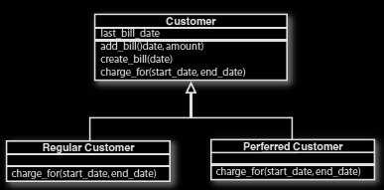
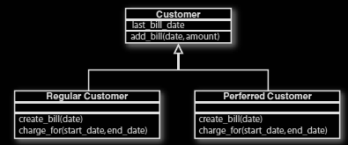
Pull Up Method - Refactoring
In this case let us assume the create_bill(date) method are identical in both method. Thus we refactor as shown above

Slide 38
Interactive Exercise 3
Quiz 3

