Slide 1
Introduction to Software Design
Lecture part 2

Slide 2
QUIZ 1: REVIEW
SRP, SoC
How can you determine if a class adheres to the SRP?
Dependencies & Coupling
What’s the difference between loose coupling and tight coupling?
Stepwise Refinement
What are four benefits that stepwise refinement allows?

Slide 3
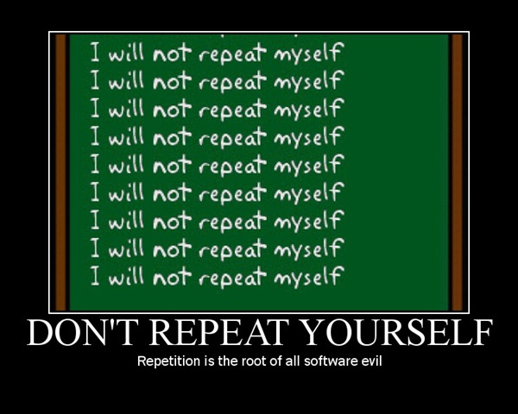

Slide 4
Don’t Repeat Yourself
Duplicated code leads to additional maintenance
and increases bugs!
If your class adheres to SRP, each bit of behavior lies
in one and only one place.
DRY code tolerates change because:
any change in behavior can be made
by changing the code in just one place
Notes:
The idea behind it is simple: whenever possible, re-use as much code as possible rather than duplicating similar code in multiple places. This reduces errors, keeps your code clean and enforces the principle of writing code once and then reusing it.
You want DRY code!
When the DRY principle is applied successfully, a modification of any single element of a system does not change other logically-unrelated elements. Additionally, elements that are logically related all change predictably and uniformly, and are thus kept in sync. Besides using methods and subroutines in the code, developers rely on code generators, automatic build systems, and scripting languages to observe the DRY principle across layers.
Duplication is an obvious problem for maintenance, but there's a secondary meaning to the DRY Principle. When I'm adding an all new feature to a system with new classes, database mappings and tables, new screens, web services, etc. I want to make the change with the fewest steps possible with a minimum of repetition. I want to tell the system what I want to happen, and I want to say it only once.

Slide 5
DRYing out with RoR
Duplication in views?

Slide 6
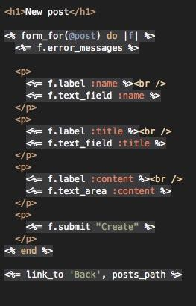
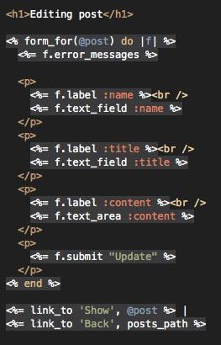
DRYing out with RoR
Duplication in views?

Slide 7
DRYing out with RoR
Duplication in views?
Use Rails partials
Notes:
DRYing up the Code
At this point, it’s worth looking at some of the tools that Rails provides to eliminate duplication in your code. In particular, you can use partials to clean up duplication in views and filters to help with duplication in controllers.
7.1 Using Partials to Eliminate View Duplication
As you saw earlier, the scaffold-generated views for the new and edit actions are largely identical. You can pull the shared code out into a partial template. This requires editing the new and edit views, and adding a new template. The new _form.html.erb template should be saved in the same app/views/posts folder as the files from which it is being extracted. Note that the name of this file begins with an underscore; that’s the Rails naming convention for partial templates.
Now, when Rails renders the new or edit view, it will insert the _form partial at the indicated point. Note the naming convention for partials: if you refer to a partial named form inside of a view, the corresponding file is _form.html.erb, with a leading underscore.

Slide 8
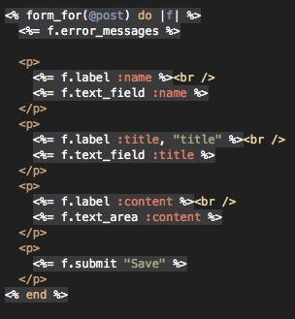
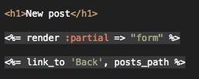
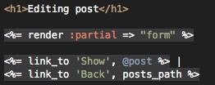

Slide 9
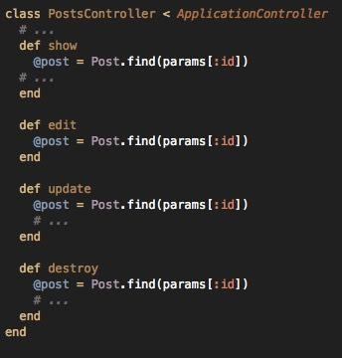
Duplication in controllers?
Use Rails filters

Slide 10
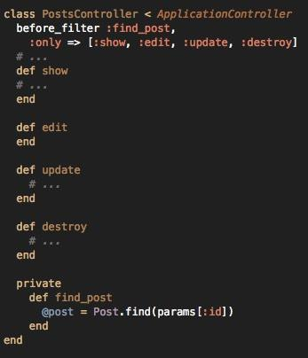
Duplication in controllers?
Use Rails filters

Slide 11
Duplication in controllers?
Use Rails filters
Notes:
7.2 Using Filters to Eliminate Controller Duplication
At this point, if you look at the controller for posts, you’ll see some duplication:
Four instances of the exact same line of code doesn’t seem very DRY. Rails provides filters as a way to address this sort of repeated code. In this case, you can DRY things up by using a before_filter:
Rails runs before filters before any action in the controller. You can use the :only clause to limit a before filter to only certain actions, or an :except clause to specifically skip a before filter for certain actions. Rails also allows you to define after filters that run after processing an action, as well as around filters that surround the processing of actions. Filters can also be defined in external classes to make it easy to share them between controllers.

Slide 12
Duplication in controllers?
Use Rails filters

Slide 13
Overview
Don’t Repeat Yourself (DRY)
Cohesion
Coupling & Cohesion
Protected Variation
SOLID Principles Overview
Dependency Inversion Principle

Slide 14
A class should only have one reason to change
Notes:
QUESTIONS:
What principle we’ve talked about is defined as “A class should only have one reason to change?”
Should the components of a class be related to one another?

Slide 15
single
responsibility
A class should only have one reason to change

Slide 16
single
responsibility
A class should only have one reason to change
...but should the components of the class all be
related to one another?

Slide 17
single
responsibility
A class should only have one reason to change
...but should the components of the class all be
related to one another?
YES!

Slide 18
Cohesion
In OOP, when everything in a class is related to its central purpose, the class is said to be highly cohesive
Low Cohesion
High Cohesion
Many unrelated responsibilities
Many related responsibilities
Notes:
In OOP, if the methods that serve a class tend to be similar in many aspects, then the class is said to have high cohesion. In a highly cohesive system, code readability and reusability is increased, while complexity is kept manageable.
Cohesion is increased if --- Class functionalities (methods) have much in common.
Advantages of high cohesion (or “strong cohesion”) are:
Reduced module complexity (they are simpler, having fewer operations).
Increased system maintainability, because logical changes in the domain affect fewer modules, and because changes in one module require fewer changes in other modules.
Increased module reusability, because application developers will find the component they need more easily among the cohesive set of operations provided by the module.
While in principle a module can have perfect cohesion by only consisting of a single, atomic element – having a single function, for example – in practice complex tasks are not expressible by a single, simple element. Thus a single-element module has an element that either is too complicated, in order to accomplish task, or is too narrow, and thus tightly coupled to other modules. Thus cohesion is balanced with both unit complexity and coupling.

Slide 19
Cohesion
High Cohesion has desirable traits:
Robustness
Reliability
Reusability
Understandability
Low Cohesion has undesirable traits:
Averse to change
Difficult to test
Difficult to maintain
Difficult to reuse
Difficult to understand
Notes:
High cohesion does not necessarily mean you want to put all of the "closely related responsibilities" in one class, but rather that all of the items in a class should correspond to closely related responsibilities.
For example, if you have a Kitchen class, you wouldn't want bathroom logic in it; however, you don't HAVE to also have oven and kitchen sink logic in it too, just because they are related.
The benefits of high cohesion are
Readability – (closely) related functions are contained in a single module
Maintainability – debugging tends to be contained in a single module
Reusability – classes that have concentrated functionalities are not polluted with useless functions

Slide 20
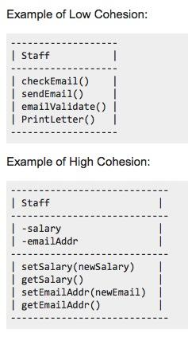
Cohesion Example

Slide 21
Cohesion Example
The top example has 3 email maintenance methods, and one for printing a document.
More than 1 task, unrelated →
LOW COHESION!
The bottom example has employee data, and getter/setter methods.
Only 1 general task, related →
HIGH COHESION!
Notes:
The top example of the Staff class has 3 methods pertaining to maintenance and use of an employee email account, however the last method is tasked with printing a document
The bottom example of the Staff class contains data for an employee’s salary and email address, and getter and setter methods for this data.

Slide 22
Cohesion Example
“Sum” class:
produces a sum of numbers AND creates a window
to display the result
exhibits Low Cohesion
display window is the visual component,
adding function is logical
To create a highly cohesive solution:
separate the original class into
a Sum class and a Window class
call on them separately

Slide 23
The more cohesive your code is ---
the more reusable, robust, and easy to maintain it will be.
Remember: KISS!
Keep your components small and focused!
Breaking programs into classes and subsystems --
one example of how to increase the
cohesive properties of a system
Notes:
EXAMPLE: ENGINE object, let’s go back to the DICTIONARY CODE
- If an object representing an engine is responsible for both accelerating and decelerating, then a change to the acceleration implementation could inadvertently effect the deceleration implementation. If, however, the engine object is responsible for acceleration and a separate brake object is responsible for deceleration, then a change to the acceleration implementation in the engine object is unlikely to effect the deceleration implementation in the brake object.
- Maintaining highly cohesive components is easy. If all the logic dealing with deceleration is in the brake object, and that logic is not spread throughout your system, then you won’t have to go hunting around your system whenever you make changes to the deceleration logic. You only need to look at your break object.
Developers I encounter usually have a good grasp of coupling—not only what it means, but why it’s a problem. I can’t say the same thing about cohesion. Cohesion comes from the same root word that “adhesion” comes from. It’s a word about sticking. When something adheres to something else (when it’s adhesive, in other words) it’s a one-sided, external thing: something (like glue) is sticking one thing to another. Things that are cohesive, on the other hand, naturally stick to each other because they are of like kind, or because they fit so well together. Duct tape adheres to things because it’s sticky, not because it necessarily has anything in common with them. But two lumps of clay will cohere when you put them together, and matched, well-machined parts sometimes seem to cohere because the fit is so precise. Adhesion is one thing sticking to another; cohesion is a mutual relationship, with two things sticking together.
This is also why we refer to a sound line of reasoning, for example, as coherent. The thoughts fit, they go together, they relate to each other. This is exactly the characteristic of a class that makes it coherent: the pieces all seem to be related, they seem to belong together, and it would feel somewhat unnatural (it would result in tight coupling!) to pull them apart. Such a class exhibits cohesion. No glue is required, you don’t have to build extra code to make the pieces fit together; the pieces hang together naturally because they’re closely related. In contrast, sometimes a class will seem to have its fingers in way too many parts of your system. Such a class is adhesive, and that’s not what we’re looking for.

Slide 24
Overview
Don’t Repeat Yourself (DRY)
Cohesion
Coupling & Cohesion
Protected Variation
SOLID Principles Overview
Dependency Inversion Principle

Slide 25
Coupling and Cohesion
THE GOAL:
High cohesion.
Low coupling.

Slide 26
Coupling and Cohesion
Coupling and Cohesion are related to one another...
Cohesion - used to describe a single software component
Coupling - used to describe the relationship between components
Different types/categories of both coupling and cohesion exist
THE GOAL:
High cohesion.
Low coupling.

Slide 27
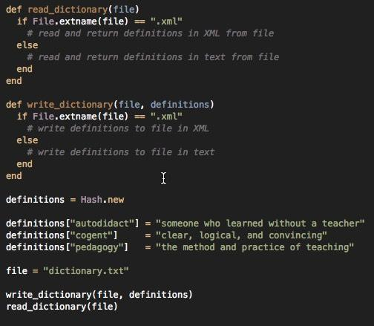
Coupling and Cohesion
Notes:
The dictionary supports reading and writing definitions to a file in either plain text or XML.
The above example is straightforward. We store the definitions in a hash, and we use two methods read_dictionary and write_dictionary to manage reading and writing to the file system in either plain text or XML.
Lets now analyze the examples using the principle of coupling. In Example 1, the two methods write_dictionary and read_dictionary are coupled together. Although the two methods don’t explicitly depend upon each other, they are implicitly related via the file format. Any changes to the file format logic will necessitate changes to both methods.
Lets begin by looking at these examples using the principle of cohesion. We learned above that common procedures spread among multiple contexts is indicative of low cohesion. In Example 1, there are three common tasks that are spread among multiple contexts. First, and most obvious, the logic determining file format is repeated in the read_dictionary and write_dictionary methods. Second, the XML formatting tasks are spread between the read_dictionaryand write_dictionary methods. And finally, the plain text formatting tasks are also spread between the read_dictionary and write_dictionary methods. Adding or removing a file format, changing the XML format, or changing the plain text format, all require changing the read_dictionary and write_dictionarymethods.

Slide 28
QUIZ 2: Coupling and Cohesion
Use the principles of coupling and cohesion to create a new version of the previous ruby Dictionary code that is more loosely coupled and more highly cohesive.

Slide 29
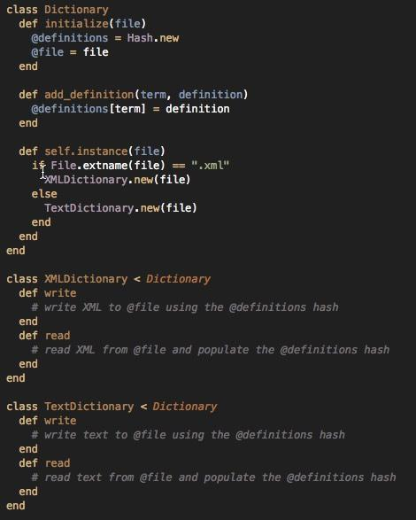
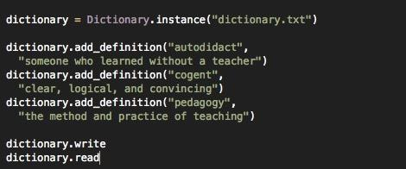
QUIZ 2: Coupling
and Cohesion
Use the principles of coupling and cohesion to create a new version of the previous ruby Dictionary code that is more loosely coupled and more highly cohesive.
Notes:
In Example 2, however, file format logic is decoupled from read/write formatting. You can change the file format logic without changing XML or plain text formatting logic. Lets, for example, assume the requirements have changed. We want to accept a file name without an extension as plain text. You only need to change the Dictionary.instance class method. You don’t need to touch the reador write methods of the Dictionary subclasses. In Example 1, you would have to change the read_dictionary method and the write_dictionary method.
Example 2 has also reduced coupling between the controlling code and the model objects. Notice how the controlling code doesn’t concern itself with file format at all. It doesn’t care if it is working with an XMLDictionary object or a TextDictionary object. We can easily add or remove a file format without making any changes to the controlling code.
In Example 2, however, the file format logic, the XML formatting logic, and the plain text formatting logic are each restricted to their own context. The file format logic is restricted to the Dictionary class method instance. The XML formatting tasks are restricted to the XMLDictionary object. And the plain text formatting tasks are restricted to the TextDictionary object. The Dictionary class, the XMLDictionary object, and the TextDictionary object all have higher functional cohesion than the methods in Example 1. As a result, it is easier to make changes. We wouldn’t have to hunt down multiple contexts when adding a file format.

Slide 30
Overview
Don’t Repeat Yourself (DRY)
Cohesion
Coupling & Cohesion
Protected Variation
SOLID Principles Overview
Dependency Inversion Principle

Slide 31
With programming, as in the real world, change is the only constant thing.
Everything right from user requirements, business domain, technologies and even human resources also changes.

Slide 32
With programming, as in the real world, change is the only constant thing.
Everything right from user requirements, business domain, technologies and even human resources also changes.
How can we protect ourselves from these variations in our software evolution?

Slide 33
Protected Variation
Identify points of predicted variation and create a stable interface around them
Notes:
In a nutshell, Protected Variations addresses the problem of assigning responsibilities in such a way that variations that might occur do not have undesirable effects upon other elements in the system. In this context, the interface is used in the broadest sense and need not be similar to C# construct called an “Interface”. This could be a complete separate subsystem fronting a much larger set of variable subsystem. This pattern, or rule, is very broad and complex. This is a fundamental design principle and used in conjunction with polymorphism and indirection.
This is also very closely linked or similar to the principle of information hiding (which was proposed by David Parnas) that underlies OOP and Bertrand Meyer’s Open-Close Principle.
According to Larman, PV (Protected Variations) is a very important and root principle motivating most of the mechanism and patterns in programming and design to provide flexibility and protection from variation, almost every design trick in his book is a specialization of the Protected Variations pattern.
As usual let’s see a practical example for this pattern in POS. We are fairly aware of the classes like Sale, Payment, and SaleLineItem etc. Every sale amount has taxes applied to arrive at the total. There are different tax rules at different places and tax rates are different also. On top of this the rates and rules are bound to changes which makes the design of such systems tricky. The best approach is design the tax calculation as separate system. There could be different tax calculator systems (third party) available or there could be web service providing the tax calculation services. There might be reason for having multiple systems or move to different system. As mentioned above, the rules, rates are the moving target and as these changes the tax calculation systems have to follow. This is the point of variation or stability. In such scenario, the changes would be the consumers or users of such systems, to change also. These changes or variations would cause the changes in POS system or it may require revision.
This is where the “protected Variations” pattern helps to design in such a way that the changes in the tax calculation system would not cause major problems. This is accomplished through implementation of polymorphism and indirection as depicted in the following diagram.

Slide 34
Protected Variation
Problem:
How can we design software so that the variations or instability of its elements doesn’t negatively affect other elements?

Slide 35
Protected Variation
Problem:
How can we design software so that the variations or instability of its elements doesn’t negatively affect other elements?
Solution:
Identify points of predicted variation or instability
assign responsibilities to create a stable interface around these points
This may involve creation of entirely new classes to encapsulate such variations.
“Interface” used in the broadest sense - not just a Java component

Slide 36
Protected Variation
Problem:
How can we design software so that the variations or instability of its elements doesn’t negatively affect other elements?
Solution:
Identify points of predicted variation or instability
assign responsibilities to create a stable interface around these points
This may involve creation of entirely new classes to encapsulate such variations.
“Interface” used in the broadest sense - not just a Java component
The Protected Variations pattern:
shields elements from variations on other elements through added interfaces and polymorphism
Notes:
Polymorphism & Protected Variations
According to Polymorphism, responsibility of defining the variation of behaviors based on type is assigned to the types for which this variation happens.
The Protected Variations pattern protects elements from the variations on other elements (objects, systems, subsystems) by wrapping the focus of instability with an interface and using polymorphism to create various implementations of this interface.
“No object in your system should have to know the class of any other object in order to know how to behave. Everything is a Duck. Tell the Duck WHAT and the Duck should know HOW.” - Sandi metz

Slide 37
Protected Variation
The Approach:
- Step I: Closely look for elements with direct coupling and also relatively prone to change.
- Step II: Identify for the objects or points of predicted variation
- Step III: Assign these responsibilities in such a way to create a stable interface around them.
In short --- “Find what varies and encapsulate it.”

Slide 38
Protected Variation
Benefits of Protected Variation:
Extensions required for new variations are easy to add
New implementations can be introduced without affecting clients
Coupling is lowered
The impact or cost of changes can be lowered
Provides more structured design
Limitations:
The design cost of speculative “future-proofing” may outweigh the design cost
incurred by a simple design that is reworked as necessary.
It’s possible that a simple design with no PV can cost much less at the present time
and then reworked when future variation occurs.

Slide 39
Overview
Don’t Repeat Yourself (DRY)
Cohesion
Coupling & Cohesion
Protected Variation
SOLID Principles Overview
Dependency Inversion Principle

Slide 40
There are five fundamental design principles that help engineers write maintainable code

Slide 41
There are five fundamental design principles that help engineers write maintainable code
Used to evaluate the health of our codebase
and architectural approach

Slide 42
There are five fundamental design principles that help engineers write maintainable code
Used to evaluate the health of our codebase
and architectural approach
The Goal: make code changes as
side-effect free as possible
Notes:
The principles, when applied together, intend to make it more likely that a programmer will create a system that is easy to maintain and extend over time.
S.O.L.I.D is an acronym for the first five object-oriented design(OOD) principles by Robert C. Martin, popularly known as Uncle Bob.
These principles, when combined together, make it easy for a programmer to develop software that are easy to maintain and extend. They also make it easy for developers to avoid code smells, easily refactor code, and are also a part of the agile or adaptive software development.
Objective way to judge designs

Slide 43
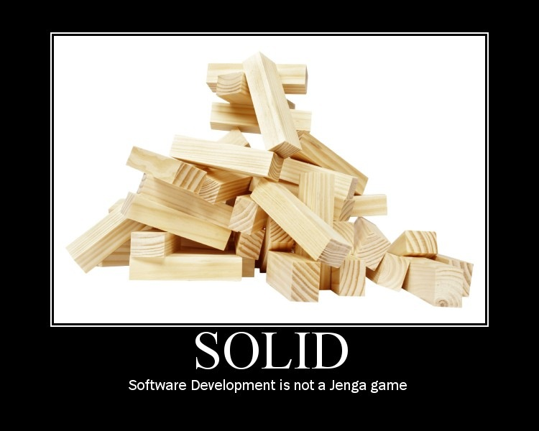
Notes:
Have you ever played Jenga? It’s that game of wooden blocks that are stacked on top of each other in rows of three. In Jenga you try to push or pull a block out of the stack and place it on top of the stack without knocking the stack over. The player that causes the stack to fall loses.
Have you ever thought you were playing a game of Jenga when you were writing or debugging software? For example, you may need to change one field on one screen. You study the stack of code, you look for that little space of light peaking between the classes, and you make the change in the one place that you thought would be safe. Unfortunately, you didn’t realize that the code you were changing was referenced in several critical processes through some strange levels of indirection. The resulting crash of the software stack has left you the loser, cleaning up the mess with your boss breathing down your neck about the customer being upset about their lost data, and … How many times have you been there? I can’t even begin to count how often it’s happened to me.
There is good news, though: software development does not have to be like a game of Jenga. In fact, software development should not be like any game where there are winners and losers. What you want, instead, is a sustainable pace of software development where everyone wins. You want to ensure that you don’t overwork the developers, that you don’t pressure managers to say “just get it done,” and the customer gets the software they want in a timeframe they agree to.

Slide 44
S
O
L
I
D

Slide 45
Single Responsibility Principle
O
L
I
D

Slide 46
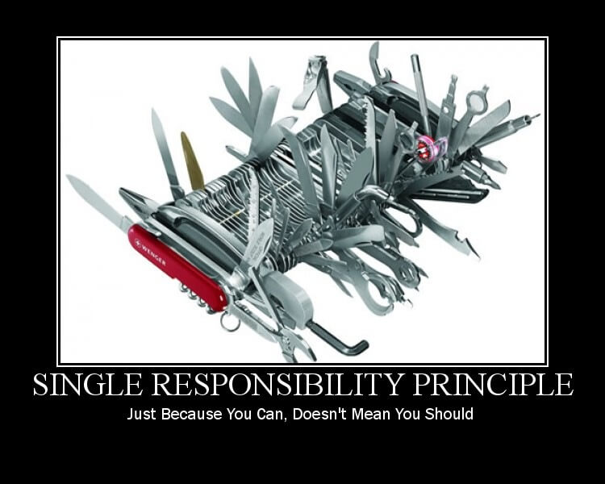

Slide 47
Single Responsibility Principle
Open / Closed Principle
L
I
D

Slide 48
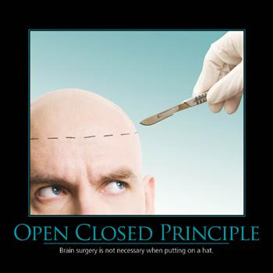
Open-Closed Principle
Software entities (classes/modules, methods) should be open for extension, but closed for modification
Helps to remove snake of ‘if-else’ cases
Removes bad switch cases
Notes:
You should make all member variables private by default. Write getters and setters only when you need them.
This tells us we should strive for modular designs that make it possible for us to change the behavior of the system without making modifications to the classes themselves.

Slide 49
Open-Closed Principle
Software entities (classes/modules, methods) should be open for extension, but closed for modification
Helps to remove snake of ‘if-else’ cases
Removes bad switch cases
Very similar to what concept we’ve discussed?

Slide 50
Open-Closed Principle
Software entities (classes/modules, methods) should be open for extension, but closed for modification
Helps to remove snake of ‘if-else’ cases
Removes bad switch cases
Very similar to what concept we’ve discussed?
Predicted Variation!

Slide 51
Single Responsibility Principle
Open / Closed Principle
Liskov Substitution Principle
I
D

Slide 52
Liskov Substitution Principle
“Subclasses should be substitutable for their base/parent class”
If a piece of client code works for a type,
then it must work for all derived types.
A new subtype should not
screw up the client code
Notes:
Rules:
Implement inheritance based on behavior
Obey the pre- and post-conditions rules

Slide 53
Single Responsibility Principle
Open / Closed Principle
Liskov Substitution Principle
Interface Segregation Principle
D

Slide 54
Interface Segregation Principle
A client should never be forced to implement
an interface that it doesn’t use
or
clients shouldn’t be forced to depend on
methods they don’t use.
Many client specific classes are better
than one general purpose class
Helps for Highly Cohesive code

Slide 55
Single Responsibility Principle
Open / Closed Principle
Liskov Substitution Principle
Interface Segregation Principle
Dependency Inversion

Slide 56
Dependency Inversion Principle
High-level modules (i.e. business logic)
should not depend on low-level modules
(i.e. database querying/IO).
Instead, both module types should
depend on abstractions
Real-world example:
Would you wire a lamp
directly into a wall socket?

Slide 57
Dependency Inversion Principle
Allows for decoupling
Abstractions should not depend on details.
Details should depend on abstractions.

Slide 58
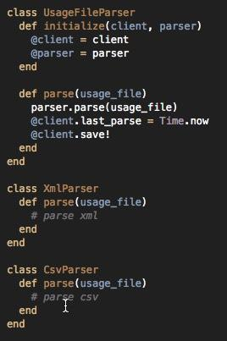
Dependency Inversion Principle
Notes:
The Dependency Inversion Principle has to do with high-level (think business logic) objects not depending on low-level (think database querying and IO) implementation details. This can be achieved with duck typing and the Dependency Inversion Principle. Often this pattern is used to achieve the Open/Closed Principle that we discussed above. In fact, we can even reuse that same example as a demonstration of this principle. Let’s take a look:
As you can see, our high-level object, the file parser, does not depend directly on an implementation of a lower-level object, XML and CSV parsers. The only thing that is required for an object to be used by our high-level class is that it responds to the parse message. This decouples our high-level functionality from low-level implementation details and allows us to easily modify what those low-level implementation details are. Having to write a separate usage file parser per file type would require lots of unnecessary duplication.

Slide 59
Why SOLID?
It helps us write code which is:
Loosely Coupled
Highly Cohesive
Easily Composable
Context Independent
Reusable
Easily tested code

Slide 60
SOLID Principles
SOLID Benefits:
Changes in different parts of the system do not affect unrelated parts
System is flexible for potential changes due to various abstractions
No need to implement unnecessary methods
Changes in details do not affect high-level abstractions

Slide 61
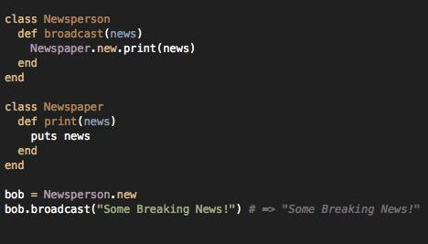
QUIZ 3: SOLID Principles
Notes:
Let’s take a look at this class.
This is a functioning broadcast method, but right now it’s tied to the Newspaper object. What if we change the name of the Newspaper class? What if we add more broadcast platforms? Both of these things would cause us to have to change our Newsperson object as well. Even though we have a very small dependency on the type of broadcasting our newsperson will be doing, it breaks all three of the requirements we defined above of good code.

Slide 62
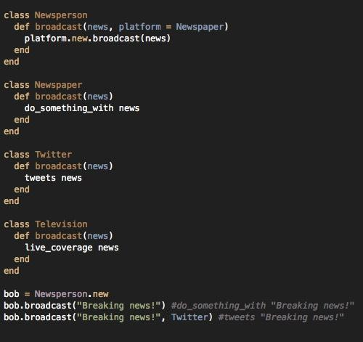
QUIZ 3:
SOLID Principles
Redo the broadcast code and
implement the dependency
inversion principle.
Notes:
As you can see, we can now pass any news broadcasting platform through the broadcast method whether that’s Twitter, TV, or Newspaper. And if we know that Newspapers are usually going to be the platform of choice, we can make newspaper the default platform. This second strategy is flexible, mobile, and not fragile. We can change any of these classes and we won’t break the other classes. The higher level Newsperson class does not depend on the lower level classes and vice versa.
Finally, this second block of code is much easier to test. You can test each of the three platforms to make sure they produce the correct output. And you can test the higher level Newsperson class with a mock platform.

Slide 63
So...what’s a good software design?
There are many aspects to consider…
Extensibility
Maintainability
Modularity
Reliability
Reusability
Robustness
Performance....

Slide 64
Why bother?
Design because you expect your application to succeed (and to change in the future to come)

Slide 65
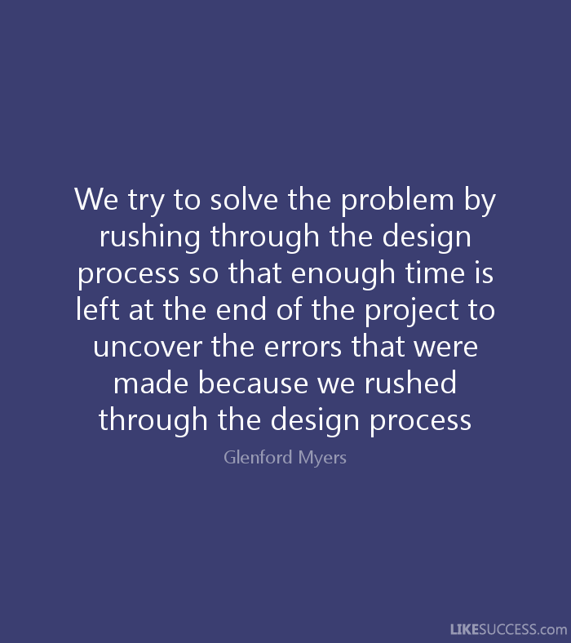
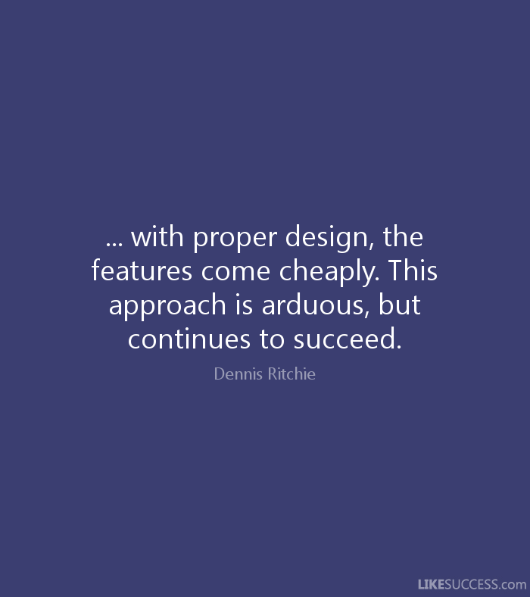

Slide 68
Thank you!
Go forth, and DESIGN!

