Slide 1
Introduction to Software Design
Lecture part 1

Slide 2
“There are two ways of constructing a software design...
make it so simple that there’s no obvious deficiencies
or
make it so complicated that there’s no obvious deficiencies.”
— C.A.R. Hoare

Slide 3
Introduction
Object-oriented design is about managing dependencies.
Every application is a collection of code
The code’s arrangement is the design.
Software Design → the art of arranging code
Notes:
“Design is a set of coding techniques that arranges dependencies in a way such that objects can effectively accommodate change.”
“When objects known too much they have many expectations about the world in which they reside. They’re picky, and they need things to be ‘just so.’ These expectations constrain them. The objects resist being reused in different contexts; they’re painful to test and susceptible to being duplicated.”
“Two different programmers could be relied upon to solve the same problem by arranging code in different ways. Software design isn’t an assembly line -- it’s a studio where you can sculpt custom applications.”
“The purpose of design is to allow you to design later and its primary goal is to reduce the cost of change.”
How do you create a good design? How do you make sure you make good decisions? -- Arm yourself with principles!

Slide 4
Benefits of Good Software Design
Maintainability
Changing requirements make the best-laid plans go awry
Modularity
Reliability
Reusability
Robustness
Scalability
…many more aspects to consider
Notes:
NOTES: - If an application succeeds/lives long enough, its next biggest problem is dealing with change. Arranging code to efficiently accommodate change is a matter of design.
“Unfortunately, something will change. The customers didn’t know what they wanted, they didn’t say what they meant. You didn’t understand their needs, you’ve learned how to do something better. Even applications that are perfect in every way are not stable. The application was a huge success, now everyone wants more. Change is unavoidable. It is ubiquitous, omnipresent, and inevitable.”
“Changing requirements are the programming equivalent of friction and gravity. They introduce forces that apply sudden and unexpected pressures that work against the best-laid plans. It is the need for change that makes design matter. Applications that are easy to change are a pleasure to write and a joy to extend. They’re flexible and adaptable. Apps that resist change are just the opposite - every change is expensive and each makes the next cost more.”

Slide 5
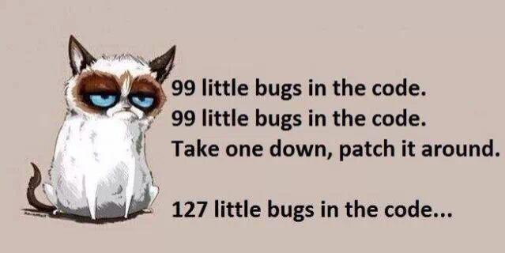
Dangers of Under-designed Software
Easy to write, but gradually becomes impossible to change
“Yes, I can add that feature, but it will break everything”
Notes:
NOTES: - “The problem with poorly designed small applications is that they grow up to be poorly designed big applications.”
In the absence of design, unmanaged dependencies wreak havoc because objects know too much about one another. Changing one object forces change upon its collaborators, which in turn forces change upon its collaborators, etc. A seemingly insignificant enhancement can cause damage that radiates outward in overlapping concentric circles, ultimately leaving no code untouched.”
This is true of any OO language but some languages are more susceptible than others. Ruby and Ruby on Rails are approachable and puts quick scripts and web applications within easy reach even to those without knowledge of software design, but the early promise of painless development can gradually fade and give way to big problems.
They key to software design is to acquire an understanding of the theories of design and to apply these theories appropriately, at the right time, and in the right amounts. When we said before that software design is like an art, sculpting custom applications, well just as a sculptor has chisels and files, an OOP designer has tools as well, in the form of principles and patterns.

Slide 6
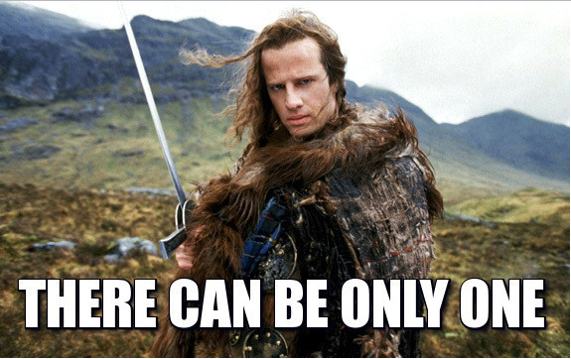
Single Responsibility Principle
What belongs in a class?
Follow the golden rule of all science:
KISS (Keep It Simple, Stupid)
A class should do the
smallest possible useful thing
Notes:
Design principles are core abstract principles which we are supposed to follow while designing software architecture. Remember they aren't concrete; rather abstract. They can be applied on any language, on any platform regardless of the state as long as we are within the permissible conditions.
The goal in designing a class is to model your application such that it does what it’s supposed to do right now and is also easy to change later.

Slide 7
Notes:
Bicycles are wonderfully efficient machines, in part because they use gears to provide humans with mechanical advantage. When riding a bike you can choose between a small gear (which is easy to pedal but not very fast) or a big gear (which is harder to pedal but sends you zooming along). Gears are great because you can use small ones to creep up steep hills and big ones to fly back down.

Slide 8
Notes:
Believe it or not, there are people who care deeply about bicycle gearing. You can help them out by writing a Ruby application to calculate gear ratios.
Module that compiles and prints a report, Bicycle and Gear
Application made of Ruby classes, each representing some part of the domain.

Slide 9
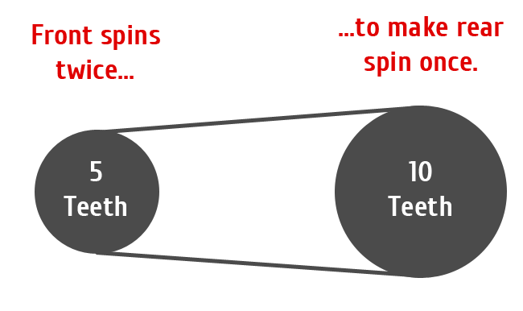
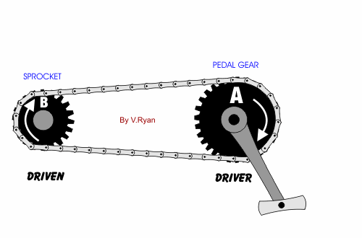
Notes:
- Bike gears control how many times the wheels rotate for each time the pedals rotate.
- To compare gears, bicyclists use the ratio of the number of a gear’s teeth.
Gears work by changing how far the bicycle travels each time your feet complete one circle with the pedals. More specifically, your gear controls how many times the wheels rotate for each time the pedals rotate. In a small gear your feet spin around several times to make the wheels rotate just once; in a big gear each complete pedal rotation may cause the wheels to rotate multiple times.

Slide 10
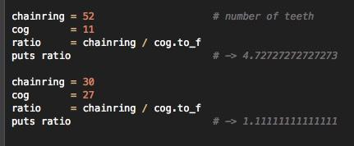
Notes:
To compare different gears, bicyclists use the ratio of the numbers of their teeth. These ratios can be calculated with this simple Ruby script
- Nouns normally represent the simplest candidates to be classes; in this case Bicycle and Gear. But bicycle doesn’t exhibit any behavior in this example though, so it doesn’t qualify, but Gear does, as it has both data and behavior! It deserves to be a class. Taking the behavior from the script above, you cre- ate this simple Gear class:

Slide 11
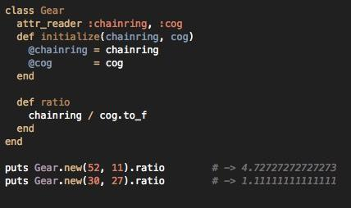
Notes:
- The Gear class is simplicity itself. New Gear instances are created by providing the number of teeth for the chainring and cog. Each instance implements 3 methods: chainring, cog, and ratio

Slide 12
How to determine if a class adheres to SRP?
Attempt to describe it in one sentence.
steer clear of using the words “and”, “or”
single thing the class does should be simple to describe
EX/ Gear: “Calculate the ratio between 2 toothed sprockets.”
Notes:
When describing what a class (or any other software entity) does in one sentence, if you use the words "and" or "or," you're most likely breaking the SRP. If you use "and," your class has at least two responsibilities. If you use "or," the class likely has more than one responsibility, and there's a good chance the responsibilities aren't related to one another.

Slide 13
Single Responsibility Principle
Methods, like classes, should have a single responsibility
same reasons apply! – easy to change, easy to reuse
Notes:
This method clearly has two responsibilities: it iterates over the wheels and it calculates the diameter of each wheel.

Slide 14
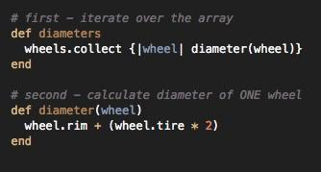
Single Responsibility Principle
Methods, like classes, should have a single responsibility
same reasons apply! – easy to change, easy to reuse
Notes:
Simplify the code by separating it into two methods, each with one responsibility. This next refactoring moves the calculation of a single wheel’s diameter into its own method. The refactoring introduces an additional message send but at this point in your design you should act as if sending a message is free. Performance can be improved later, if need be. Right now the most important design goal is to write code that is easily changeable.

Slide 15
Single Responsibility Principle
Methods, like classes, should have a single responsibility
same reasons apply! – easy to change, easy to reuse
Methods that have a single responsibility:
Expose previously hidden qualities
Avoid the need for comments
Encourage reuse
Are easy to move to another class

Slide 16
Single Responsibility Principle
Methods, like classes, should have a single responsibility
same reasons apply! – easy to change, easy to reuse
Methods that have a single responsibility:
Expose previously hidden qualities
Avoid the need for comments
Encourage reuse
Are easy to move to another class
If a muddled class has too many responsibilities:
separate those responsibilities into different classes.
Notes:
Separating iteration from the action that’s being performed on each element is a common case of multiple responsibility that is easy to recognize.

Slide 17
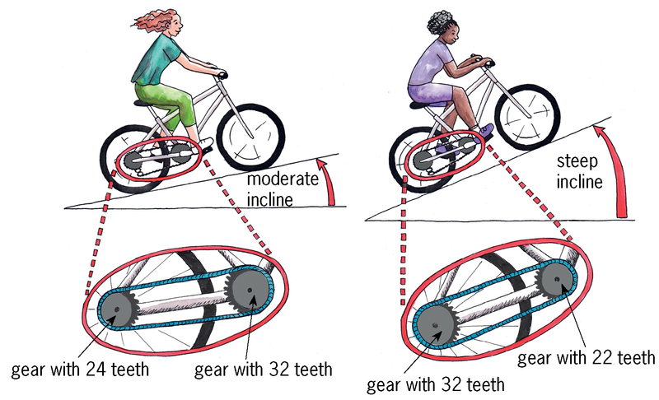
Notes:
“We show our Gear calculator to a cyclist friend and she loves it, but immediately asks for an enhancement. She has 2 bicycles; the bicycles have exactly the same gearing but they have different wheel sizes. She’d like you to also calculate the effect of the difference in wheels.”
A bike with huge wheels travels much farther during each wheel rotation than one with tiny wheels.
Cyclists (at least those in the United States) use something called gear inches to
compare bicycles that differ in both gearing and wheel size. The formula follows: gear inches = wheel diameter * gear ratio
where
wheel diameter = rim diameter + twice tire diameter.
You change the Gear class to add this new behavior:

Slide 18
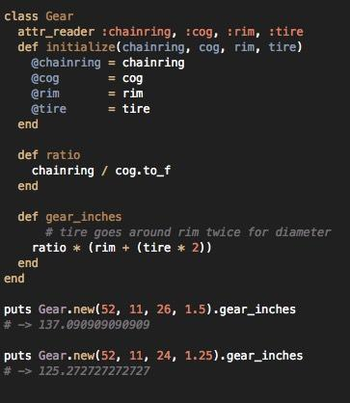
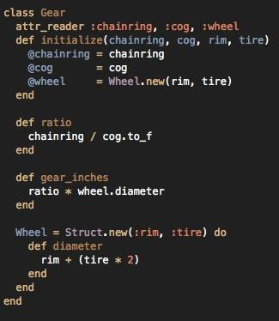
Single Responsibility Principle
Notes:
So here’s the modified version of our Gear class for the effect of the difference in wheels. It works well for a while, then you show your calculator to another cyclist friend (you’re popular among this crowd) and he tells you that it’s very nice but that while you’re writing calculators he would also like to have one for “bicycle wheel circumference.”
This is a new feature request that supplies the exact information you need to make the next design decision.
You know that the circumference of a wheel is PI times its diameter. You then add embedded Wheel that calculates diameter; it’s a simple matter to add a new method to calculate circumference.
BUT our initial implementation isn’t quite SRP-friendly...

Slide 19
Aziza:
Pay attention to indentation, maintain method order as shown in the original code
‘Reset’ button returns all blocks to initial container
Only one chance to submit, but can retry under Quiz ‘Report’
Use ‘Get Feedback’ button to troubleshoot errors
http://utopia.cs.memphis.edu:3000
Username: <your UMemphis email> Password: software
Please use either Chrome or FireFox
Solution container auto-resizes, so be aware that it may shift from the right of the initial container to below it
Drag code blocks from initial to solution and arrange in the correct order to solve

Slide 20
QUIZ 1: SRP
1.) Remove code from the enhanced Gear class to allow it to more closely adhere to SRP.
Notes:
For this question, all initial code blocks will be used in the solution.
Pay attention to indentation.
Try to maintain method order as shown in the original code.
The real change here is that now your application has an explicit need for a Wheel class that it can use independently of Gear. It’s time to set Wheel free to be a separate class of it’s own.
You can arrange the code so that Gear will be easy to change even if you don’t know what changes will come. Because change is inevitable, coding in a changeable style has big future payoffs. As an additional bonus, coding in these styles will improve your code, today, at no extra cost.

Slide 21
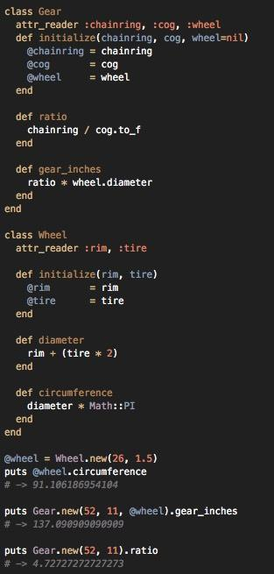
QUIZ 1: SRP
1.) Remove code from the enhanced Gear class to allow it to more closely adhere to SRP.
Notes:
Gear is the first of many classes of an application that will evolve. To efficiently evolve, code must be easy to change.
Once every method has a single responsibility, the scope of your class will be more apparent. The Gear class has some wheel-like behavior. Does this application need a Wheel class?

Slide 22
SRP...Y?
More than one responsibility = difficult to reuse!
Leads to code duplication --- Do. Not. Want.
Application’s chance of breaking unexpectedly INCREASES
if you depend on classes that do too much
Notes:
Applications that are easy to change consist of classes that are easy to reuse. Reusable classes are pluggable units of well-defined behavior that have few entanglements. An application that is easy to change is like a box of building blocks; you can select just the pieces you need and assemble them in unanticipated ways.
A class that has more than one responsibility is difficult to reuse. The various responsibilities are likely thoroughly entangled within the class. If you want to reuse some (but not all) of its behavior, it is impossible to get at only the parts you need. You are faced with two options and neither is particularly appealing.
If the responsibilities are so coupled that you cannot use just the behavior you need, you could duplicate the code of interest. This is a terrible idea. Duplicated code leads to additional maintenance and increases bugs. If the class is structured such that you can access only the behavior you need, you could reuse the entire class. This just substitutes one problem for another.
Because the class you’re reusing is confused about what it does and contains several tangled up responsibilities, it has many reasons to change. It may change for a reason that is unrelated to your use of it, and each time it changes there’s a possibility of breaking every class that depends on it. You increase your application’s chance of breaking unexpectedly if you depend on classes that do too much.

Slide 23
Overview
Single Responsibility Principle
Separation of Concerns
Dependencies & Coupling
Stepwise Refinement

Slide 24
Any complex problem can be more easily handled if
it is subdivided into pieces that can each be solved
and/or optimized independently

Slide 25
Separation of Concerns
SoC is a design principle for:
Separating a computer program into distinct sections
Each section addresses a separate concern
As little overlap in functionality as possible
Notes:
- Look at a hospital, and think about all of the different roles that are involved in providing care to a patient: triage nurses, doctors, medical assistants, techs, clerical staff, cafeteria, etc.
Is there any one person that knows how all of those people get their jobs done? No, because it would be overwhelming. They have to separate out the different responsibilities into distinct roles and the touchpoints between those roles are very specific.

Slide 26
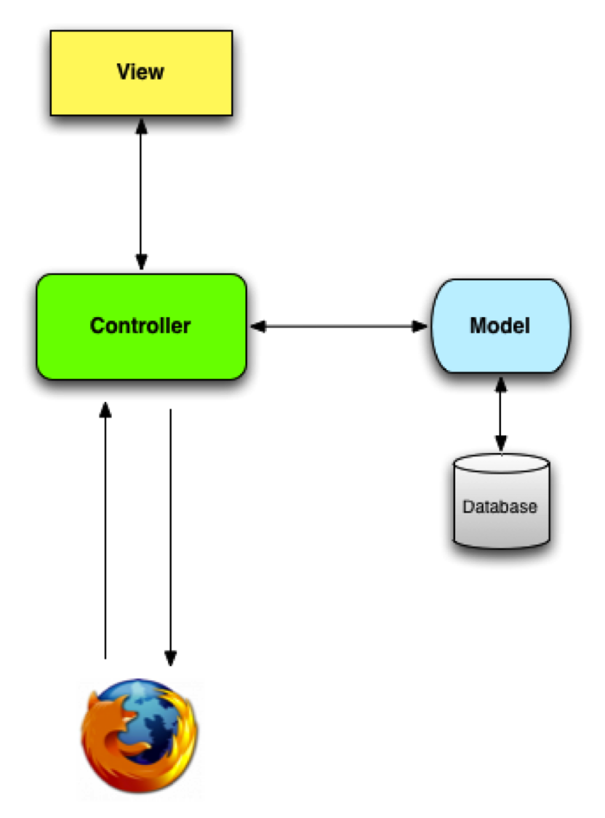
Separation of Concerns
Example: Model-View-Controller (MVC)
separates concerns for
better software maintainability
The MVC design pattern:
separates content from presentation
and data-processing from content.
Notes:
- Model-View-Controller (MVC) design pattern is an excellent example of separating these concerns for better software maintainability.
- purpose of the MVC design pattern = separate content from presentation and data-processing from content. --- separate content from presentation and the data-processing (model) from content
- where can this be seen?
- between the data-processing (Model) and the rest of the application
- The Model is independent of Views and Controllers, it only holds business entities that can be ed to any View by the Controller as per the needs for exposing them to the end user. The business entities (Model), business logic (Controllers) and presentation logic (Views) lie in logical/physical layers independent of each other

Slide 27
Separation of Concerns
SoC is achieved by the establishment
of boundaries, which:
improves testability
increases code reuse
gets rid of code duplication
makes the application more stable
and easier to understand

Slide 28
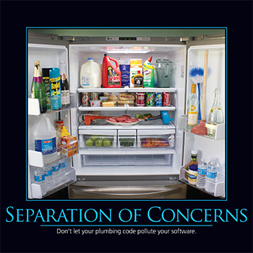
By separating concerns into smaller, and therefore more manageable pieces, a problem takes less effort and time to solve!

Slide 29
“Separation of Concerns, even if not perfectly possible, is yet
the only technique for the effective ordering of one’s thoughts,
that I know of.”
— Edsger W. Dijkstra

Slide 30
Overview
Single Responsibility Principle
Separation of Concerns
Dependencies & Coupling
Stepwise Refinement

Slide 31
An object depends on another object if, when one
object changes, the other might be forced
to change in turn.

Slide 32
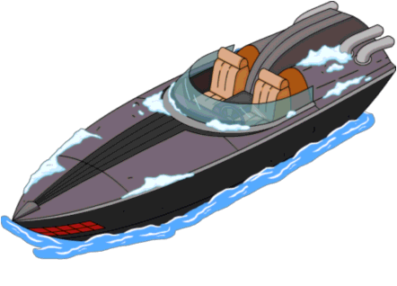
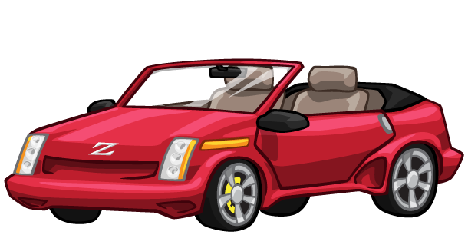
Examples of Dependencies
Notes:
EXAMPLE: ENGINE object
- If a car object, boat object, and plane object all depend on the same engine object,

Slide 33
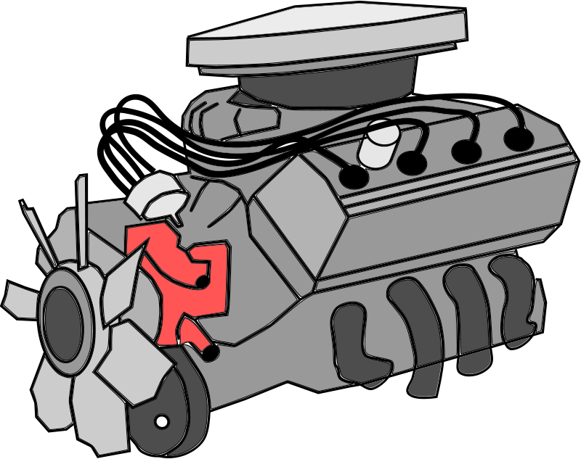
Examples of Dependencies
Notes:
- If a car object, boat object, and plane object all depend on the same engine object,

Slide 34
Examples of Dependencies
Notes:
then a modification to the engine object will necessitate changes to the car, boat, and plane objects (in order for them to work properly). And if any of those objects are dependent on other objects (like brakes, landing gear, rudder), then those other objects will also have to be changed, and so on and so forth.

Slide 35
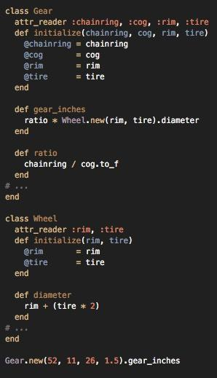
Some other examples
are in the case
where...
- When an object
knows the name
of another class
Gear expects a class
named Wheel to exist
Notes:
Here’s a modified version of the Gear class, where Gear is initialized with four fa- miliar arguments. The gear_inches method uses two of them, rim and tire, to create a new instance of Wheel. Wheel has not changed since you last you saw it

Slide 36
- When an object
knows the
arguments that a
method requires...
Gear knows that
Wheel.new requires
a rim and a tire

Slide 37
...and when the
object knows the
order of those
arguments
Gear knows the
1st argument for
Wheel.new is rim,
and the second is tire
Notes:
Each of these dependencies creates a chance that Gear will be forced to change because of a change to Wheel. Some degree of dependency between these two classes is inevitable, after all, they must collaborate, but most of the dependencies listed above are unnecessary. These unnecessary dependencies make the code less reasonable. Because they increase the chance that Gear will be forced to change, these dependen- cies turn minor code tweaks into major undertakings where small changes cascade through the application, forcing many changes.
Your design challenge is to manage dependencies so that each class has the fewest possible; a class should know just enough to do its job and not one thing more.

Slide 38
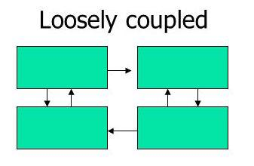
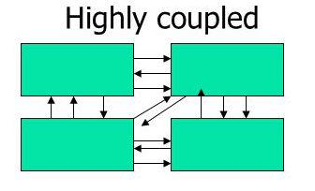
What is Coupling?
These dependencies lead into the concept of Coupling →
Coupling -- the extent to which a component of your software depends on other components
Notes:
What if we wanted to use our Gear class for other uses of gears in the real world? Ex/ Clock, Factory…. Drag Wheel along?

Slide 39
What is Coupling?
These dependencies lead into the concept of Coupling →
Coupling -- the extent to which a component of your software depends on other components

Slide 40
Which do we prefer?
The Goal: LOOSELY coupled components!
Benefits of loose coupling ---
Lower dependency between the classes
Change in one class having lower impact on other classes
Higher reuse potential
Unnecessary dependencies make code
less reusable!

Slide 41
Tight Coupling
Each dependency is like a little dot of glue ---
This glue causes your class to stick to the things it touches.
A few dots are necessary, but apply too much glue…
...and your application will harden into a solid block.
When objects are so tightly coupled that they behave like a single unit:
It’s impossible to reuse just one
Changes to one object forces changes to all
If you change Wheel, you may have to change Gear...
If you reuse Gear, Wheel comes along for the ride...
If you test Gear, you’ll be testing Wheel too...
Notes:
- Because well-designed objects have a single responsibility, their very nature requires that they collaborate to accomplish complex tasks.
- The dependencies cause these objects to act like a single thing. They move in lockstep; they change together.
- When objects are so tightly coupled that they behave like a single unit, it’s impossible to reuse just one. Changes to one object forces changes to all.
- Each dependency is like a little dot of glue that causes your class to stick to the things it touches. A few dots are necessary, but apply too much glue and your application will harden into a solid block.
- Loosely coupled components have fewer dependencies than tightly coupled components.
- Modifying a tightly coupled component is difficult.

Slide 42
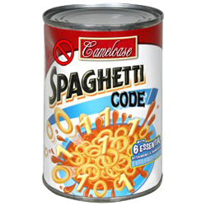
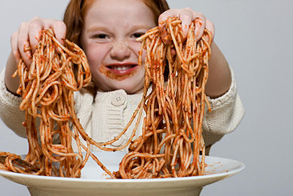
Tight coupling = Spaghetti Code:
□ difficult to understand and maintain
□ difficult to implement and debug
□ expensive to develop as highly-coupled
elements can’t be developed independently
Notes:
In spaghetti code, the relations between the pieces of code are so tangled that it is nearly impossible to add or change something without unpredictably breaking something somewhere else.

Slide 43
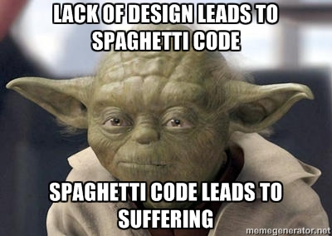

Slide 44
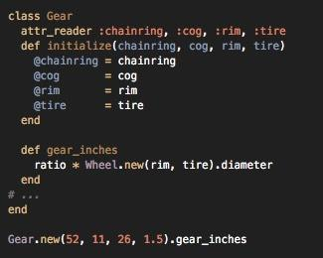
These dependencies couple Gear to Wheel,
or, each coupling creates a dependency.
The more Gear knows about Wheel:
the more tightly coupled they are
The more tightly coupled 2 objects are, the more they behave like a single entity.
Notes:
Referring to another class by its name creates a major sticky spot. In the version of Gear we’ve been discussing, the gear_inches method contains an explicit reference to class Wheel:
The immediate, obvious consequence of this reference is that if the name of the Wheel class changes, Gear’s gear_inches method must also change.
A deeper problem exists that is far less visible but significantly more destructive.
When Gear hard-codes a reference to Wheel deep inside its gear_inches method, it is explicitly declaring that it is only willing to calculate gear inches for instances of Wheel. Gear refuses to collaborate with any other kind of object, even if that object has a diameter and uses gears.
If your application expands to include objects such as disks or cylinders and you need to know the gear inches of gears which use them, you cannot. Despite the fact that disks and cylinders naturally have a diameter you can never calculate their gear inches because Gear is stuck to Wheel.
The code above exposes an unjustified attachment to static types. It is not the class of the object that’s important, it’s the message you plan to send to it. Gear needs access to an object that can respond to diameter
Gear does not care and should not know about the class of that object. It is not necessary for Gear to know about the existence of the Wheel class in order to calculate gear_inches.

Slide 45
QUIZ 2: Coupling
The original Gear class refers to the Wheel class by its name in the gear_inches method, creating a dependency. Create a new version of the Gear class that isn’t glued to the Wheel class.
Hint: the new version expects to be initialized with an object that can respond to diameter.

Slide 46
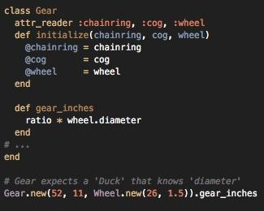
QUIZ 2: Coupling
The original Gear class refers to the Wheel class by its name in the gear_inches method, creating a dependency. Create a new version of the Gear class that isn’t glued to the Wheel class.
Hint: the new version expects to be initialized with an object that can respond to diameter.
Notes:
It doesn’t need to know that Wheel expects to be initialized with a rim and then a tire; it just needs an object that knows diameter.
Hanging these unnecessary dependencies on Gear simultaneously reduces Gear’s reusability and increases its susceptibility to being forced to change unnecessarily. Gear becomes less useful when it knows too much about other objects; if it knew less it could do more.
Instead of being glued to Wheel, this next version of Gear expects to be initialized with an object that can respond to diameter:
Gear now uses the @wheel variable to hold, and the wheel method to access, this object, but don’t be fooled, Gear doesn’t know or care that the object might be an instance of class Wheel. Gear only knows that it holds an object that responds to diameter.
This change is so small it is almost invisible, but coding in this style has huge benefits. Moving the creation of the new Wheel instance outside of Gear decouples the two classes. Gear can now collaborate with any object that implements diameter. As an extra bonus, this benefit was free. Not one additional line of code was written; the decoupling was achieved by rearranging existing code.
This technique is known as dependency injection.

Slide 47
Overview
Single Responsibility Principle
Separation of Concerns
Coupling
Stepwise Refinement

Slide 48
Stepwise Refinement
A top-down way of developing a computer program:
First describe general functions
Then break each function down into details
Refine the function in successive steps
Repeat until the whole program is fully defined
Stepwise refinement enables you to:
concentrate on the most relevant "chunks" at the current phase of development
ignore unrelated details
achieve incremental development on a very fine level of granularity
produce working (and tested) prototypes of software as it develops
Often in remarkably short periods of time

Slide 49
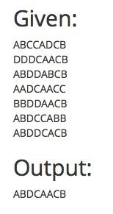
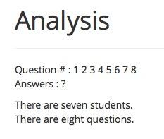
Example: The Lazy Professor Problem
I am the laziest professor ever. I've given a multiple choice test (A-D are valid answers) but I lost my test key. I'll assume that whatever answer was most popular for a question is the correct answer.
I've included a file that contains the students’ quiz answers. Each row represents one student. Write code that figures out the most popular answer to each question and then prints out the key.

Slide 50
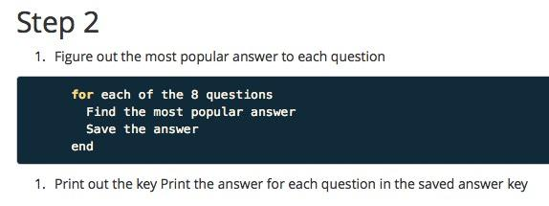
First Step!
then...
REFINE!

Slide 51
then...
REFINE!
then...
REFINE!

Slide 52
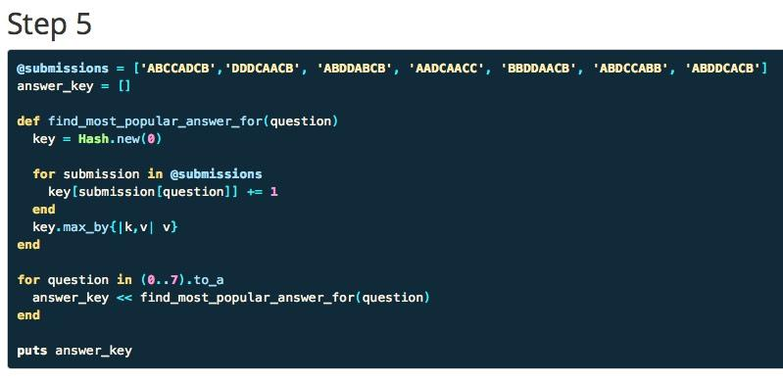
then...
SUCCESS!

Slide 53
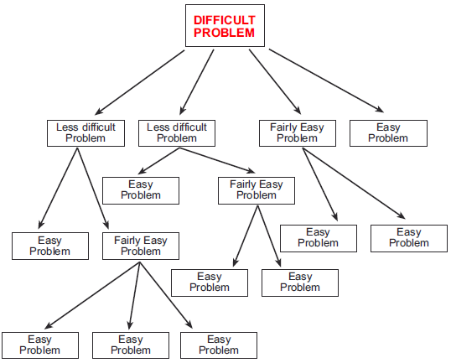
Stepwise Refinement
Stepwise Refinement is a useful technique for solving problems
Start with the 'What'
Gradually move towards the 'How'
Then finally code the solution
Procedural (step-by-step) form of
Separation of Concerns
Somewhat intuitive, like SRP and KISS

