Slide 1
https://flic.kr/p/hcgHcm
Iteration Planning

Slide 2
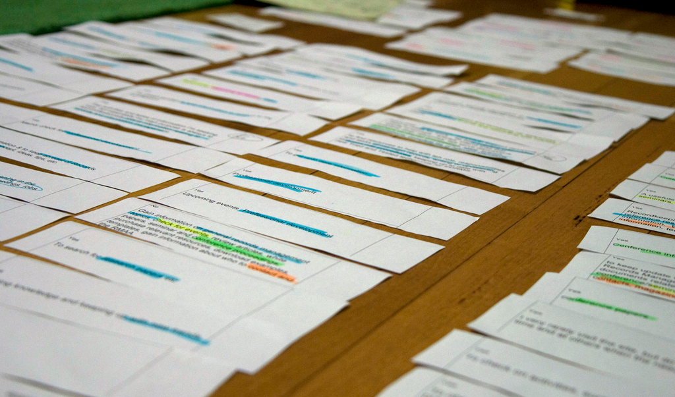
Now you have a bunch of user stories with estimates, so what’s next?

Slide 3
Developer
Customer
Requirements
Create USs
USs
Check USs
Corrections/Clarifications
Fix USs
Add Estimates
USs + Estimates
Add Priorities
USs + Estimates + Priorities
Choose USs for Iteration
Divide Chosen USs into Tasks
Estimate Tasks
Assign Tasks to Workers
Get to Work!

Slide 4
Principle: Customer sets priorities
Ensures alignment with customer goals
Helps customer feel in control
Project isn’t going “off the rails”
Estimates help customer maximize cost-benefit

Slide 5
Priority Numbering Scheme
Multiples of 10:
10 - Highest priority
20
30
40
50
… - Lowest priority
Non-multiples of 10 may be used if helpful

Slide 6
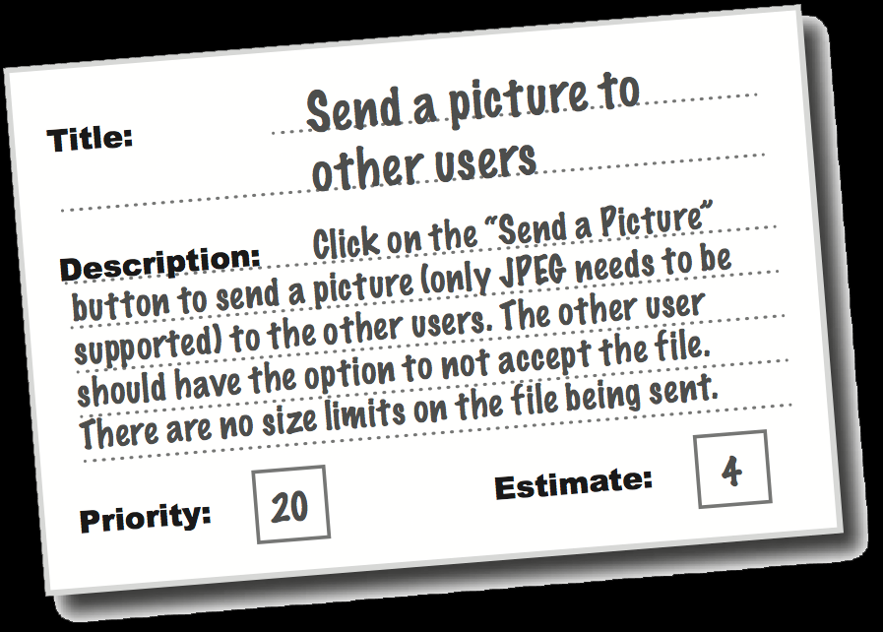
So now you have…
Collection of user stories
With estimates
And customer priorities
What’s next?

Slide 7
Developer
Customer
Requirements
Create USs
USs
Check USs
Corrections/Clarifications
Fix USs
Add Estimates
USs + Estimates
Add Priorities
USs + Estimates + Priorities
Choose USs for Iteration
Divide Chosen USs into Tasks
Estimate Tasks
Assign Tasks to Workers
Get to Work!

Slide 8
What’s next…
Choose subset of USs to implement this iteration
Based on customer priorities
Based on time constraints
Breakdown subset into tasks
More detailed estimates
May affect iteration plan
Assign people to tasks

Slide 9
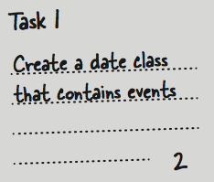
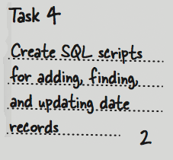
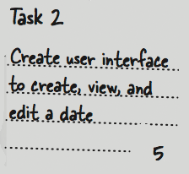
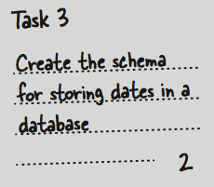
From USs to Tasks
User Story
Estimate

Slide 10
Incremental Development Principle
Each task produces running code
Unit tests count

Slide 11
Task design strategy
Make tasks build upon one another
First task makes subset of US work (e.g., partial form)
Second task makes bit more work (e.g., add persistence)
Etc…

Slide 12
2-Part Activity
Part 1: Collect customer priorities
Assign number each US
Also note any corrections/clarifications
Part 2:
Choose USs for Development Iteration 1
3 weeks worth of work
Fill out iteration plan with what each team member will do
Everyone codes
Tasks must be verifiable and executable
Due by start of next class!

