Slide 1
http://flic.kr/p/5wDp8h
Project Planning and Estimation

Slide 2
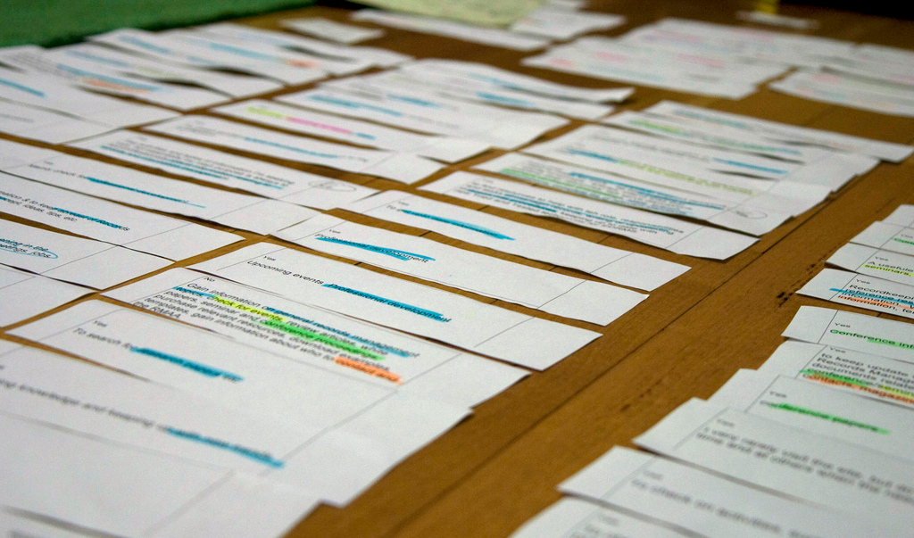
Now you have a bunch of user stories, so what’s next?

Slide 3
Iterative Development Process
We are here
Analysis
Design
Implementation
Requirements
Planning
Initial Planning
Testing
Evaluation
Deployment

Slide 4
Developer
Customer
Requirements
Create USs
USs
Check USs
Corrections/Clarifications
Fix USs
Add Estimates
USs + Estimates
Add Priorities
USs + Estimates + Priorities
Choose USs for Iteration
Divide Chosen USs into Tasks
Estimate Tasks
Assign Tasks to Workers
Get to Work!

Slide 5
Developer
Customer
Requirements
Create USs
USs
Check USs
Corrections/Clarifications
Fix USs
Add Estimates
USs + Estimates
Add Priorities
USs + Estimates + Priorities
Choose USs for Iteration
Divide Chosen USs into Tasks
Estimate Tasks
Assign Tasks to Workers
Get to Work!

Slide 6
Estimating Time
http://xkcd.com/1658/

Slide 7
Hofstadter's Law
It always takes longer than you expect, even when you take into account Hofstadter's Law.
— Douglas Hofstadter, Gödel, Escher, Bach

Slide 8
Principles for Estimation
Principle: Past performance is the best indicator of future performance
Approach: Track your outcomes; refine your estimates
Principle: Wisdom of the crowd
Goal: Predict how events will unfold
Think event planning
Problem: Easy to miss something
Solution: More brains = more opportunities to catch eventualities

Slide 9
Principles for Estimation
Principle: Past performance is the best indicator of future performance
Approach: Track your outcomes; refine your estimates
Principle: Wisdom of the crowd
Goal: Predict how events will unfold
Think event planning
Problem: Easy to miss something
Solution: More brains = more opportunities to catch eventualities
No past performance yet, so…

Slide 10
Estimation with Planning Poker
Cards with units of work: 1, 3, 5, 8, 13, 20, 40
Assume team can do 20 units in an iteration
For each US:
Discuss work involved
Flip cards
Repeat until consensus
Efficiency in estimating is important
Don’t expect your estimates to be super accurate

Slide 11
Let’s watch this video to find out what planning poker is all about:
http://youtu.be/0FbnCWWg_NY

Slide 12
Some additional estimation principles
Give honest estimates that customers can trust
Engineers refine estimates; customers refine expectations
Estimates are basis for customer’s cost assessment
Work at a sustainable pace
No heroes, no all-nighters, no super-human feats
Either you get the code done like a human being, or you don’t

Slide 13
What’s next…
Work on
Designs (sitemap, wireframes, model classes)
US Estimates

