Slide 1
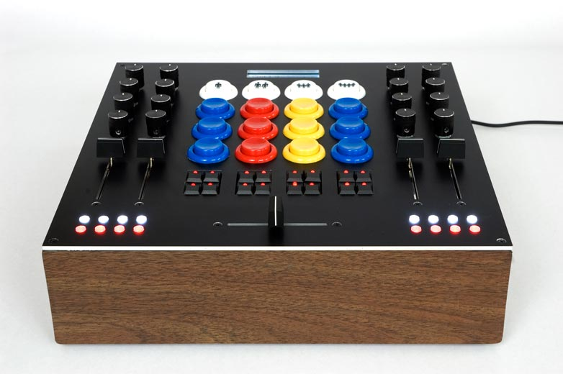
https://flic.kr/p/4MRZPn
MVC Controllers

Slide 2
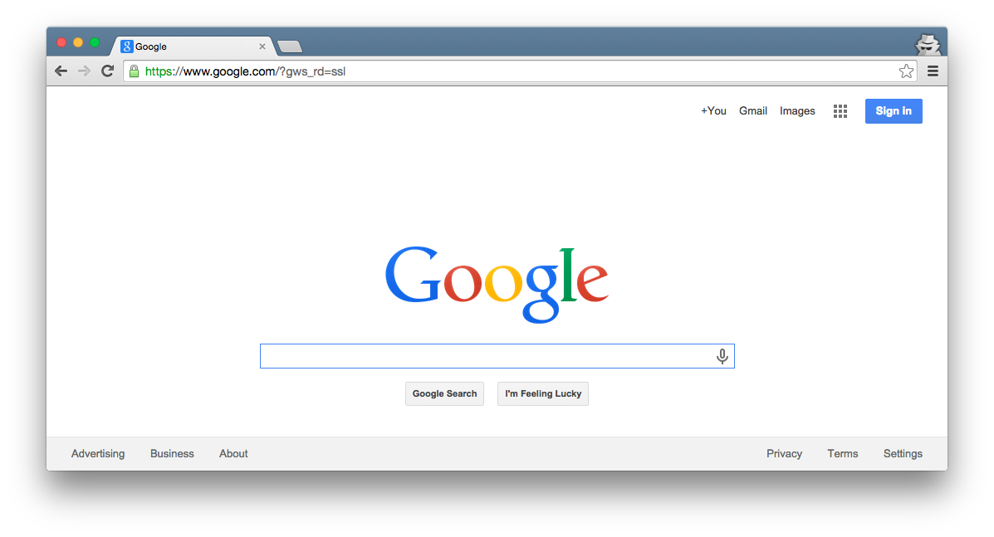
Browser
Migrations
Ye Olde Internet
Tests
DB
Server
Today’s focus
View
Router
Controller
Model

Slide 3
5 Basic Controller Patterns
Create
new/create: Enter a new record
Read
index: List all records
show: Display a particular record
Update
edit/update: Modify an existing record
Delete
destroy: Remove a record

Slide 4
5 Basic Controller Patterns
Create
new/create: Enter a new record
Read
index: List all records
show: Display a particular record
Update
edit/update: Modify an existing record
Delete
destroy: Remove a record

Slide 5
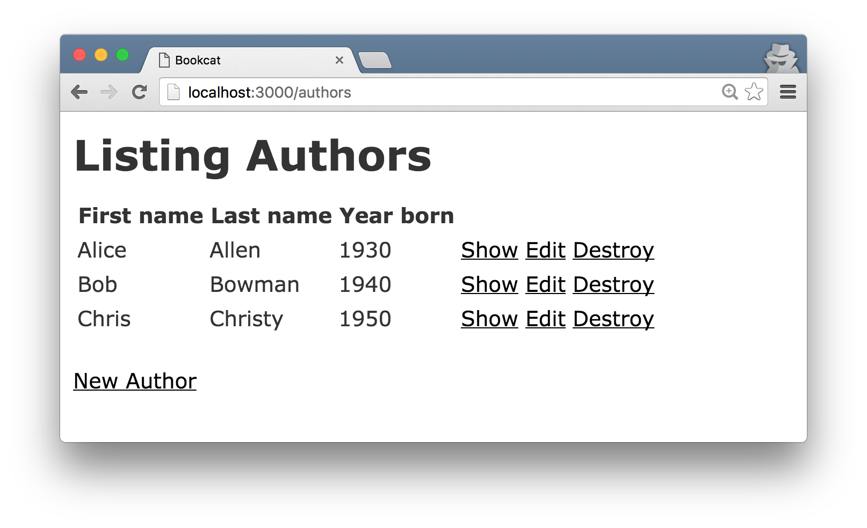
index Page

Slide 6
Browser
How to implement index?
Ye Olde Internet
DB
Server
View
Router
Controller
Model

Slide 7
Browser
How to implement index?
Route “index” URL pattern
Controller uses Model to retrieve records
Controller uses View to generate HTML (passes records to View)
Ye Olde Internet
Demo Time!
DB
Server
View
3
1
Router
Controller
Model
2

Slide 8
5 Basic Controller Patterns
Create
new/create: Enter a new record
Read
index: List all records
show: Display a particular record
Update
edit/update: Modify an existing record
Delete
destroy: Remove a record
✔

Slide 9
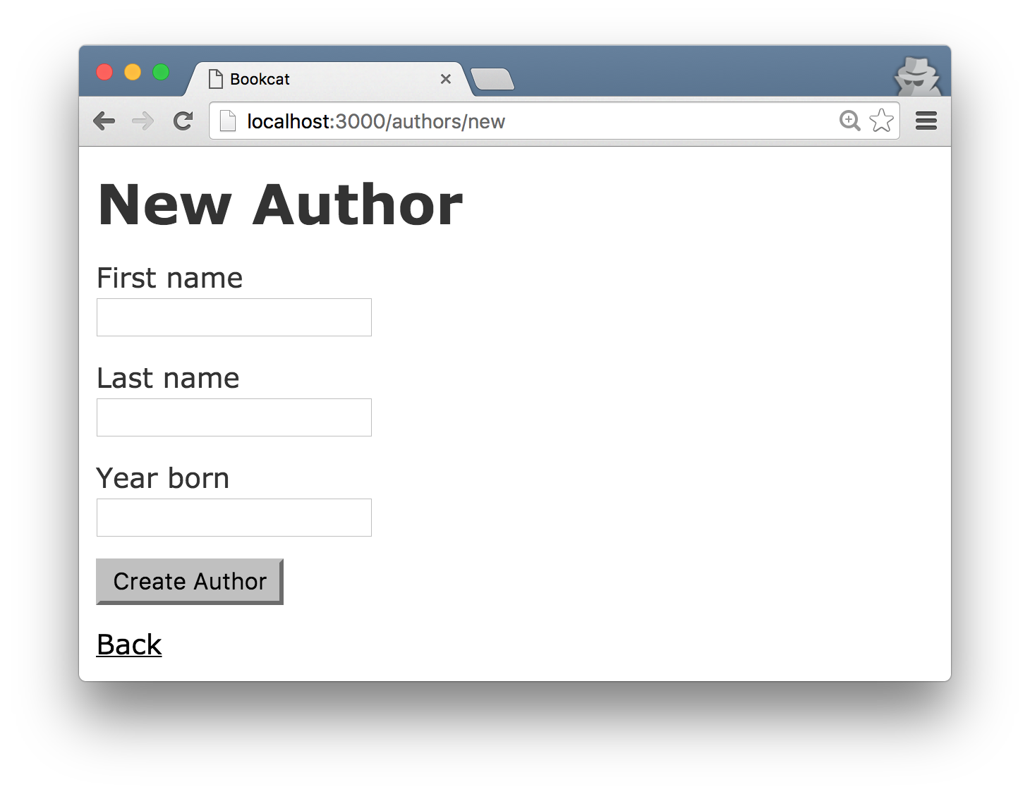
new Form

Slide 10
Browser
How many HTTP requests does it take to create a record?
Ye Olde Internet
DB
Server
View
Router
Controller
Model

Slide 11
Browser
How many HTTP requests does it take to create a record?
Two:
One to request a form (GET)
One to perform the add (POST)
Ye Olde Internet
DB
Server
View
Router
Controller
Model

Slide 12
Browser
How to implement get form?
Ye Olde Internet
DB
Server
View
Router
Controller
Model

Slide 13
Browser
How to implement get form?
Route URL pattern
Controller uses View to generate HTML (passes View records)
Ye Olde Internet
DB
Server
View
2
1
Router
Controller
Model

Slide 14
Browser
How to implement post new record?
Ye Olde Internet
DB
Server
View
Router
Controller
Model

Slide 15
Browser
How to implement post new record?
Route URL pattern
Controller uses Model to add rec
Controller sends HTTP redirect
Ye Olde Internet
Demo Time!
DB
Server
View
3
1
Router
Controller
Model
2

Slide 16
5 Basic Controller Patterns
Create
new/create: Enter a new record
Read
index: List all records
show: Display a particular record
Update
edit/update: Modify an existing record
Delete
destroy: Remove a record
✔
✔
Like index
Like create
Needs explaining…
Demo Time!

Slide 17
Appendix

Slide 18
Browser
Migrations
Ye Olde Internet
Tests
DB
Server
View
Router
Controller
Model

