Slide 1
Object-Oriented Design Overview

Slide 2
“His focus on the user experience above all else has always been an inspiration to me.”
—Larry Page

Slide 3
Donald Norman
Worked for Apple in the 90s as User Experience Architect
1st to have “UX” in job title

Slide 4
Software Objects
Knows information
Performs services
Makes decisions
And perhaps most importantly…

Slide 5
Object Collaborations
Maintains connections to other objects
Communicate by passing messages

Slide 6
Object Diagrams
Object
AppleInc
Link name
department
department
Link
SalesDept
R&DDept
name=“US Sales”
name=“R&D”
Attribute value
manager
VPofSales
name=“Erin”
employeeID=4362
title=“VP of Sales”
ErinsContactInfo
address=“1472 Miller St”

Slide 7
Communication Diagrams
Message
AppleInc
1: print
department
2: print
department
SalesDept
R&DDept
name=“US Sales”
name=“R&D”
1.1: print
manager
VPofSales
1.2: print
ErinsContactInfo
name=“Erin”
employeeID=4362
title=“VP of Sales”
address=“1472 Miller St”

Slide 8
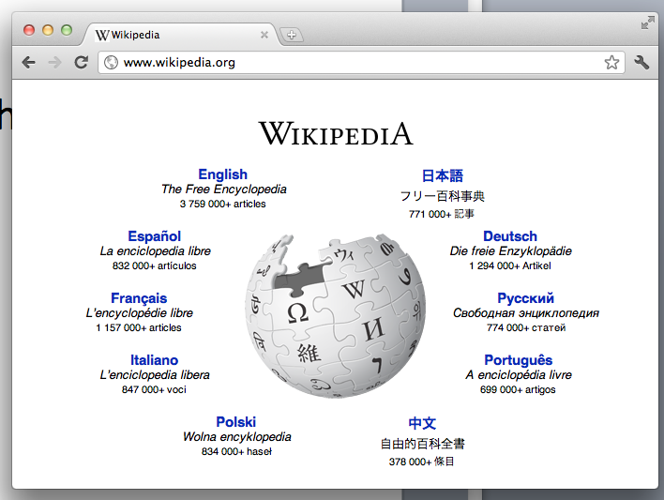
Activity
Create an object diagram for the GUI features of a typical web browser
Here’s a start:
LocationBar
text=“www.wikipedia.org”

Slide 9
How do we specify what messages objects can receive?
Answer: Define interfaces
Involves designing software classes

Slide 10
Object Diagrams (with Classes)
Class
AppleInc : Company
department
department
SalesDept : Department
R&DDept : Department
name=“US Sales”
name=“R&D”
manager
VPofSales : Manager
name=“Erin”
employeeID=4362
title=“VP of Sales”
ErinsContactInfo : ContactInfo
address=“1472 Miller St”

Slide 11
Class Diagrams
Company
1
department
1..*
Department
name: String
Attributes
print()
…
Operations
1
manager
1..*
contact
ContactInfo
Manager
1
1
name : String
employeeID : Integer
title : String
address : String
print()
…
print()
…

Slide 12
Activity
Create a class diagram for the GUI features of a typical web browser

Slide 13
Couple things to note about software class models
Low representational gap from domain model
Gap will also be small to implementation model
Classes like blueprints for objects
Object is instance of class

Slide 14
Question
What if there is more than one type of Department?
R&D may have different attributes than Sales
Answer that doesn’t scale: Union attributes (or overload attributes)
Fortunately, there’s inheritance

Slide 15
Inheritance
Company
1
Sales
Abstract class
department
1..*
…
Department
…
name: String
print()
…
R&D
…
1
Inherits (“is-a”)
…
manager
1..*
contact
ContactInfo
Manager
1
1
name : String
employeeID : Integer
title : String
address : String
print()
…
print()
…

Slide 16
Now you can have this object diagram
AppleInc : Company
department
department
SalesDept : Sales
R&DDept : R&D
name=“US Sales”
name=“R&D”
manager
VPofSales : Manager
name=“Erin”
employeeID=4362
title=“VP of Sales”
ErinsContactInfo : ContactInfo
address=“1472 Miller St”

Slide 17
What if print() differed between R&D and Sales?
Sales
…
Department
print()
name: String
print()
…
R&D
…
print()
Abstract operation
Polymorphism: Having multiple forms
Objects of type Sales or R&D can play the role of Department
The proper print() operation will be invoked

Slide 18
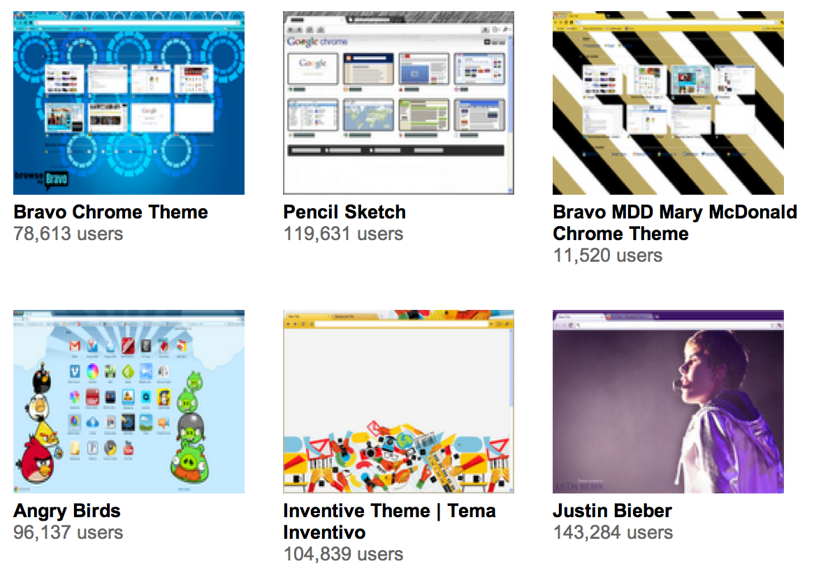
Activity
How might you design a browser that supports different themes? (Use inheritance.)

Slide 19
One basic approach…
Button
LocationBar
BieberButton
BieberLB
AngryBirdsButton
AngryBirdsLB
BravoButton
BravoLB
Benefit: Pluggable objects

Slide 20
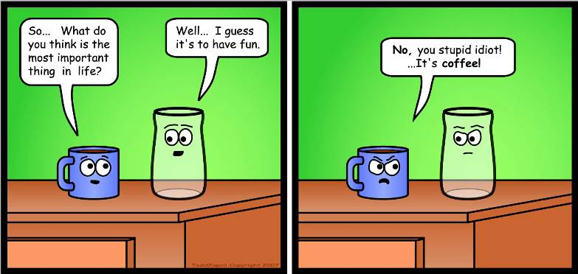
Two Key Design Skills
(1) Assigning responsibilities to objects
Keep responsibilities focused
Emphasize one concern
(2) Creating collaborations
Each object plays a role
Notes:
http://www.flickr.com/photos/digitalcolony/2725932075/sizes/o/

Slide 21
Two key design attributes
Coupling
When one module is involved in another module’s concern
Cohesion
When a module is devoted to its concern
* Classes are modules; so are packages, components, etc.
Notes:
Modular programming is a software design technique that increases the extent to which software is composed of separate, interchangeable components, called modules by breaking down program functions into modules, each of which accomplishes one function and contains everything necessary to accomplish this. Conceptually, modules represent a separation of concerns, and improve maintainability by enforcing logical boundaries between components. Modules are typically incorporated into the program through interfaces. A module interface expresses the elements that are provided and required by the module. The elements defined in the interface are detectable by other modules. The implementation contains the working code that corresponds to the elements declared in the interface. --Wikipedia

Slide 22
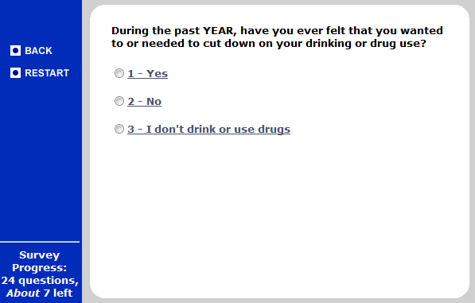
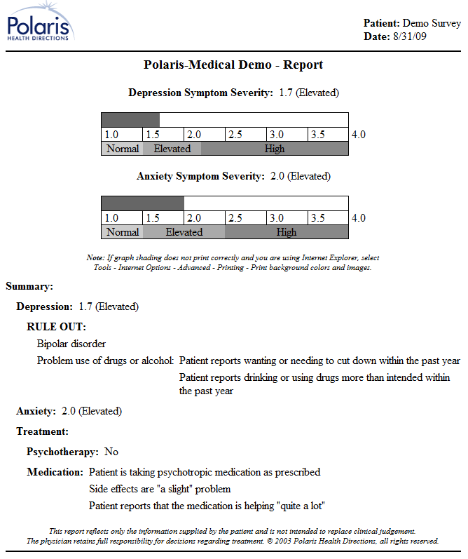
An example system to support drug and alcohol counseling
http://cf.polarishealth.com/demo/start_demo.html

Slide 23
What are the key concerns in this req. dataflow diagram?
Last name & PIN
Authenticate
Counselee
User ID
Health Information
Survey
Survey answers
Survey DB
All this patient’s answers (ever)
Pick up
Create report
Printout
Printer
Postscript
Printout
Counselor

Slide 24
Some key concerns
Managing the users
Authenticating counselees
Matching counselees to counselors
Performing the survey
Representing the questions
Representing the answers
Performing skip logic
Storing the answers
Generating the report
Reading the data
Performing calculations in the report
Sending to the printer

Slide 25
Assigning concerns to code in this arch. dataflow diagram
Authenticator
Survey Server
Counselee Rec.
Question loader
Skip logic module
Counselor Rec.
Answer storer
Survey Instance
Questions
Report Maker
Data loader
Answers
Calculation module
Printer controller
Notes:
One box per component
Lines without arrowheads show references
Lines with regular arrowheads indicate data flow
Roundtangles are packages

Slide 26
Coupling reduces maintainability
Levels of coupling A and B are different modules…
Content coupling (worst)
A modifies B
Common coupling
A and B both read/write the same data
Control coupling
A calls B
Stamp coupling
A provides structured data to B
Data coupling
A provides unstructured data to B
Uncoupled (best)
None of the above
If A and B are coupled, then modifying A may require modifying B.
If two forms of coupling apply, then choose the one higher in the list.

Slide 27
Inter-package coupling
Content coupling
Common coupling
Control coupling
Stamp coupling
Data coupling
Uncoupled
Authenticator
Authenticator
Survey Server
Survey server
Data Records
Counselee Rec.
Question loader
Skip logic module
Counselor Rec.
Answer storer
Survey Instance
Report Maker
Questions
Report Maker
Data loader
Answers
Calculation module
Printer controller

Slide 28
Cohesion increases maintainability
Levels of cohesion A and B are inside same module…
Functional/informational cohesion (best)
A and B work together for just one purpose
Communicational cohesion
A and B use the same data
Procedural cohesion
A executes, then B executes, and A & B are steps in a certain process
Temporal cohesion
A executes, then B executes, but A & B do not have any related purpose or shared process
Logical cohesion
Either A or B might be executed
Coincidental cohesion (worst)
None of the above
If A is highly cohesive, then it is easy to find the code for a concern.
If two forms of cohesion apply, then choose the one higher in the list.

Slide 29
Intra-package cohesion
Functional/informational cohesion
Communicational cohesion
Procedural cohesion
Temporal cohesion
Logical cohesion
Coincidental
Authenticator
Survey Server
Counselee Rec.
Question loader
Skip logic module
Counselor Rec.
Answer storer
Survey Instance
Questions
Report Maker
Data loader
Answers
Calculation module
Printer controller

Slide 30
Tips and techniques
Some tips and techniques to help improve your software designs…
Don’t talk to strangers
Move code to where it’s used
Split modules to reduce cycles
Prefer composition over inheritance
Use interfaces to declare promises
Plan for future development

Slide 31
Tip #1: Don’t talk to strangers (“Law of Demeter”)
This would be bad:
Authenticator
Survey Server
Counselee Rec.
Question loader
Skip logic module
Counselor Rec.
Answer storer
Survey Instance
Questions
Report Maker
Data loader
Answers
Calculation module
Printer controller
Notes:
Don’t access the components of a composite

Slide 32
Tip #2: Move code to where it’s used
Reducing inter- package coupling.
Authenticator
Survey Server
Counselee Rec.
Question loader
Skip logic module
Counselor Rec.
Answer storer
Survey Instance
Report Maker
Questions
Data loader
Answers
Calculation module
Printer controller

Slide 33
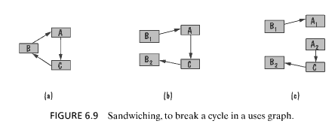
Tip #3: Split modules to reduce cycles
Cycles are bad for incremental development
But may not be avoidable
Our design had no cycles
But here’s one way to get rid of cycles when they do happen to occur…
Pfleeger & Atlee

Slide 34
Tip #4: In reuse, prefer composition over inheritance
In general, use composition to add features or to reuse code, and use inheritance to add a new version of an entity.
Survey Server
Survey Instance
Question loader
Questions
Skip logic module
Answers
Answer storer
Timing data
Answer cross-check
Logging module

Slide 35
Tip #4: In reuse, prefer composition over inheritance
In general, use composition to add features or to reuse code, and use inheritance to add a new version of an entity.
Survey Instance
Report Maker
Data loader
Questions
Answers
Calculation module
Numeric question
Numeric answer
Printer controller
Multiple choice ques.
Multiple choice ans.
Free-text question
Free-text answer
Physical printer ctrllr.
Printout-by-email ctrllr.
Printout-by-web ctrllr.

Slide 36
Tip #5: Use interfaces to declare promises
An interface is a promise
I can do this for you.
If you meet these preconditions, then I can meet these postconditions.
Functional or non-functional
Polymorphism
If A and B and C and D each implement an interface, then they all make the same promise
But may keep the promise in different ways!

Slide 37
Tip #6: Plan for future development
Use incremental development
When much of the system’s value resides in one subsection
When one part of the system must be completed (logically) before another
There should be a module boundary around each increment, eventually.
Use iterative development
When the system’s value is spread out over much of the system
When the whole system needs to work at least a bit before you can build up
Modules should be decomposed to facilitate maintenance.

Slide 38
Incremental and iterative development
Incremental examples
Adding new kinds of print outs
From customers’ standpoint, paper printout carried much of the system’s value
Adding a new data export module
Logically, the main system needs to be done before we can worry about exporting data.
Iterative examples
Tweaking reports and surveyor user interface to improve usability
Improvements to existing pieces of system
Adding new kinds of questions (and answers), changing reports accordingly
Changes are spread across system

Slide 39
What’s next for you?
HW3.5 due in 1 week
Midterm exam in 1 week
See old exam posted online

Slide 40
Copyright (c) Christopher Scaffidi 2009 All rights reserved.
Redistribution and use in source and binary forms, with or without modification, are permitted provided that the following conditions are met:
Redistributions of source code must retain the above copyright notice, this list of conditions and the following disclaimer.
Redistributions in binary form must reproduce the above copyright notice, this list of conditions and the following disclaimer in the documentation and/or other materials provided with the distribution.
Neither the name of Oregon State University nor the names of its contributors may be used to endorse or promote products derived from this software without specific prior written permission.
THIS SOFTWARE IS PROVIDED BY THE COPYRIGHT HOLDERS AND CONTRIBUTORS "AS IS" AND ANY EXPRESS OR IMPLIED WARRANTIES, INCLUDING, BUT NOT LIMITED TO, THE IMPLIED WARRANTIES OF MERCHANTABILITY AND FITNESS FOR A PARTICULAR PURPOSE ARE DISCLAIMED. IN NO EVENT SHALL THE COPYRIGHT OWNER OR CONTRIBUTORS BE LIABLE FOR ANY DIRECT, INDIRECT, INCIDENTAL, SPECIAL, EXEMPLARY, OR CONSEQUENTIAL DAMAGES (INCLUDING, BUT NOT LIMITED TO, PROCUREMENT OF SUBSTITUTE GOODS OR SERVICES; LOSS OF USE, DATA, OR PROFITS; OR BUSINESS INTERRUPTION) HOWEVER CAUSED AND ON ANY THEORY OF LIABILITY, WHETHER IN CONTRACT, STRICT LIABILITY, OR TORT (INCLUDING NEGLIGENCE OR OTHERWISE) ARISING IN ANY WAY OUT OF THE USE OF THIS SOFTWARE, EVEN IF ADVISED OF THE POSSIBILITY OF SUCH DAMAGE.
Modified by Scott D. Fleming <Scott.Fleming@memphis.edu> 2011.

