Slide 1
Seminar on empirical paper: “Eliciting Design Requirements for Maintenance-Oriented IDEs: A Detailed Study of Corrective and Perfective Maintenance Tasks” by Ko et al. (2005) Presented by Scott Fleming Wed 27 Aug 2014

Slide 2
Problem
Developers spend considerable time reading and navigating code during maintenance
maintenance = 60-90% of development cost
But recent tools have focused on creation of code
Example: Eclipse
Goal: Better understand how developers navigate and provide implications for design

Slide 3
High-Level Approach
Observational study of Java programmers
Based on findings, propose IDE design

Slide 4
Method: Empirical Study
Participants: 10 Expert(-ish) Java programmers
Tasks: Five maintenance tasks
70 min to complete
Environment: Eclipse
Interruptions included for realism
Data collected: Video (mainly)
Analysis method: Qualitative coding

Slide 5
Overview of Results
Maintenance interleaves 3 activities:
Collecting task-relevant code fragments—a working set
Navigating dependencies between fragments
Repairing/creating code
Excessive time:
Navigating between dependencies
Inspecting irrelevant code

Slide 6
Evidence of working sets
Some programmers started tasks, switched to easier ones, and then switched back
When switching away, they lost their tabs (working sets)
They spent avg of 60 seconds recovering tabs when they switched back

Slide 7
Evidence of dependency navigations
Avg 65 deps navigated in 70 min—almost 1 per min
Types of deps navigated:
Direct (58%)
Table 4 from the paper

Slide 8
Evidence of considerable time navigating
“Glancing” over direct dependencies costly
Avg 27% of direct dep navs returned to code just navigated from
Searched avg 9 seconds before finding prev location
Indirect navs costly
Example: Each programmers spent avg 10 min total visually searching files (14% of their time)
Example: Scrolling in package explore and searching tabs cost each programmer avg 5 min total (7% of their time)
TOTAL COST: 19 min (35% of 70 min) on nav alone!

Slide 9
Evidence of considerable time spent inspecting irrelevant code
88% of programmers’ hypotheses about cause of bug were false
Programmers spent avg of 25 min (out of 70) inspecting task-irrelevant code

Slide 10
Evidence of more time wasted
Misleading feedback in Eclipse
Bad syntax error highlighting
Long line hid the defective code
Copy/paste errors
In 10% of copies, programmers forgot to change refs (vis. indistinct or off screen)

Slide 11
Discussion: Empirically Based Requirements
Table 5 from the paper
Notes:
First two noteworthy—Mylyn and CodeBubbles

Slide 12
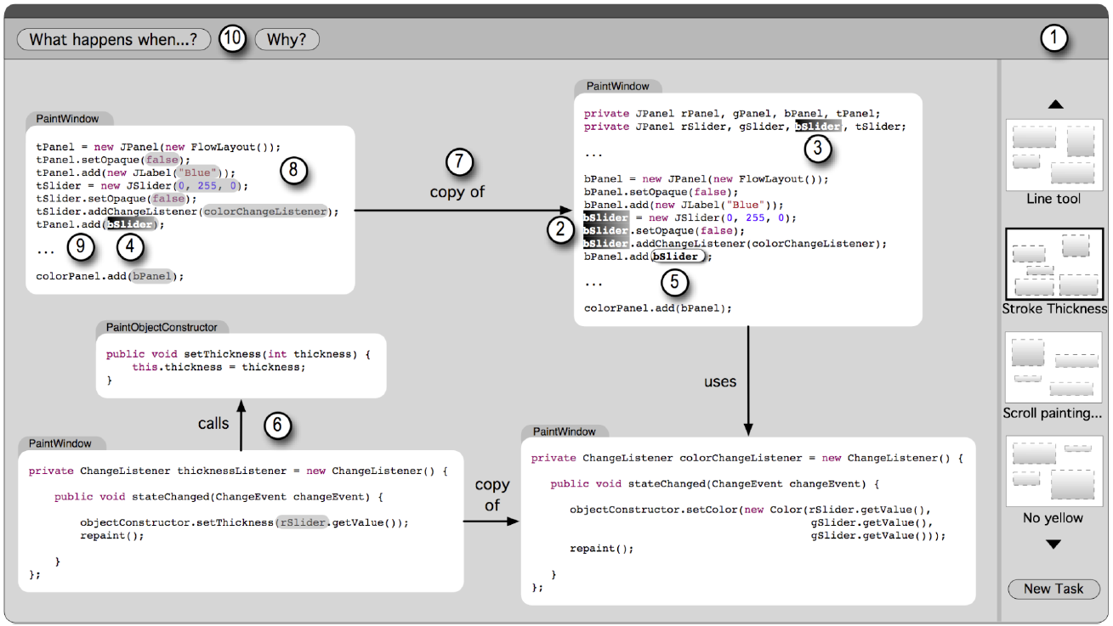
Discussion: Design That Satisfies Reqs
Figure 10 from the paper
Notes:
Fragments instead of files
Sets of working sets (1)
Supporting reading (2-5)
Visualizing dependencies (6-9)
Context in-place (press meta key to see code surrounding fragments)
Working sets from questions (10)

Slide 13
Conclusion
Empirical findings
3 key activities
Excessive time wasted
IDE requirements/design
The End – Thank You!

