Slide 1
Software Design and Design Patterns
Notes:
St. Paul's Cathedral, London
Photo by Scott Fleming

Slide 2
Software Maintenance and Evolution
Defn: Post-deployment development activities
Change software while preserving integrity
Maintenance older (waterfall) term
Evolution newer (agile) term
Categories of maintenance
Correction (corrective, preventative)
Enhancement (perfective, adaptive)
Why important?
Software tends to be long lived
Requirements change, environments change, bugs appear
Statistic: > 80% of total cost in maintenance 😲

Slide 3
Maintainability and Software Design
Maintainability includes
Modularity
Understandability
Changeability
Reusability
Transferability
Designing maintainable software is challenging!

Slide 4
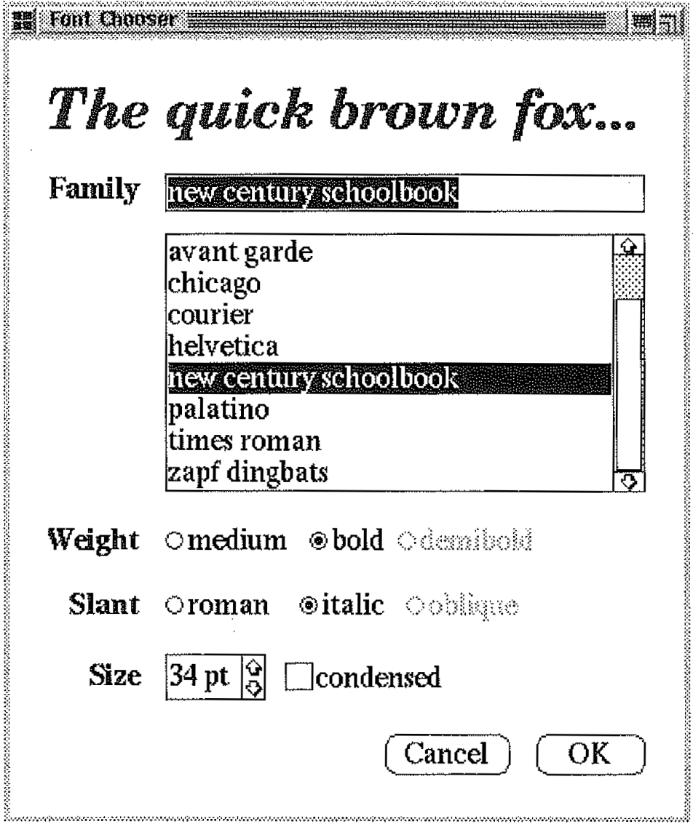
Motivating Example: Font Chooser Dialog

Slide 5
Consider Objects
Label
Entry Field
List Box
Bullet List
Bullet List
Check Box
Spinner
Button
Button

Slide 6
Consider Objects
Label
Each object extends base type to get specialized behavior
Modular design good for reusability
But consider interconnections...
Entry Field
List Box
Bullet List
Bullet List
Spinner
Check Box
Button
Button

Slide 7
When User Interacts with One Widget, Others Must Update
Label
Entry Field
List Box
Bullet List
Bullet List
Spinner
Check Box
Button
Button

Slide 8
When User Interacts with One Widget, Others Must Update
Label
Entry Field
List Box
Bullet List
Bullet List
Spinner
Check Box
Button
Button

Slide 9
When User Interacts with One Widget, Others Must Update
Label
Entry Field
List Box
Bullet List
Bullet List
Spinner
Check Box
Button
Button

Slide 10
When User Interacts with One Widget, Others Must Update
Label
Entry Field
List Box
Bullet List
Bullet List
Spinner
Check Box
Button
Button

Slide 11
What a Mess!
Label
Poor understandability
Poor changeability
Poor reusability
Entry Field
List Box
Bullet List
Bullet List
Spinner
Check Box
Button
Button
Notes:
Difficult to understand interaction behavior of widgets.
Code implementing interaction behavior spread across objects, making changes difficult (e.g., easy to miss relevant code).
(Partial) knowledge of this particular collaboration encoded into each object, making it difficult to reuse objects.

Slide 12
Design Patterns
Template solutions to common problems
Cupola
Oculus
Pediment
Cornice
Columns
Portico

Slide 13
Benefits
Promote quality
Reusability, maintainability, etc.
Avoid re-inventing solutions
Facilitate communication

Slide 14
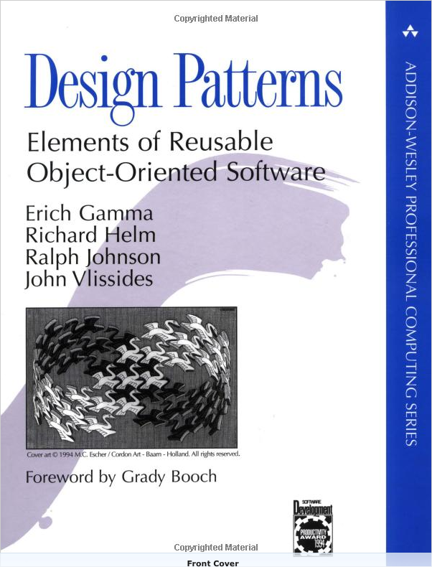
Popularized by the “Gang of Four” Book (GoF)
Catalog of 23 patterns
Many now ubiquitous
Must-read for pro devs

Slide 15
How can design patterns help?
Label
Entry Field
List Box
Bullet List
Bullet List
Spinner
Check Box
Button
Button
Notes:
Difficult to understand interaction behavior of widgets.
Code implementing interaction behavior spread across objects, making changes difficult (e.g., easy to miss relevant code).
(Partial) knowledge of this particular collaboration encoded into each object, making it difficult to reuse objects.

Slide 16
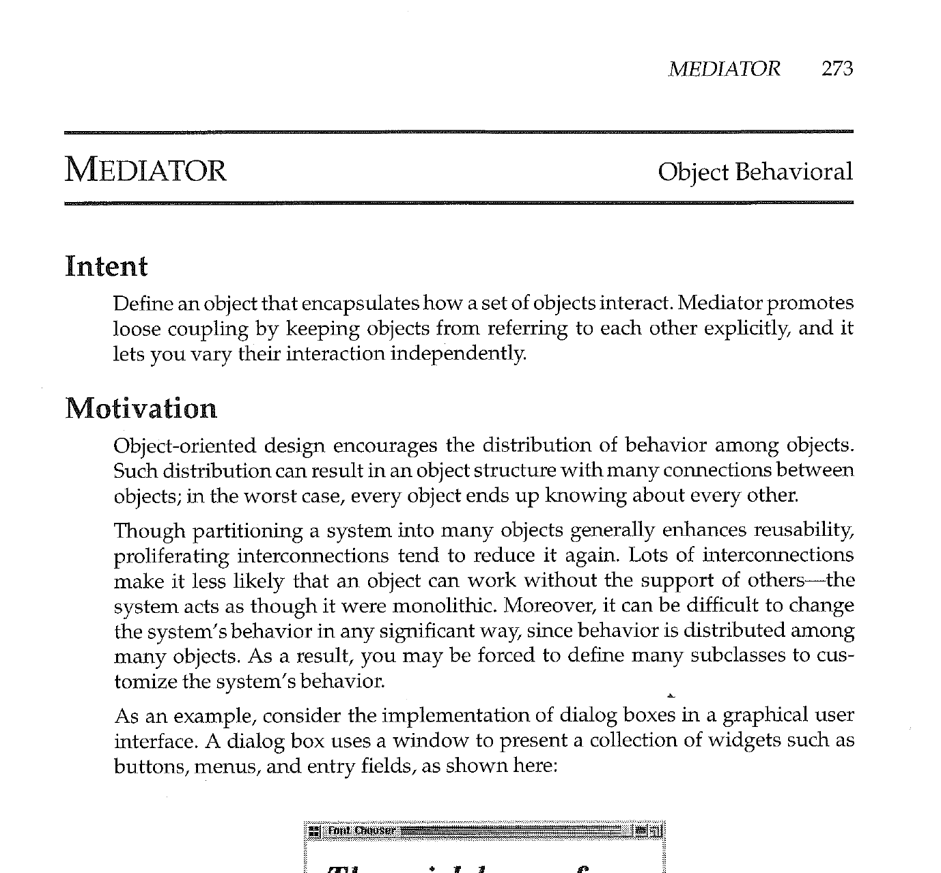
Mediator Pattern

Slide 17
Elements of a Design Pattern in GoF
Intent
Also Known As
Motivation
Applicability
Structure
Participants
Collaborations
Consequences
Implementation
Sample Code
Known Uses
Related Patterns
Mediator Pattern covers in 10 pages

Slide 18
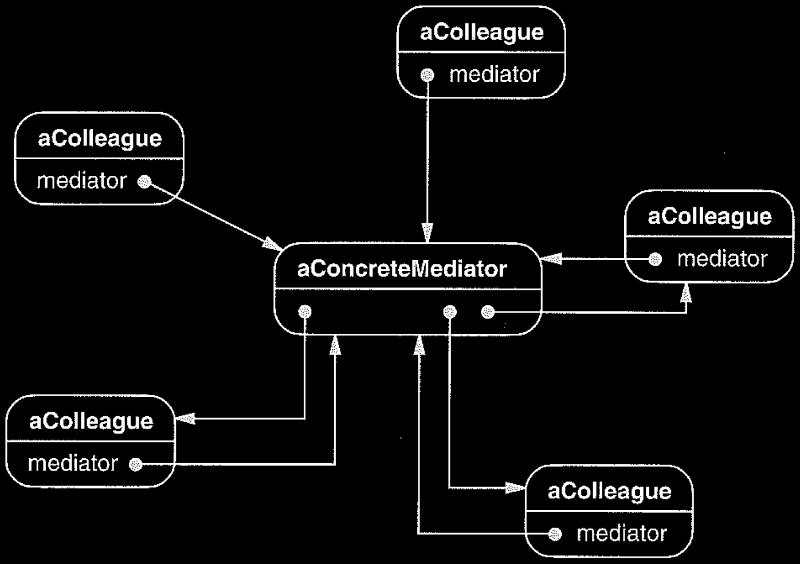
Mediator Structure
Class Diagram
Object Diagram

Slide 19
Applying Mediator to Font Dialog
: FontSampleLabel
: FontFamilyEntryField
: FontFamilyListBox
: FontDialogMediator
: FontWeightBulletList
: FontSlantBulletList
: FontSizeSpinner
:CancelButton
: OkButton
: CondesedFontCheckBox
Notes:
Interaction behavior of widgets now the responsibility of a single class.
Easier to understand and change because interaction behavior code is all in one place.
Reusability is improved because widgets don't need to know about each other – just tell the mediator when they've changed. Thus, widget could also be used with a different mediator that manages a different set of interacting widgets.

Slide 20
What was the essential problem here?
Label
Entry Field
List Box
Bullet List
Bullet List
Spinner
Check Box
Button
Button
Notes:
Difficult to understand interaction behavior of widgets.
Code implementing interaction behavior spread across objects, making changes difficult (e.g., easy to miss relevant code).
(Partial) knowledge of this particular collaboration encoded into each object, making it difficult to reuse objects.

Slide 21
Coupling
Measure of how strongly one component...
is connected to others
has knowledge of others
depends on others
Compare loosely versus tightly coupled components
Looser Coupling
Tighter Coupling
Notes:
An object depends on another object if, when one object changes, the other might be forced to change in turn.

Slide 22
Although metrics have been proposed, coupling remains difficult to precisely measure However, intuition about coupling is useful for informing design decisions
Looser Coupling
Tighter Coupling

Slide 23
Common Types of Coupling in Ruby
Class C₁ is coupled to class C₂ if
C₁ has instance variable that refers to C₂
C₁ invokes methods of C₂
C₁ method parameter or local variable references C₂
C₁ is direct or indirect subclass of C₂
Caution! Coupling can also occur in less obvious ways (e.g., one component having encoded knowledge of others)

Slide 24
Problems with High Coupling
Given class C₁ highly coupled to class C₂ :
Changes in C₂ may force changes in C₁
Harder to understand C₁ in isolation
Harder to reuse C₁ because of dependencies on C₂

Slide 25
Coupling Explains Benefits of Mediator
Tighter Coupling
Looser Coupling

Slide 26
How Does Mediator Do It? Indirection
To decouple two components, assign responsibility to an intermediate component to mediate between the two
Intermediary creates indirection

Slide 27
Let's see another GoF pattern

Slide 28
Design Problem: Email Notifications
?
OrdersController
...
create()
…
EmailNotifier
...
order_notification()
...

Slide 29
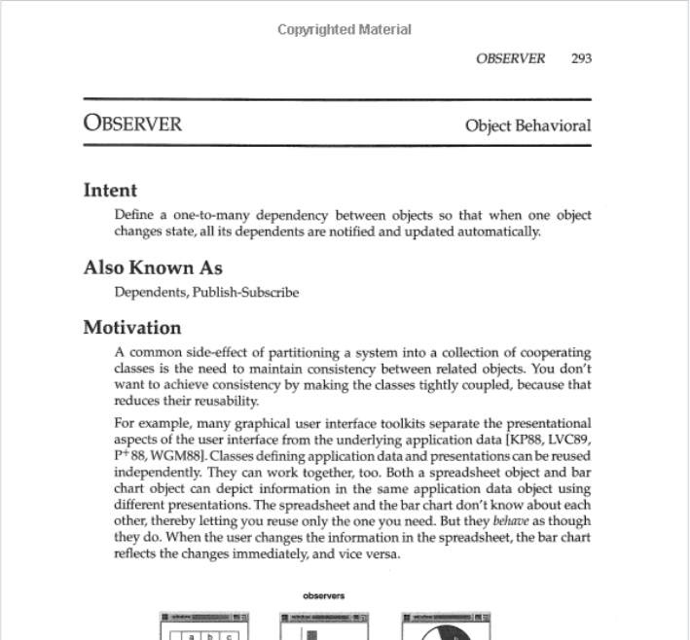
Observer Pattern
From Gamma et al. Design Patterns: Elements of Reusable Object-Oriented Software

Slide 30
Observer Pattern Structure
From Gamma et al. Design Patterns: Elements of Reusable Object-Oriented Software
Notes:
GoF uses an outdated version of class diagram notation from OMT (https://en.wikipedia.org/wiki/Object-modeling_technique).

Slide 31
Side Note: Lots of (Minor) Variations Exist for Design Patterns

Slide 32
OODesign.com Variant
http://www.oodesign.com/observer-pattern.html
Notes:
Subject -> Observable
No association b/t ConcreteObserver and ConcreteObservable

Slide 33
Refactoring.Guru Variant
https://refactoring.guru/design-patterns/observer
Notes:
Subject -> Publisher
Observer -> Subscriber
Array of subscribers
update now takes publisher as argument

Slide 34
Wikipedia Variant #1
Actually very similar to the GoF version
https://en.wikipedia.org/wiki/Observer_pattern

Slide 35
Wikipedia Variant #2
https://en.wikipedia.org/wiki/Observer_pattern
Notes:
Nothing about ConcreteSubject
Attach/Detach -> register/unregister

Slide 36
Application of Observer Pattern

Slide 37
Application of Observer Pattern
OrdersController
...
create()
…
EmailNotifier
...
order_notification()
...

Slide 38
Application of Observer Pattern
Subject
...
attach(observer)
detach(observer)
notify()
OrdersController
...
create()
…
EmailNotifier
...
order_notification()
...

Slide 39
Application of Observer Pattern
Subject
...
attach(observer)
detach(observer)
notify()
OrdersController
...
create()
…
EmailNotifier
...
order_notification()
...

Slide 40
Application of Observer Pattern
Subject
...
attach(observer)
detach(observer)
notify()
Observer
update()
OrdersController
...
create()
…
EmailNotifier
...
order_notification()
...

Slide 41
Application of Observer Pattern
Subject
...
attach(observer)
detach(observer)
notify()
Observer
update()
OrdersController
...
create()
…
EmailNotifier
...
order_notification()
...

Slide 42
Application of Observer Pattern
Subject
...
attach(observer)
detach(observer)
notify()
Observer
update()
OrdersController
...
create()
…
EmailNotifier
...
order_notification()
update()
...

Slide 43
Application of Observer Pattern
Subject
...
attach(observer)
detach(observer)
notify()
*
observer
Observer
update()
OrdersController
...
create()
…
EmailNotifier
...
order_notification()
update()
...

Slide 44
Application of Observer Pattern
Subject
...
attach(observer)
detach(observer)
notify()
*
observer
Observer
update()
OrdersController
...
create()
…
EmailNotifier
...
order_notification()
update()
...
subject

Slide 45
Application of Observer Pattern
Subject
...
attach(observer)
detach(observer)
notify()
*
observer
Observer
update()
OrdersController
...
create()
…
EmailNotifier
...
order_notification()
update()
...
subject

Slide 46
Scenario: Create Order and Send Email
: OrdersController
: EmailNotifier
create()
<<create>>
: Order
save()
Saved to DB
notify()
update()
order_notification()
Email Sent

Slide 47
Common Uses of Observer Pattern
GUI programs
Used to respond to user input (e.g., button presses)
Sometimes referred to as callback
Server software
Used to listen for/respond to requests (e.g., HTTP requests)

Slide 48
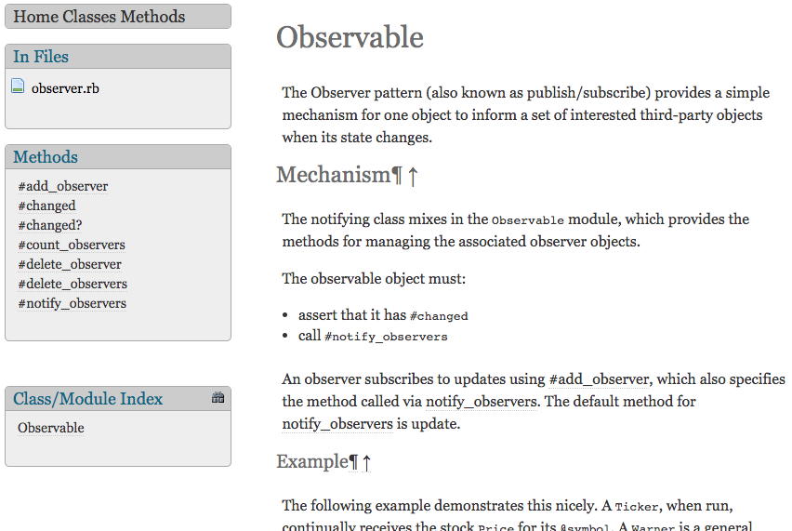
Observer Support in Ruby Std-lib
https://ruby-doc.org/stdlib-2.6.3/libdoc/observer/rdoc/Observable.html

Slide 49
Summary
Design Patterns – what and why
GoF Book
Mediator Pattern
Coupling
Indirection
Observer Pattern
http://flic.kr/p/aCLor3

