Slide 1
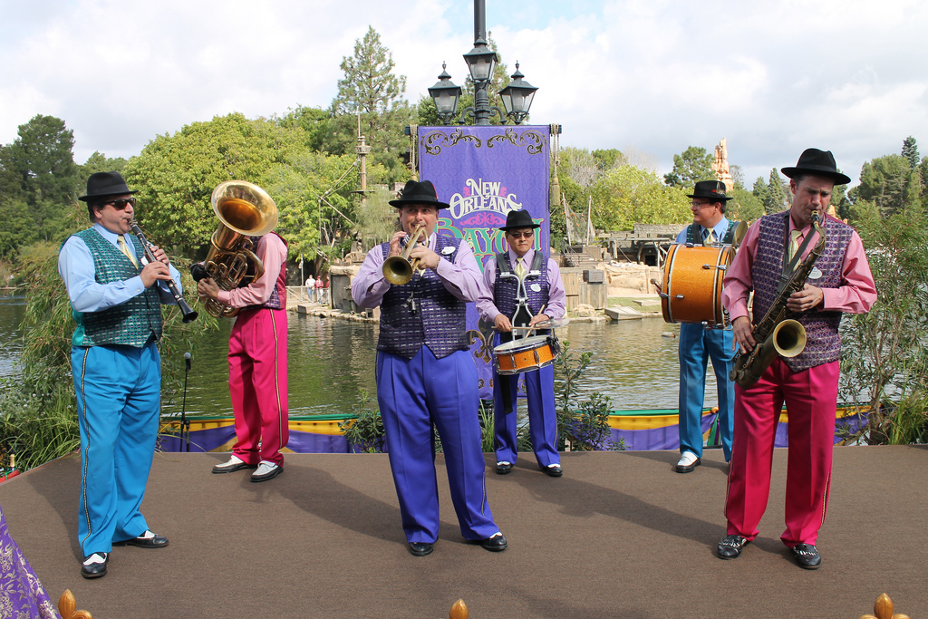
http://flic.kr/p/btp5ZK
MVC and Rails

Slide 2
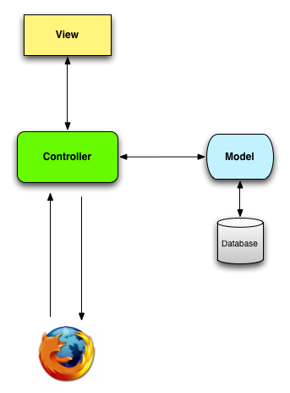
Model-View-Controller (MVC) Architectural Pattern
Server
Timeout!
What kind of diagram is this?
Ye Olde Internet

Slide 3
Data Flow Diagrams
Server
components
flows
Ye Olde Internet

Slide 4
Model-View-Controller (MVC) Architectural Pattern
Server
Timeout!
What do we mean by “architectural”?
Ye Olde Internet

Slide 5
Two levels of software design
Architectural design: High-level structure of software system
Detailed design: Low-level design of individual components/modules/classes

Slide 6
Model-View-Controller (MVC) Architectural Pattern
Server
Being “architectural”, these components may contain many subcomponents (classes, etc.)
Ye Olde Internet

Slide 7
MVC Component Responsibilities
Server
Ye Olde Internet

Slide 8
Responsibility-Driven Design
Frames object design as deciding
How to assign responsibilities to objects
How objects should collaborate
What role each object should play in a collaboration
http://flic.kr/p/btp5ZK

Slide 9
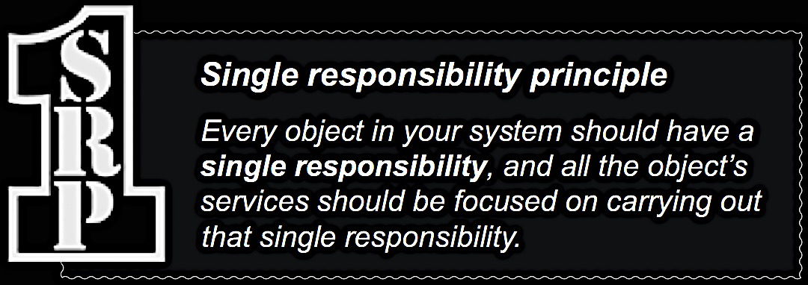

Slide 10
MVC Component Responsibilities
Server
View: Responsible for UI (generating HTML)
Ye Olde Internet

Slide 11
MVC Component Responsibilities
Server
View: Responsible for UI (generating HTML)
Ye Olde Internet
Model: Business logic, domain objects

Slide 12
MVC Component Responsibilities
Server
View: Responsible for UI (generating HTML)
Controller: Translates UI actions into operations on domain objects
Ye Olde Internet
Model: Business logic, domain objects

Slide 13
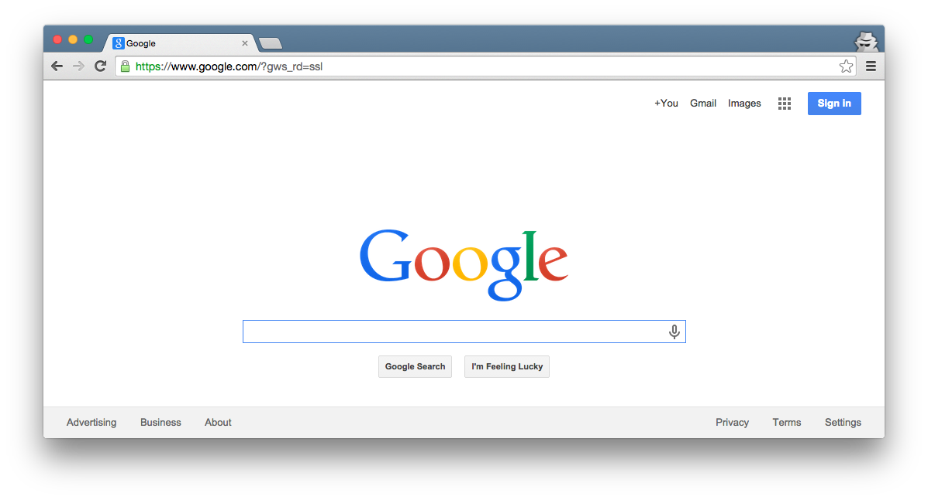
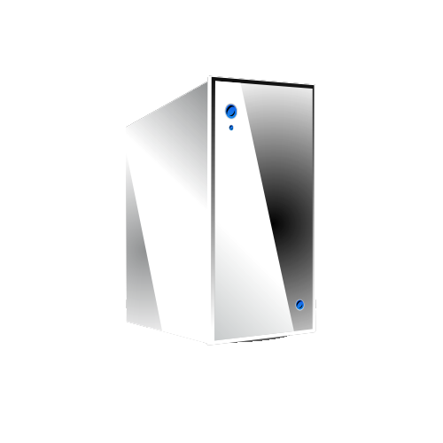
Rails MVC – Fill in the blanks!
Browser
Ye Olde Internet
DB
Server
???
???
???
???

Slide 14
Rails MVC – Fill in the blanks!
Browser
Ye Olde Internet
DB
Server
View
Router
Controller
Model

Slide 15
Browser
Router: Translates HTTP request into call to controller method
Ye Olde Internet
DB
Server
View
Router
Controller
Model

Slide 16
Browser
Programming a Rails web app mainly involves customizing the Router, Model, View, and Controller components
Ye Olde Internet
DB
Server
View
Router
Controller
Model

Slide 17
Browser
Customize Ruby classes
Ye Olde Internet
DB
Server
View
Router
Controller
Model

Slide 18
Browser
Customize Ruby block
Ye Olde Internet
DB
Server
View
Router
Controller
Model

Slide 19
Browser
Customize ERB (Embedded Ruby) files
Ye Olde Internet
DB
Server
View
Router
Controller
Model

Slide 20
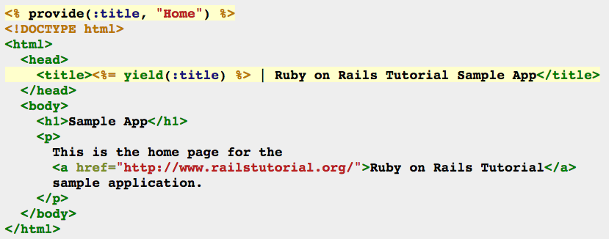
Example ERB: HTML with embedded Ruby code
<%= … %> executes embedded code and prints return value before printing subsequent HTML code
<% … %> executes embedded code before printing subsequent HTML code

Slide 21
Lots More in the Demos & Deets!

Slide 22
Summary
MVC Architectural Pattern
Dataflow Diagrams
Responsibility-Driven Design and SRP
Rails MVC Architecture
http://flic.kr/p/aCLor3

