Slide 1
Design Patterns Part 2: Builder & Memento

Slide 2
Last time
Observer:
Keeping up with the times
Singleton:
Making sure there is only one
Adapter:
Filling the gaps

Slide 3
Today’s Objectives: Two more patterns
Builder
Memento

Slide 4
Running Example: Tiger Dining

Slide 5
Recall: Adapter Pattern Solution to Support Multiple Payment Methods

Slide 6
Goal: To add additional payment methods
PaymentsController
new
create
…
DiningDollars
charge(uid)
…

Slide 7
Solution: Adapter
Interface which bridge a gap in payment methods
Key objects are Target, Adapter and Adaptee
Client
Target
request()
Adapter
request()
Adaptee
specificrequest()

Slide 8
PaymentsController
PaymentProcessor
process_payment()
…
DiningDollarsAdapter
process_payment()
VisaPayAdapter
process_payment()
DiningDollars
charge(uid)
VisaPay
pay(debitcard, cvv, exp)

Slide 9
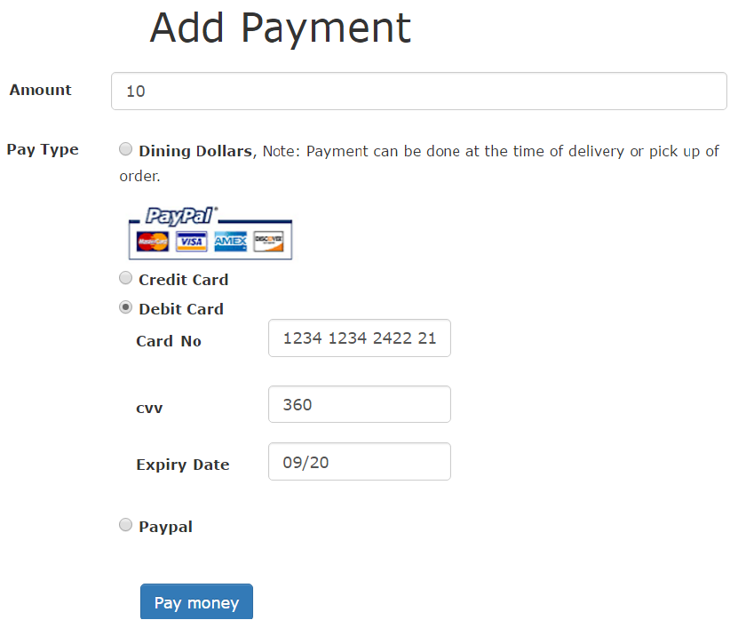

Slide 10
Control Flow
PaymentsController
create

Slide 11
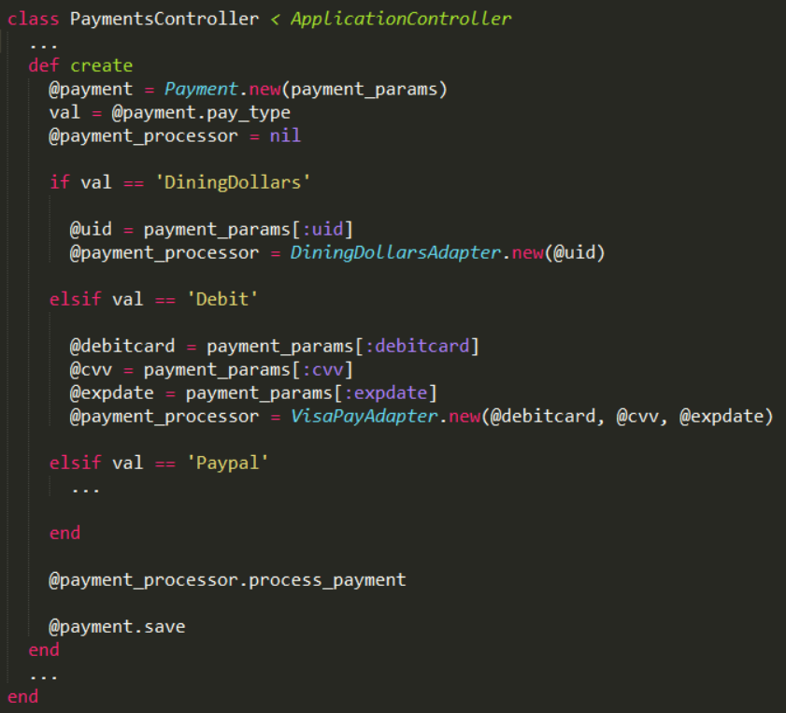

Slide 15
Control Flow
PaymentsController
create
new
vpa:VisaPayAdapter

Slide 18
Control Flow
PaymentsController
create
new
vpa:VisaPayAdapter
new
vp:VisaPay

Slide 20
Control Flow
PaymentsController
create
new
vpa:VisaPayAdapter
new
vp:VisaPay
process_payment

Slide 23
Control Flow
PaymentsController
create
new
vpa:VisaPayAdapter
new
vp:VisaPay
process_payment
pay
Visa processes the payment

Slide 24
Yuck!

Slide 25
Design problem:
Clean up payment initialization

Slide 26
Solution: Separate construction code
Needs to separate construction of a complex object
Same construction interface creates different representation

Slide 27
Solution: Builder
Director
construct()
Builder
build()
ConcreteBuilder
build()
Product

Slide 28
PaymentsController
create()
PaymentProcessorBuilder
build(params)
…
DiningDollarsAdapterBuilder
build(params)
VisaPayAdapterBuilder
build(params)
DiningDollarsAdapter
VisaPayAdapter

Slide 29
Goal: Implement Builder pattern
Step 1: Create Builder Classes
Step 2: Move constructor code out of controller inside build
Step 3: instantiate build class inside construct

Slide 30
Goal: Implement Builder pattern
Step 1: Create Builder Classes
Step 2: Move constructor code out of controller inside build
Step 3: instantiate build class inside construct

Slide 32
Goal: Implement Builder pattern
Step 1: Create Builder Classes
Step 2: Move constructor code out of controller inside build
Step 3: instantiate build class inside construct

Slide 36
Goal: Implement Builder pattern
Step 1: Create Builder Classes
Step 2: Move constructor code out of controller inside build
Step 3: instantiate build class inside construct

Slide 38
Control Flow
: PaymentsController
create
new
vpab:VisaPayAdapterBuilder
build

Slide 39
Control Flow
: PaymentsController
create
new
vpab:VisaPayAdapterBuilder
build
new
vpa:VisaPayAdapter
process_payment

Slide 40
Design problem:
Delete from cart and Undo

Slide 42
Cannot retrieve back

Slide 43
OrdersController
new
create
…
destroy

Slide 44
Solution: Memento
Needs to store the state of the order
Originator
state …
create_memento(): Memento
set_memento(memento)
Memento
state …
getters and setters …
Caretaker

Slide 45
Originator
state …
create_memento(): Memento
set_memento(memento)
Memento
state …
getters and setters …
Caretaker
Order
…
create_memento
set_memento(version)
OrderMemento
order …
initialize
OrderMementoCaretaker

Slide 46
Control Flow: destroy
: OrdersController
destroy

Slide 47
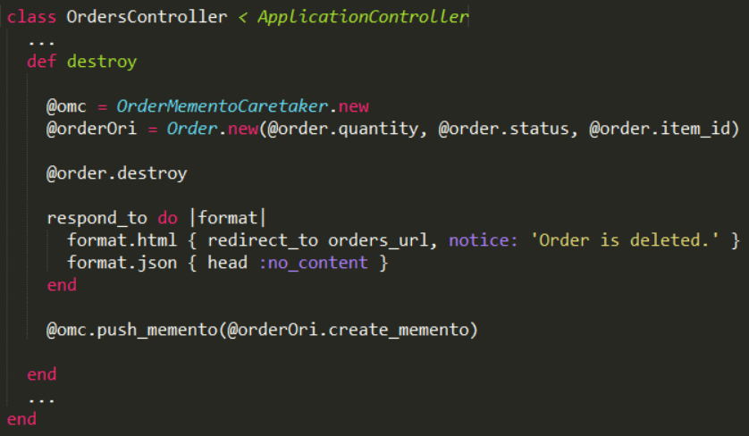
Goal: Implement Memento pattern

Slide 48
Control Flow: destroy
: OrdersController
destroy
omc: OrderMementoCaretaker
or: Order

Slide 49
Goal: Implement Memento pattern

Slide 50
Goal: Implement Memento pattern

Slide 51
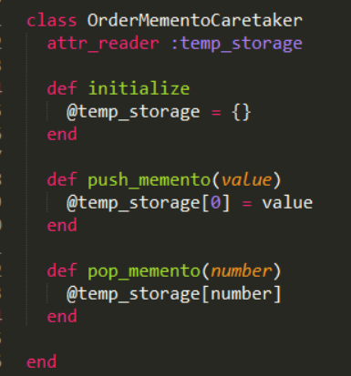
Goal: Implement Memento pattern

Slide 52
Control Flow: destroy
: OrdersController
destroy
omc: OrderMemento
Caretaker
new
new
or: Order
destroy

Slide 53
Goal: Implement Memento pattern

Slide 54
Goal: Implement Memento pattern

Slide 55
Control Flow: destroy
: OrdersController
destroy
omc: OrderMemento
Caretaker
new
new
or: Order
destroy
create_memento
new
om:OrderMemento

Slide 56
Goal: Implement Memento pattern

Slide 57
Goal: Implement Memento pattern

Slide 59
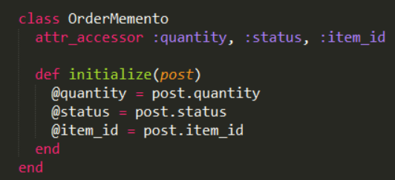
Goal: Implement Memento pattern

Slide 60
Control Flow: destroy
: OrdersController
destroy
omc: OrderMemento
Caretaker
new
new
or: Order
destroy
create_memento
new
om:OrderMemento
push_memento

Slide 61
Goal: Implement Memento pattern

Slide 62
Goal: Implement Memento pattern

Slide 63
Control Flow: undo
: OrdersController
undo
omc: OrderMemento
Caretaker
new
or: Order
pop_memento
set_memento
new
om:OrderMemento
save

Slide 64
Goal: Implement memento pattern
Order
“create_memento” and “set_memento”
OrderMemento
initialize
OrderMementoCaretaker
“push_memento” and “pop_memento”

Slide 65
Memento : Examples
Editor (Notepad, Sublime, Notepad++)
Provides features of undo and redo

Slide 66
For more design patterns, see the “Gang of Four” book (GoF)

