Slide 1
Design Patterns Part 1 Observer, Singleton, & Adapter
Notes:
St. Paul's Cathedral, London
Photo by Scott Fleming

Slide 2
Design Patterns
Template solutions to common problems
Cupola
Oculus
Pediment
Cornice
Columns
Portico

Slide 3
Benefits
Avoid re-inventing solutions
Promotes quality
Reusability, maintainability, etc.
Facilitate communication

Slide 4
This Lecture
Design patterns: what & why
When and how to apply
Several popular patterns:
Observer
Singleton
Adapter

Slide 5
Running Example: Tiger Dining
I'm hungry!
https://flic.kr/p/X6PBUC

Slide 6
Tiger Dining Web App

Slide 8
Design Problem 1: Email Notifications

Slide 9
Chef’s View of Orders
Problem: Send email notifications as orders arrive
Notes:
When orders are placed they show up in the system like this.
Problem: The chef (and others) would like to receive email notifications to let them know when a new order has been placed. That way, they won't have to be constantly monitoring this webpage.

Slide 10
Existing Class: Subscribers List
Notes:
The system already has a subscription list of users who should receive email notifications (as shown in the picture).

Slide 11
Existing Classes
?
OrdersController
...
create()
…
EmailNotifier
...
order_notification()
...

Slide 12
Solution: Observer Pattern
From Gamma et al. Design Patterns: Elements of Reusable Object-Oriented Software
Notes:
Needs to add an observer for the food order activity
Define one-to-many dependency

Slide 13
Side Note: Lots of (Minor) Variations Exist for Design Patterns

Slide 14
OODesign.com Variant
http://www.oodesign.com/observer-pattern.html

Slide 15
Refactoring.Guru Variant
https://refactoring.guru/design-patterns/observer

Slide 16
Wikipedia Variant #1
Actually very similar to the GoF version
https://en.wikipedia.org/wiki/Observer_pattern

Slide 17
Wikipedia Variant #2
https://en.wikipedia.org/wiki/Observer_pattern

Slide 18
Application of Observer Pattern

Slide 19
Application of Observer Pattern
OrdersController
...
create()
…
EmailNotifier
...
order_notification()
...

Slide 20
Application of Observer Pattern
Subject
...
attach(observer)
detach(observer)
notify()
OrdersController
...
create()
…
EmailNotifier
...
order_notification()
...

Slide 21
Application of Observer Pattern
Subject
...
attach(observer)
detach(observer)
notify()
OrdersController
...
create()
…
EmailNotifier
...
order_notification()
...

Slide 22
Application of Observer Pattern
Subject
...
attach(observer)
detach(observer)
notify()
Observer
update()
OrdersController
...
create()
…
EmailNotifier
...
order_notification()
...

Slide 23
Application of Observer Pattern
Subject
...
attach(observer)
detach(observer)
notify()
Observer
update()
OrdersController
...
create()
…
EmailNotifier
...
order_notification()
...

Slide 24
Application of Observer Pattern
Subject
...
attach(observer)
detach(observer)
notify()
Observer
update()
OrdersController
...
create()
…
EmailNotifier
...
order_notification()
update()
...

Slide 25
Application of Observer Pattern
Subject
...
attach(observer)
detach(observer)
notify()
*
observer
Observer
update()
OrdersController
...
create()
…
EmailNotifier
...
order_notification()
update()
...

Slide 26
Application of Observer Pattern
Subject
...
attach(observer)
detach(observer)
notify()
*
observer
Observer
update()
OrdersController
...
create()
…
EmailNotifier
...
order_notification()
update()
...
subject

Slide 27
Application of Observer Pattern
Subject
...
attach(observer)
detach(observer)
notify()
*
observer
Observer
update()
OrdersController
...
create()
…
EmailNotifier
...
order_notification()
update()
...
subject

Slide 28
Scenario: Create Order and Send Email
: OrdersController
: EmailNotifier
create()
<<create>>
: Order
save()
Saved to DB
notify_observers()
update()
Email Sent

Slide 29
How to Apply Observer Pattern
Modify OrdersController (Subject)
include Observable
Add observer using add_observer()
After saving order, call notify_observers()
Modify EmailNotifier (Observer)
Add update method that xxx
Notes:
Add code snippet

Slide 30
Example OrdersController
...
...

Slide 31
Example EmailNotifier

Slide 32
Goal: Implement Observer pattern
Notes:
** ExampleMailer is a goofy name, and this is not consistent with the class diagram.
** Probably should show Notification class in class diagrams
** Emailer gem would be good know about here

Slide 33
Other Examples
Spreadsheet
Employee payroll
GUI program (callback)

Slide 34
Design problem:
Sales Logging

Slide 35
Problem
Saves records of transactions as backup
Sales logging for transaction failure

Slide 36
Existing Class
SalesLogger
initialize(file)
formatter
log(message)

Slide 37
Solution: Singleton Pattern
From Gamma et al. Design Patterns: Elements of Reusable Object-Oriented Software

Slide 38
Application of Singleton Pattern
SalesLogger
inst : SalesLogger
initialize(file)
formatter
log(message)
instance() : SalesLogger
**Static Association???

Slide 39
Solution: Singleton
Single file to log all the sales information
Easy to look up
Singleton
inst: Singleton
instance(): Singleton
…
if inst == nil
inst = Singleton.new
end
return inst

Slide 40
Making class Singleton
Steps of making a class Singleton:
Creating the class variable
@@instance
Initializing it with the single instance
@@instance = SimpleLogger.new
Creating the class level instance method
Making new private

Slide 41
Goal: Implement Singleton pattern
SalesLogger class
include “Singleton”
SalesController
call instance
call log(message)

Slide 42
Goal: Implement Singleton pattern
Notes:
** This example is a mess

Slide 43
Singleton Examples
In Rails:
development.log
test.log
Webrick in rake
Outside Rails:
tomcat
ant

Slide 44
Design problem:
New Payment method

Slide 45
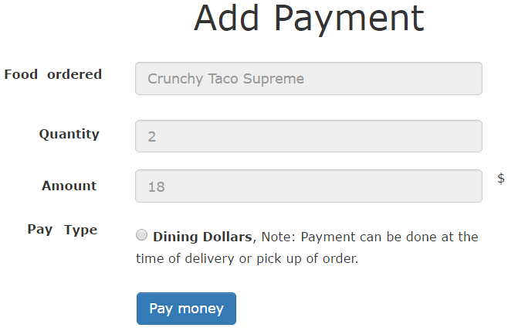
Goal: To Add Visa Debit Card and Paypal

Slide 46
Goal: To add VisaPay
PaymentsController
new
create
…
DiningDollars
charge(uid)
…

Slide 47
Solution: Adapter
Interface which bridge a gap in payment methods
Key objects are Target, Adapter and Adaptee
Client
Target
Request()
Adapter
Request()
Adaptee
SpecificRequest()

Slide 48
PaymentsController
PaymentProcessor
process_payment()
DiningDollarsAdapter
process_payment()
VisaPayAdapter
process_payment()
…
…
DiningDollars
charge(uid)
VisaPay
pay(debitcard, cvv, exp)
…
…

Slide 49
Control Flow
PaymentsController
VisaPayAdapter
VisaPay
create
process_payment
pay
Visa processes the payment

Slide 50
Goal: Implement Adapter Pattern
PaymentsController
“create” method call the adapter based on the input type
VisaPayAdapter
defines “process_payments” inherited from the PaymentProcessor
VisaPay
defines pay(creditcard, cvv, exp) saves the information

Slide 51
Adapter: Example in Rails
Active Records
Contains adapters for several databases (PostgreSQL or MySQL)
Wraps them up in common interface
AbstractAdapter implements common functionality
PostgreSQLAdapter
AbstractMysqlAdapter

Slide 52
Summary
Singleton:
Making Sure There Is Only one
Observer:
Keeping Up with the Times
Adapter:
Filling the gaps

