Slide 1

https://flic.kr/p/9AWLK
White-Box Testing

Slide 2
Recall: Common ways to choose test cases
Black-box testing
White-box testing
Regression testing

Slide 3
White-Box Testing
Uses internal logic to choose tests
Different levels of code coverage
  Example: Cover all statements
Aka glass box testing, clear box testing

Slide 4
Code Coverage
Degree to which source code of a program is tested by a test suite
Examples:
  Statement coverage
  Branch coverage
  Path coverage
To compute these, you need…
Notes:
There are more types of coverages

Slide 5
Control Flow Graph (CFG)
Represents possible control paths through code:
Given some code:
def create
@profile = profile.new(params)
if @profile.save
redirect_to show_prof_url(@profile)
else
render ‘new’
end
end

Slide 6
How to construct a CFG
Step 1: Identify basic blocks
  Straight-line pieces of code without any jumps or jump targets
def create
@profile = profile.new(params)
if @profile.save
redirect_to show_prof_url(@profile)
else
render ‘new’
end
end
}

Slide 7
How to construct a CFG
Step 2: Model the jumps (control branches) as directed lines
@profile = profile.new(params)
if @profile.save
true
false
redirect_to show_prof_url(@profile)
else
render ‘new’
end

Slide 8
How to construct a CFG
Step 3: Model entry and exit (return) points
@profile = profile.new(params)
if @profile.save
true
false
redirect_to show_prof_url(@profile)
else
render ‘new’
end

Slide 9
How to construct a CFG
Now you have a CFG!
@profile = profile.new(params)
if @profile.save
true
false
redirect_to show_prof_url(@profile)
else
render ‘new’
end

Slide 10
Code Coverage Levels
Statement coverage
Branch coverage
Path coverage

Slide 11
Statement Coverage
Set of test cases such that…
Each program statement (line or basic block) is executed at least once

Slide 12
Define a test suite that provides statement coverage
def foo(x, y)
@z = 0
if x > 0 && y > 0
@z = x
end
return @z
end
@z = 0
if x > 0 && y > 0
@z = x
return @z
true
false
input |  | expected
x | y

Slide 13
Define a test suite that provides statement coverage
def foo(x, y)
@z = 0
if x > 0 && y > 0
@z = x
end
return @z
end
@z = 0
if x > 0 && y > 0
@z = x
return @z
✔
true
✔
false
input |  | expected
x | y
✔
1 1 1

Slide 14
Code Coverage Levels
Statement coverage
Branch coverage
Path coverage

Slide 15
Branch Coverage
Set of test cases such that…
Each boolean expression (in control structures) evaluates to true at least once and to false at least once

Slide 16
Define a test suite that provides branch coverage
def foo(x, y)
@z = 0
if x > 0 && y > 0
@z = x
end
return @z
end
@z = 0
if x > 0 && y > 0
@z = x
return @z
true
false
input |  | expected
x | y

Slide 17
Define a test suite that provides branch coverage
def foo(x, y)
@z = 0
if x > 0 && y > 0
@z = x
end
return @z
end
@z = 0
if x > 0 && y > 0
@z = x
return @z
✔
true
✔
false
input |  | expected
x | y
1 1 1
0 0 0

Slide 18
Code Coverage Levels
Statement coverage
Branch coverage
Path coverage

Slide 19
Path Coverage
Set of test cases such that…
Each possible path through a program’s control flow graph is taken at least once

Slide 20
Define a test suite that provides path coverage
def foo(x, y)
@z = 0
if x > 0 && y > 0
@z = x
end
return @z
end
@z = 0
if x > 0 && y > 0
@z = x
return @z
true
(a)
(c)
false
input |  | expected
x | y
(b)

Slide 21
Define a test suite that provides path coverage
def foo(x, y)
@z = 0
if x > 0 && y > 0
@z = x
end
return @z
end
@z = 0
if x > 0 && y > 0
@z = x
return @z
true
(a)
(c)
false
input |  | expected
x | y
(b)
1 1 1
Paths:
a, b
c
0 0 0
✔
✔

Slide 22
Coverage Support Tools
SimpleCov Ruby Gem

Slide 23
Coverage Support Tools
SimpleCov Ruby Gem

Slide 24
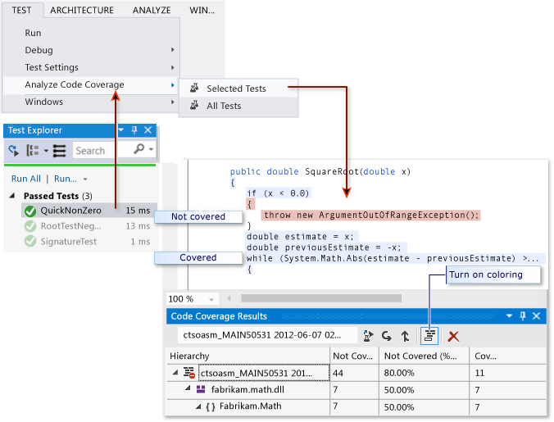
Coverage Support Tools
Visual Studio
https://msdn.microsoft.com/en-us/library/dd537628.aspx

Slide 25
Recap
White-box testing
Control Flow Graph (CFG)
Code Coverage
  Statement
  Branch
  Path

