Slide 1
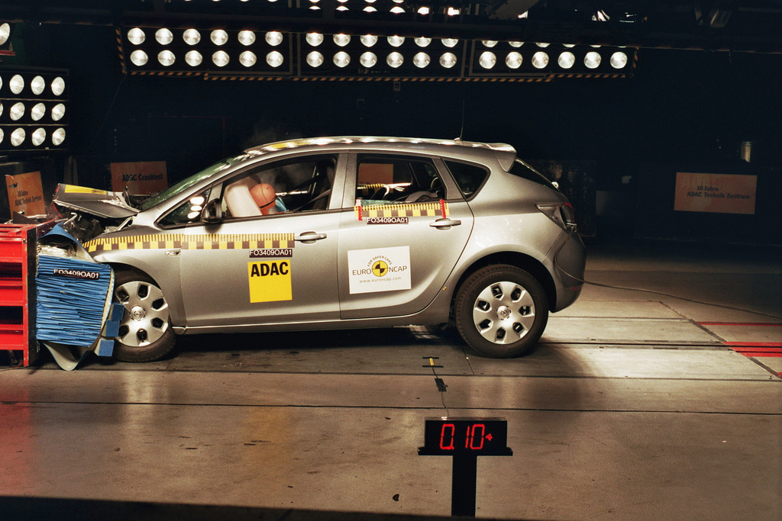
http://flic.kr/p/7iffKj
Software Testing

Slide 2
SWEBOK Knowledge Areas
Software Requirements
Software Design
Software Construction
Software Testing
Software Maintenance
Software Configuration Management
Software Engineering Management
Software Engineering Process
Software Engineering Models and Methods
Software Quality
Software Engineering Professional Practice
Software Engineering Economics
Computing Foundations
Mathematical Foundations
Engineering Foundations
Today’s topic

Slide 3
Can you create bug-free software?
Notes:
In real software, there are hundred of lines so it is very difficult to create a program that is 100% bug free.

Slide 4
Can you create bug-free software?
For practical purposes, no!
Goal: Reduce the number of bugs
Notes:
In real software, there are hundred of lines so it is very difficult to create a program that is 100% bug free.

Slide 5
Can you create bug-free software?
What can you do to discover bugs?
For practical purposes, no!
Goal: Reduce the number of bugs
Notes:
In real software, there are hundred of lines so it is very difficult to create a program that is 100% bug free.

Slide 6
Can you create bug-free software?
What can you do to discover bugs?
For practical purposes, no!
Goal: Reduce the number of bugs
Most common ways in practice:
Software testing
Code reviews
Notes:
In real software, there are hundred of lines so it is very difficult to create a program that is 100% bug free.

Slide 7
Testing-Related Terminology
Testing: Execute code to reveal defects
Given some input, does it produce expected output?
Does it behave as expected?
Test/Test Case: One execution of code that may expose bug
Test Suite: Set of test cases
Often used to group related tests

Slide 8
How do you completely test a program?
Think of simple example:
UNIX file operation
Takes file name as argument
Each character an 8-bit byte

Slide 9
How do you completely test a program?
Think of simple example:
UNIX file operation
Takes file name as argument
Each character an 8-bit byte
Exhaustive Testing: Try all possible inputs

Slide 10
Can exhaustive testing be done in practice?

Slide 11
Can exhaustive testing be done in practice?
No!
How many tests cases to exhaustively test simple UNIX file command?
If you limit file name to 10 characters, there are 256¹⁰ different test cases
Even if you can run 1000 tests per second, it would still take over 1013 years!
And that's just varying the file's name, not its contents!!
Clearly, exhaustive testing not feasible…
Notes:
=((2^8)^10)/(1000*60*60*24*365)

Slide 12
The Testing Problem:
How to choose set of test cases that reveals all errors?
Fundamental research problem
Essentially unsolvable in general case

Slide 13
Design Decisions for Tests
What subset of system to test?
How to choose test cases?

Slide 14
What subset of system to test?
larger subset
System testing: Test the complete system
Integration testing: Test groups of collaborating units
Unit testing: Test modules in isolation; smallest “units” of code
smaller subset

Slide 15
Unit versus Integration Testing
Problem: Definition of “unit” varies (class? method?)
Common distinctions:
Unit test | Integration test
Repeatable (context independent) | May involve system time, machine name, etc.
Deterministic | May involve threads, random numbers, etc.
In memory | May involve file system, DB
Fast (less than 0.5 seconds) | May be slow
Tests one property | May test multiple properties

Slide 16
Design Decisions for Tests
What subset of system to test?
How to choose test cases?

Slide 17
Common ways to choose test cases
Black-box testing
White-box testing
Regression testing

Slide 18
Black-Box Testing
Choose based on module’s possible inputs and outputs (i.e., its interface)
Do not use internal code
Often test boundary cases
Example: Values at 0, 1, and -1 (around the zero boundary)

Slide 19
White-Box Testing
Uses internal logic to choose tests
Different levels of code coverage
Example: Cover all statements
Aka glass box testing, clear box testing

Slide 20
Regression Testing
Prevent working code regressing to broken state
Tests code to detect breakage
Run frequently or at regular intervals
Might include tests that reveal bugs found in wild
Circumstances that caused bug may cause it to recur!
May include black-box or white-box tests

Slide 21
More testing techniques
Test-Driven Development
Acceptance Testing
Functional Testing
…

Slide 22
Summary
Testing terminology
The Testing Problem
Unit, integration, and system testing
Black-box, white-box, and regression testing

Slide 23
Appendix

Slide 24
QUIZ!

Slide 25
Imagine you are given a compiled application to test. Which of the following would be the correct tests to use?
Option 1: Blackbox and Unit Testing
Option 2: Whitebox and Integration Testing
Option 3: Blackbox and Integration Testing
Option 4: Whitebox and Unit Testing
True or False? Exhaustive testing generally results in small set of test cases for small programs.

Slide 26
John wants to be able to quickly test individual subcomponents in his grade management system. Which testing should he use to accomplish the task at hand?
Option 1: Integration Testing
Option 2: System Testing
Option 3: Unit Testing
Option 4: None of the above
Which of the following about Unit testing is NOT correct?
Option 1: In memory
Option 2: Deterministic
Option 3: Involves network I/O
Option 4: Tests one property

Slide 27
What type of testing were you doing when you wrote tests for your model classes?
Option 1: Integration Testing
Option 2: System Testing
Option 3: Unit Testing
Option 4: None of the above

Slide 28
Answers
Option 3: Blackbox and Integration Testing
False; Even for small programs, test cases can be large. Refer to file operation example
Option 3: Unit Testing
Option 3: Involves the network I/O
Option 3: Unit Testing

