Slide 1
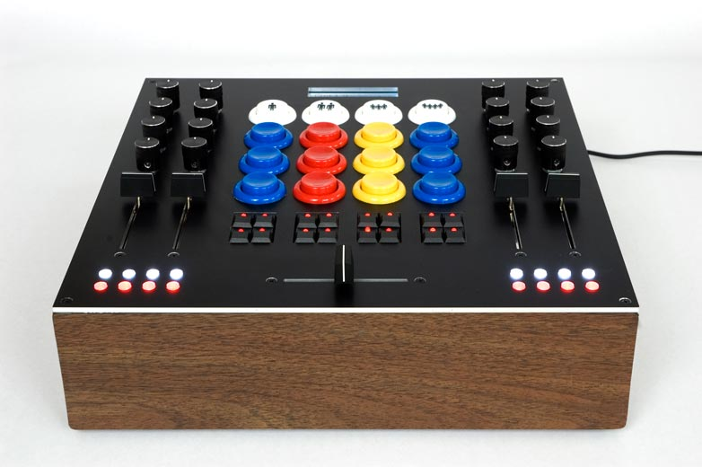
https://flic.kr/p/4MRZPn
MVC Controllers

Slide 2
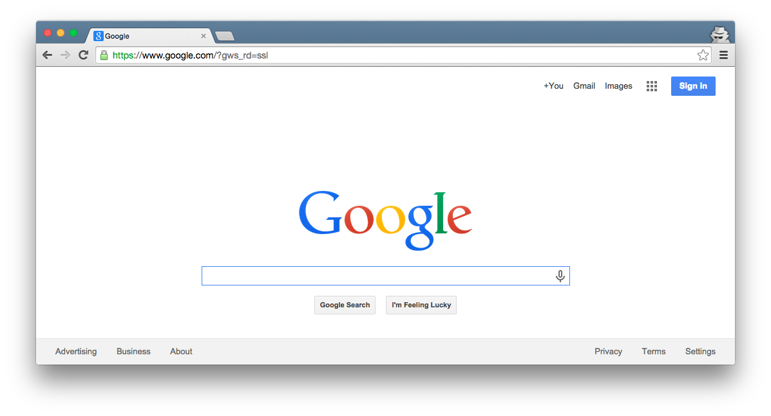
Browser
Migrations
Ye Olde Internet
Tests
DB
Server
Today’s focus
View
Router
Controller
Model

Slide 3
5 Basic Controller Patterns
Create
new/create: Enter a new record
Read
index: List all records
show: Display a particular record
Update
edit/update: Modify an existing record
Delete
destroy: Remove a record

Slide 4
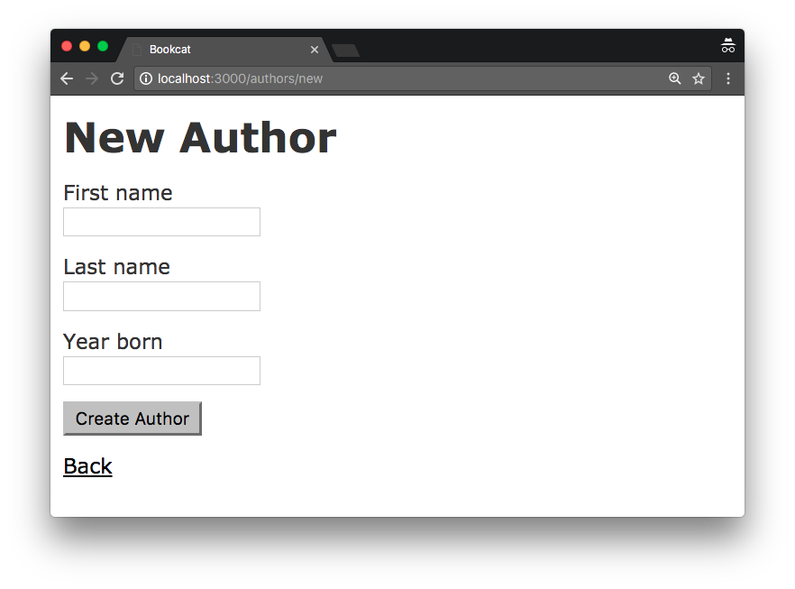
new Form

Slide 5
5 Basic Controller Patterns
Create
new/create: Enter a new record
Read
index: List all records
show: Display a particular record
Update
edit/update: Modify an existing record
Delete
destroy: Remove a record

Slide 6
Browser
Migrations
Ye Olde Internet
Tests
DB
Server
View
Router
Controller
Model

Slide 7
5 Basic Controller Patterns
Create
new/create: Enter a new record
Read
index: List all records
show: Display a particular record
Update
edit/update: Modify an existing record
Delete
destroy: Remove a record

Slide 8
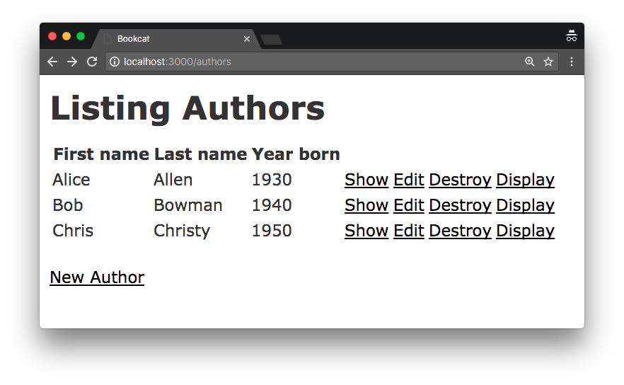
index Page

Slide 9
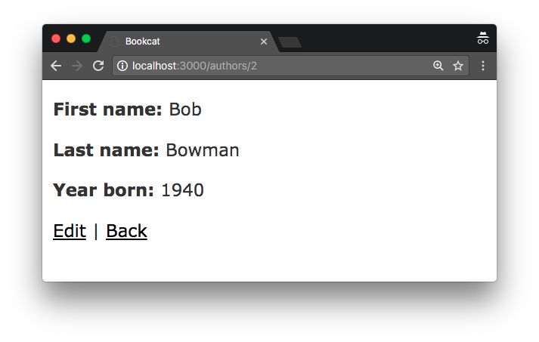
show Page

Slide 10
5 Basic Controller Patterns
Create
new/create: Enter a new record
Read
index: List all records
show: Display a particular record
Update
edit/update: Modify an existing record
Delete
destroy: Remove a record

Slide 11
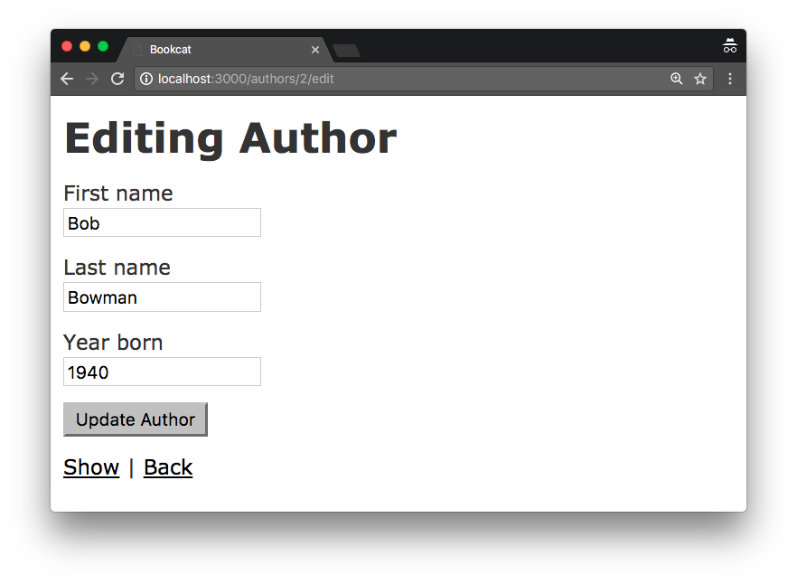
edit Form

Slide 12
5 Basic Controller Patterns
Create
new/create: Enter a new record
Read
index: List all records
show: Display a particular record
Update
edit/update: Modify an existing record
Delete
destroy: Remove a record

Slide 13
destroy Link

Slide 14
Appendix

Slide 15
5 Basic Controller Patterns
Create
new/create: Enter a new record
Read
index: List all records
show: Display a particular record
Update
edit/update: Modify an existing record
Delete
destroy: Remove a record

Slide 16
Browser
How to implement index?
Ye Olde Internet
DB
Server
View
Router
Controller
Model

Slide 17
Browser
How to implement index?
Route “authors” URL pattern
Controller uses Model to retrieve all records
Controller uses View to generate HTML (passes records to View)
Ye Olde Internet
DB
Server
View
3
1
Router
Controller
2
Model

Slide 18
Browser
How to implement index?
Ye Olde Internet
DB
Server
View
Router
Controller
Model

Slide 19
Browser
How to implement index?
Route “author” URL pattern
Controller uses Model to retrieve record with id in URL
Controller uses View to generate HTML (passes record to View)
Ye Olde Internet
DB
Server
View
3
1
Router
Controller
2
Model

Slide 20
5 Basic Controller Patterns
Create
new/create: Enter a new record
Read
index: List all records
show: Display a particular record
Update
edit/update: Modify an existing record
Delete
destroy: Remove a record
✔
✔

Slide 21
Browser
How many HTTP requests does it take to create a record?
Ye Olde Internet
DB
Server
View
Router
Controller
Model

Slide 22
Browser
How many HTTP requests does it take to create a record?
Two:
One to request a form (GET)
One to perform the add (POST)
Ye Olde Internet
DB
Server
View
Router
Controller
Model

Slide 23
Browser
How to implement get form?
Ye Olde Internet
DB
Server
View
Router
Controller
Model

Slide 24
Browser
How to implement get form?
Route URL pattern
Controller uses View to generate HTML (passes View records)
Ye Olde Internet
DB
Server
View
2
1
Router
Controller
Model

Slide 25
Browser
How to implement post new record?
Ye Olde Internet
DB
Server
View
Router
Controller
Model

Slide 26
Browser
How to implement post new record?
Route URL pattern
Controller uses Model to add rec
Controller sends HTTP redirect
Ye Olde Internet
DB
Server
View
3
1
Router
Controller
2
Model

Slide 27
5 Basic Controller Patterns
Create
new/create: Enter a new record
Read
index: List all records
show: Display a particular record
Update
edit/update: Modify an existing record
Delete
destroy: Remove a record
✔
✔
✔
Like create
Needs explaining…

Slide 28
5 Basic Controller Patterns
Create
new/create: Enter a new record
Read
index: List all records
show: Display a particular record
Update
edit/update: Modify an existing record
Delete
destroy: Remove a record

