Slide 1
COMP 7012: Foundations of Software Engineering
Spring 2018
Dr. Scott Fleming, Instructor
Borhan Samei, Teaching Assistant
http://flic.kr/p/3f1RGT

Slide 2
Questions!
What’s an SE project like?
What knowledge/skills must SEs master?
How will you learn in this course?

Slide 3
Questions!
What’s an SE project like?
What knowledge/skills must SEs master?
How will you learn in this course?
Caveat: Every project is an individual

Slide 4
Characteristics of SE Projects
Large Scale
Customers
Teams of Developers
http://flic.kr/p/83MmEP
http://flic.kr/p/hnrKZ
http://flic.kr/p/sAPm8

Slide 5
What is the measure of a successful software engineering project?

Slide 6
What is the measure of a successful software engineering project?
Customer Satisfaction
http://flic.kr/p/hnrKZ
* OK, effect on society and humanity matters too, but humor me…

Slide 7
What do customers want?

Slide 8
What do customers want?
Software that
Meets their needs,
On time,
and
On budget

Slide 9
Unfortunately, satisfying customers is hard…
http://flic.kr/p/7pGoCd
Have you ever been a dissatisfied customer?

Slide 10
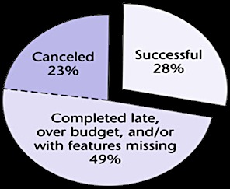
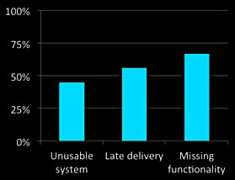
The “Software Crisis”
Since the 1960s
(More like a depression)
Of 28,000 projects completed in 2000…
2002 Study: 78% of orgs landed in court
(Standish Group)
(Cutter Consortium)

Slide 11
Although stats improving, challenges remain…
Recent headlines (Oct 2013–Aug 2014):
Tech Problems Plague First Day Of Health Exchange Rollout
Health Exchange Tech Problems Point To A Thornier Issue
It's Easy To Blame The Canadians For HealthCare.gov Problems
Sebelius: Hold Me Accountable For HealthCare.gov Debacle
Add Security To The List Of HealthCare.gov Tech Issues
Oregon's State Exchange May Be Worse Than HealthCare.gov
Could A Tech Giant Build A Better Health Exchange? Maybe Not
Official In Charge Of Creating HealthCare.gov Steps Down
Giving Up On Its Obamacare Exchange No Cure For Oregon's Ills
Oregon Sues Oracle For "Abysmal" Healthcare Website
( )
( )

Slide 12
Questions!
What’s an SE project like?
What knowledge/skills must SEs master?
How will you learn in this course?

Slide 13
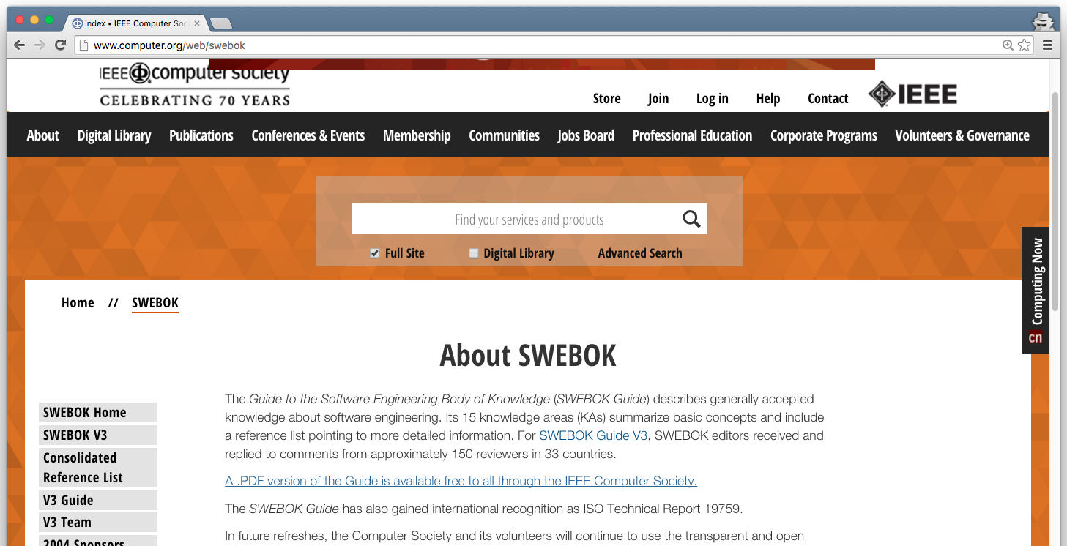
The SWEBOK (pronounced “SWEE-bock”) Software Engineering Body Of Knowledge SWEBOK Guide: http://www.computer.org/web/swebok

Slide 14
One possible (albeit circular) definition of Software Engineering: Applying SWEBOK to software creation and evolution
So what’s in this SWEBOK anyway?

Slide 15
15 Knowledge Areas (KAs)
Software Requirements
Software Design
Software Construction
Software Testing
Software Maintenance
Software Configuration Management
Software Engineering Management
Software Engineering Process
Software Engineering Models and Methods
Software Quality
Software Engineering Professional Practice
Software Engineering Economics
Computing Foundations
Mathematical Foundations
Engineering Foundations

Slide 16
15 Knowledge Areas (KAs)
Software Requirements
Software Design
Software Construction
Software Testing
Software Maintenance
Software Configuration Management
Software Engineering Management
Software Engineering Process
Software Engineering Models and Methods
Software Quality
Software Engineering Professional Practice
Software Engineering Economics
Computing Foundations
Mathematical Foundations
Engineering Foundations
We’ll focus on this subset

Slide 17
Questions!
What’s an SE project like?
What knowledge/skills must SEs master?
How will you learn in this course?

Slide 18
Levels of Mastery
Familiarity
Understand what concept means
“What do you know about this?”
Usage
Use or apply concept
“What do you know how to do?”
Assessment
Justify selection of concept vs others
“Why would you do that?”
Which will be our focus?
From the ACM/IEEE Curriculum Guidelines for Undergraduate Degree Programs in Computer Science (2013)
Notes:
We use three levels of mastery, defined as:
● Familiarity: The student understands what a concept is or what it means. This level of mastery concerns a basic awareness of a concept as opposed to expecting real facility with its application. It provides an answer to the question “What do you know about this?”
● Usage: The student is able to use or apply a concept in a concrete way. Using a concept may include, for example, appropriately using a specific concept in a program, using a particular proof technique, or performing a particular analysis. It provides an answer to the question “What do you know how to do?”
● Assessment: The student is able to consider a concept from multiple viewpoints and/or justify the selection of a particular approach to solve a problem. This level of mastery implies more than using a concept; it involves the ability to select an appropriate approach from understood alternatives. It provides an answer to the question “Why would you do that?”

Slide 19
Levels of Mastery
Familiarity
Understand what concept means
“What do you know about this?”
Usage
Use or apply concept
“What do you know how to do?”
Assessment
Justify selection of concept vs others
“Why would you do that?”
This one!
From the ACM/IEEE Curriculum Guidelines for Undergraduate Degree Programs in Computer Science (2013)

Slide 20
Levels of Mastery
Familiarity
Understand what concept means
“What do you know about this?”
Usage
Use or apply concept
“What do you know how to do?”
Assessment
Justify selection of concept vs others
“Why would you do that?”
How do you learn usage?
Practice!
From the ACM/IEEE Curriculum Guidelines for Undergraduate Degree Programs in Computer Science (2013)

Slide 21
How You’ll Practice
Boot Camp
Significant software project
Team skills
Communication skills
Project management

Slide 22
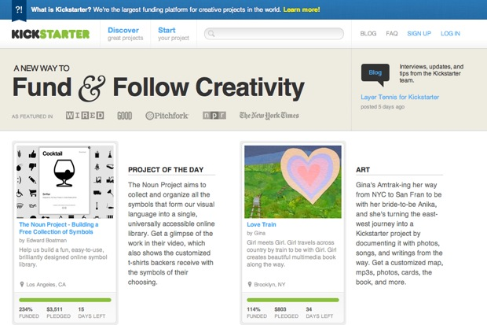
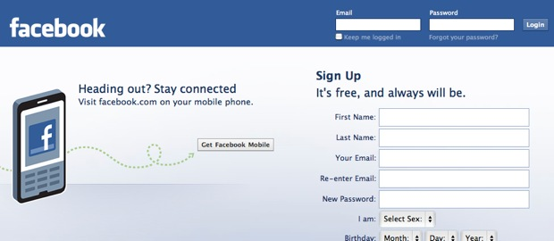
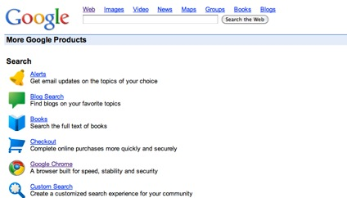
What type of software will you build for the project?
Web Apps!

Slide 23
Why web apps?
Every bit as dynamic and interactive as native apps
Avoid deployment problems
Reach people world wide
http://flic.kr/p/9DTDXi

Slide 24
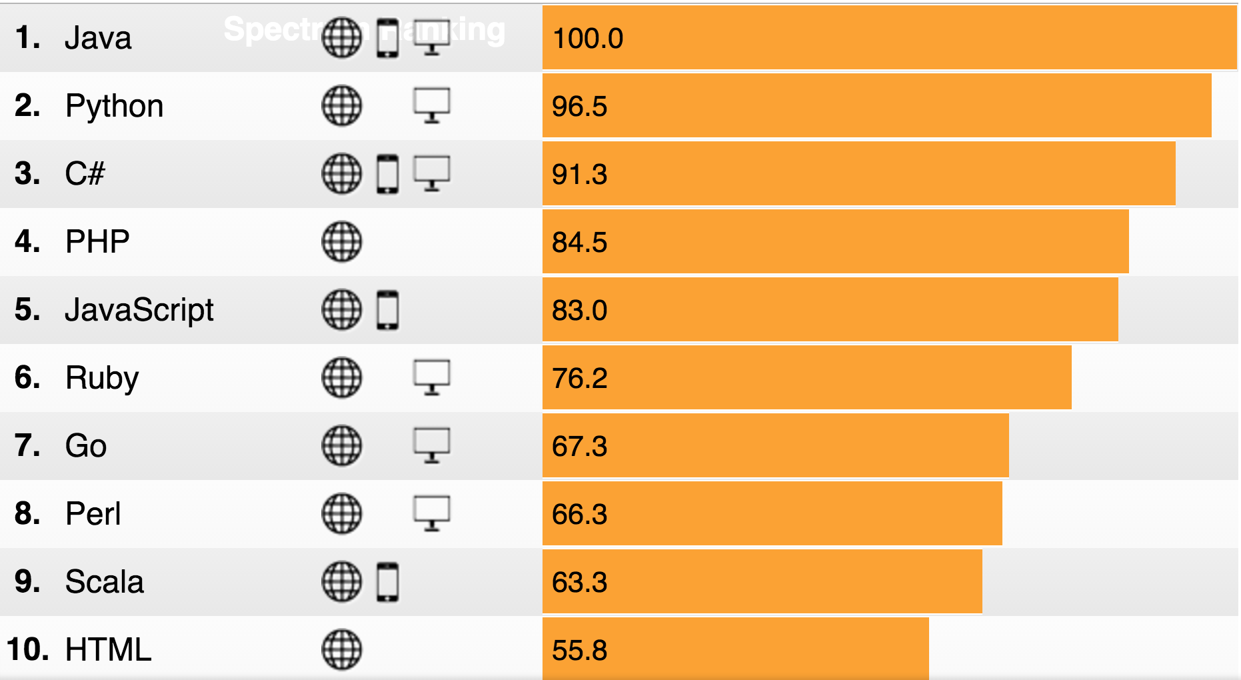
What programming language(s)?
http://spectrum.ieee.org/static/interactive-the-top-programming-languages-2015
Notes:
2014 numbers were similar: http://spectrum.ieee.org/static/interactive-the-top-programming-languages (2014)

Slide 25
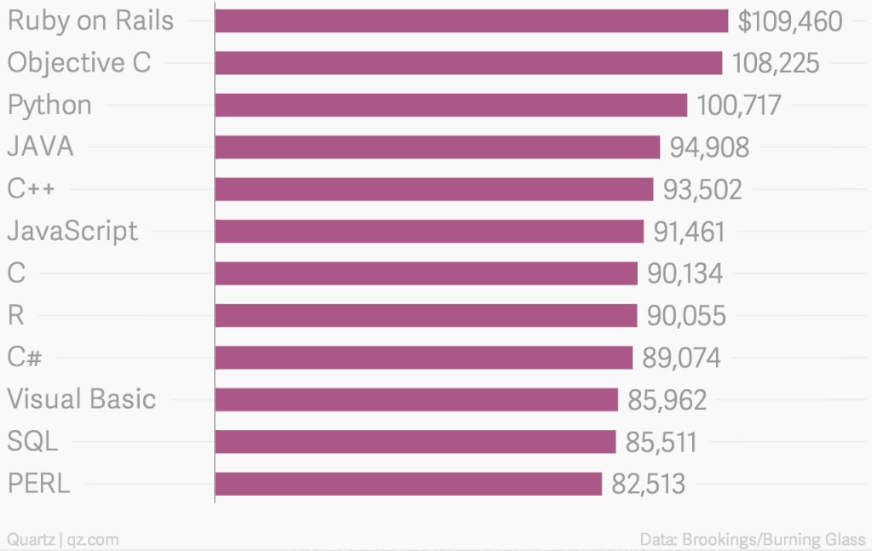
Most Valuable Skills on Resume (2014)

Slide 26
Course Structure
Rails Web App Boot Camp (7 weeks)
Weekly Homework
Team Project
Initial Planning (2 weeks)
Development Iteration 1 (3 weeks)
Development Iteration 2 (3 weeks)
Pop quizzes throughout
Two exams
Each project iteration ends with demos

Slide 27
Grading
40% Team Project
Initial Planning 5% Team Milestone 0
Dev. Iteration 1 4% Team Milestone 1 7% Individual Contrib.
Dev. Iteration 2 4% Team Milestone 2 7% Individual Contrib.
8% Final Product (team)
5% A&B (individual)
36% Exams (18% ea.)
14% Homework and Quizzes
10% Participation

Slide 28
Policies of Interest
No cheating!
I use plagiarism detection system!
Participate! (or lose participation point)
Be here at beginning of class
Stay until the end
Be engaged in between!
Expect seating chart
Laptops required in class, but…

Slide 29
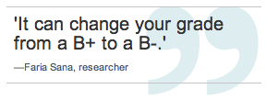
http://www.cbc.ca/news/technology/story/2013/08/14/technology-laptop-grades.html

Slide 30
Let’s tour the course web pages and see what’s coming up…

