Slide 1
How to Give a Great Demo
https://flic.kr/p/88CCw2
Notes:
Mathieu Thouvenin
FaceTime demo
First public video phone call with FaceTime, between Steve Jobs and Jony Ive.
Photo taken during the Steve Jobs' Keynote at the Apple WWDC 2010.

Slide 2
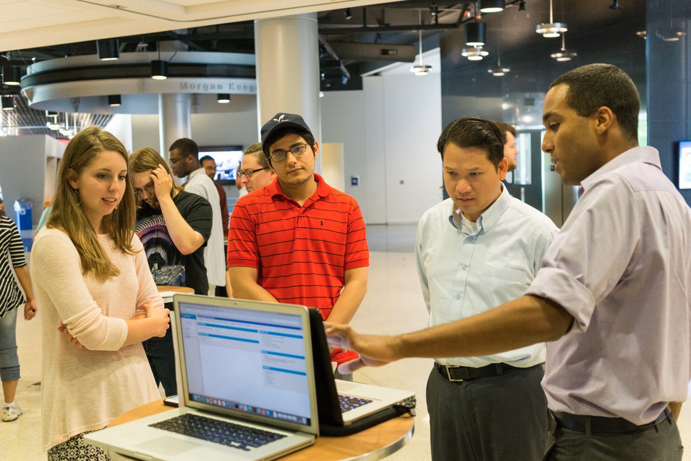
Our Setup: Demo Booths

Slide 3
4 Ingredients
Understandable
Interesting
Good length
No crashes

Slide 4
Making your demo understandable
What pitfalls can you think of?
Any advice?

Slide 5
Making your demo understandable
Give gentle introduction
Assume no knowledge of project
Avoid jargon/acronyms
Carefully plan the flow
Don’t forget to introduce key concepts/entities
Avoid doubling back to talk about something you should have introduced earlier

Slide 6
Making your demo interesting
What pitfalls can you think of?
Any advice?

Slide 7
Making your demo interesting
“Where are the people?”
People find people most interesting
More than buttons and widgets
More than technologies
Organize around user goals/tasks
Makes clear how the system helps the user

Slide 8
Making your demo an appropriate length
What pitfalls can you think of?
Any advice?

Slide 9
Making your demo an appropriate length
Rehearse!
So you know the length
Don’t make it too long
Cut the weak stuff
Don’t make it too short
Slow down and savor the most interesting stuff

Slide 10
Avoiding failures
What pitfalls can you think of?
Any advice?

Slide 11
Avoiding failures
Avoid making last-minute changes
Or be extremely suspicious of them
Rehearse
Using the version you will demo
Know your system
Know where the bugs/incomplete features are
Don’t forget the demo environment
Need wifi? Power? Open network ports?
Test your system in the demo environment!

Slide 12
Summary
Make your demo…
Understandable
Interesting
Appropriately long
And avoid crashes!

