Slide 1
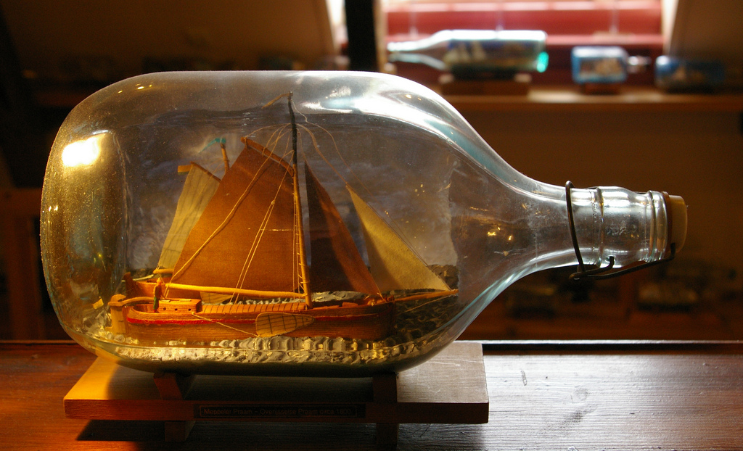
http://flic.kr/p/9RR1BL
Object-Oriented Database Design

Slide 2
Prologue
Generalization Class Relationship

Slide 3
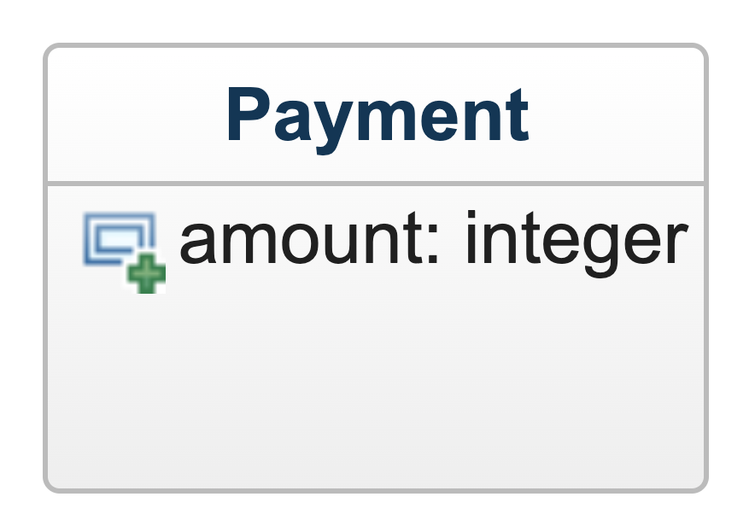
Consider a Payment class
There are different types of payments,
like cash, credit, and check payments,
and each type has some unique attributes
How would you model
the different payment types?

Slide 4
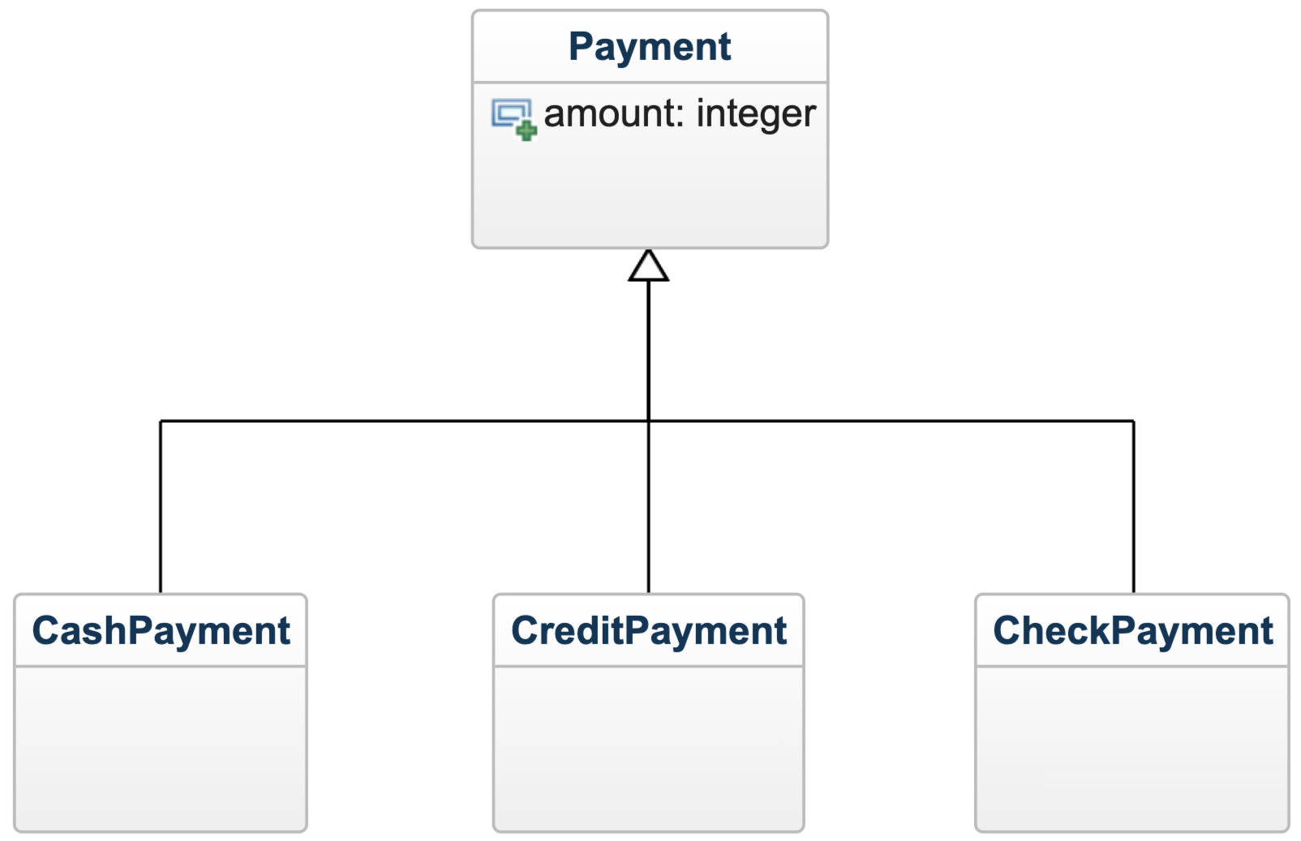
Generalization
superclass – more
general concept
generalization
relationship
(3 overlapping
triangle-arrows)
subclasses – more
specialized concepts

Slide 5
The Is-A Rule
For a generalization to be valid, the following statement must be true for all subclass objects:
A <subclass object> is a <superclass object>.
Examples:
A cash payment is a payment.
A credit payment is a payment.
A check payment is a payment.
Implication: All attributes/associations of superclass must be applicable to subclass

Slide 6
Rails Caveat Regarding Generalization
Rails model API doesn't have features for explicitly specifying generalization relationships
You can get some of the same effects, though:
  Most common approach: single-table inheritance
    https://guides.rubyonrails.org/association_basics.html#single-table-inheritance
  Another approach: polymorphic associations
    https://guides.rubyonrails.org/association_basics.html#polymorphic-associations
Quick & Dirty Solution: Simply merge the superclass and subclasses into a single class with all their attributes/associations

Slide 7
Object-Oriented Database Design

Slide 8
Challenges: From Requirements to Design
User stories not unified model
  Can't see the forest for the trees
Representational gap b/t requirements and design
  USs are text descriptions of features
  OO designs are interrelated classes of objects

Slide 9
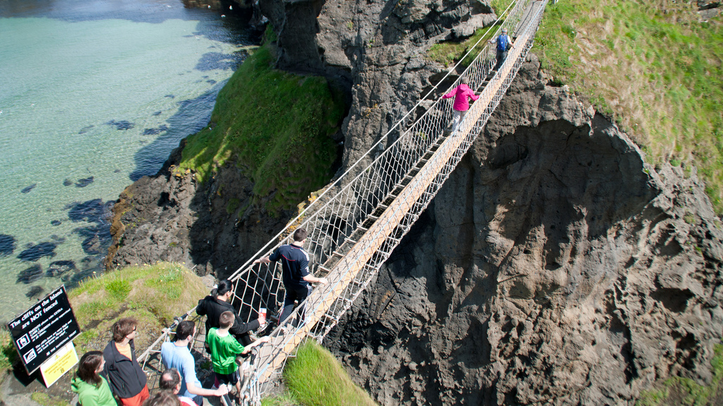
Analysis bridges the gap between requirements and design
Design
http://flic.kr/p/a1NZHb
Analysis
Requirements

Slide 10
Object-Oriented Data Modeling
(a key type of analysis)
Identify data that the system will need to manage
Structure data using object-oriented design
Represent with UML class diagram
Use class diagram as basis for software classes
  Our focus: Rails model classes

Slide 11
Practical Problem
How to get
OO design elements
(classes, attributes, associations, etc.)
from
textual requirements specifications
(e.g., user stories)
???

Slide 12
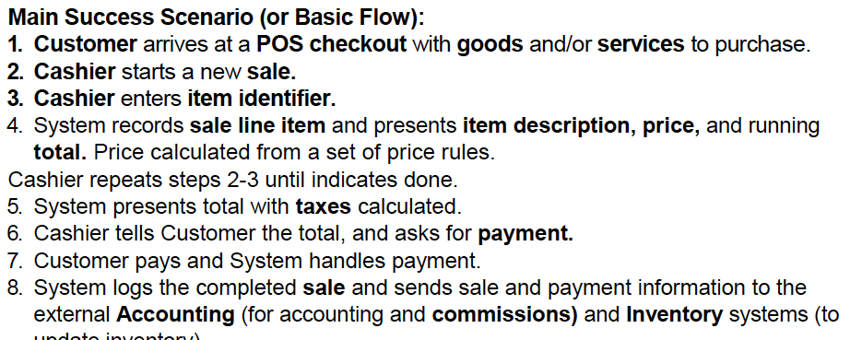
Noun Phrase Identification
Finds Classes and Attributes
Identify nouns and noun phrases in descriptions of a domain (e.g., USs)
Nouns suggest possible classes or attributes

Slide 13
What about Verb Phrases?
Less clear than noun phrases, but...
has-a type phrases suggest associations or attributes
  "An album has one or more tracks." (association)
  "A person has a name." (attribute)
is-a type phrases suggest generalization relationships
  "A credit card payment is one type of payment."

Slide 14
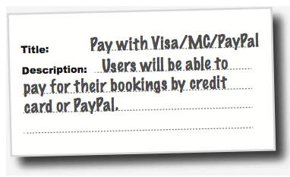
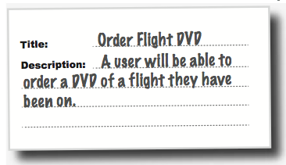
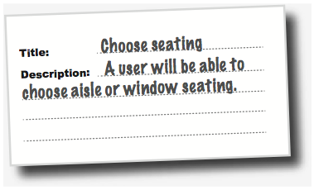
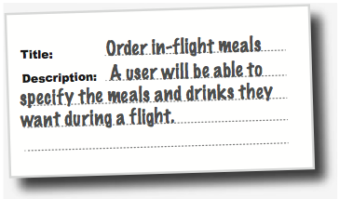
Example: Flight Booking

Slide 15
Noun-Phrase Identification

Slide 16
Noun-Phrase Analysis
VISA/MC/PayPal
User
Booking
Flight DVD
Seating (aisle or window)
In-Flight Meal/Drink
Flight

Slide 17
Noun-Phrase Analysis
VISA/MC/PayPal
User
Booking
Flight DVD
Seating (aisle or window)
In-Flight Meal/Drink
Flight
What sense can we make here?
Which seem like model classes?
(Not being domain experts, we might need to ask follow-up questions)

Slide 18
Noun-Phrase Analysis
VISA/MC/PayPal
User
Booking
Flight DVD
Seating (aisle or window)
In-Flight Meal/Drink
Flight
☜
Seems likely that the system will need to save "bookings" in the DB

Slide 19
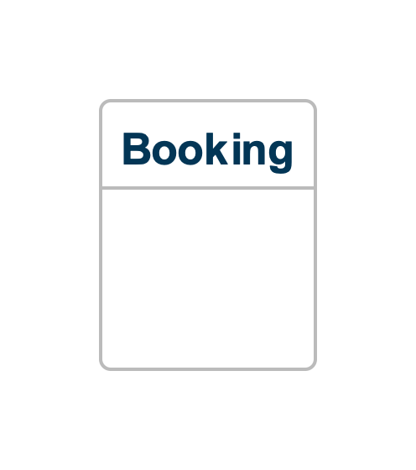

Slide 20
Noun-Phrase Analysis
VISA/MC/PayPal
User
Booking
Flight DVD
Seating (aisle or window)
In-Flight Meal/Drink
Flight
☜
Seems likely that a booking will be for one or more flights (a description of a particular flight)

Slide 21
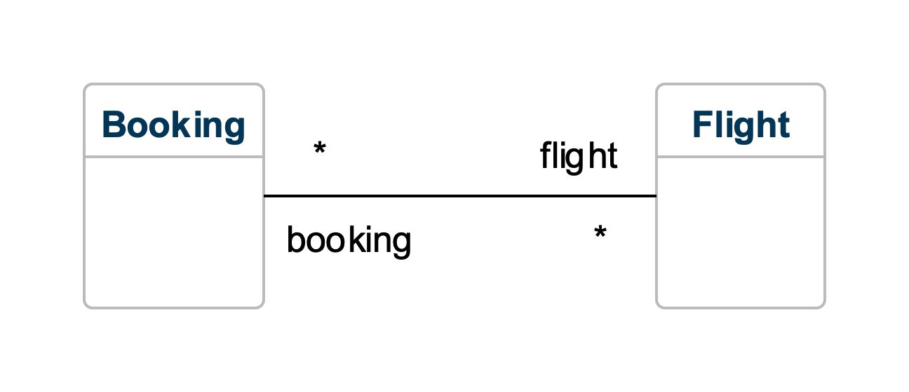

Slide 22
Noun-Phrase Analysis
☜
VISA/MC/PayPal
User
Booking
Flight DVD
Seating (aisle or window)
In-Flight Meal/Drink
Flight
Seems like this is really referring to a "payment" for the booking...

Slide 23
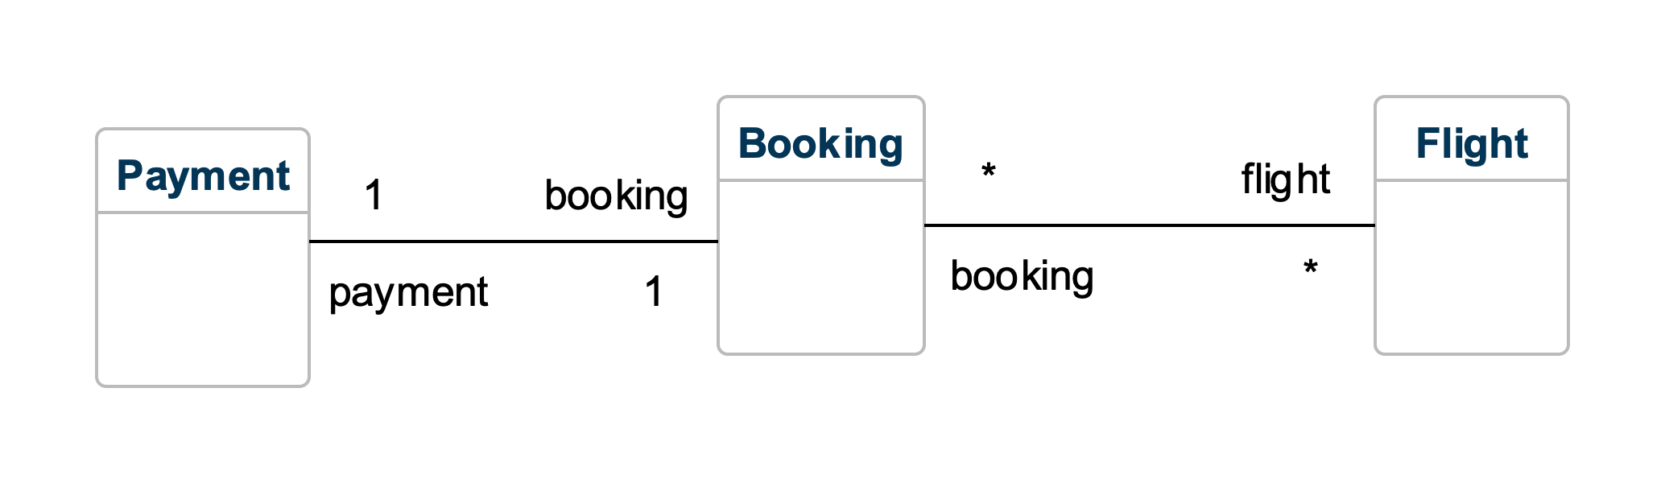

Slide 24
Noun-Phrase Analysis
☜
VISA/MC/PayPal
User
Booking
Flight DVD
Seating (aisle or window)
In-Flight Meal/Drink
Flight
... and each of these is a type of payment

Slide 25
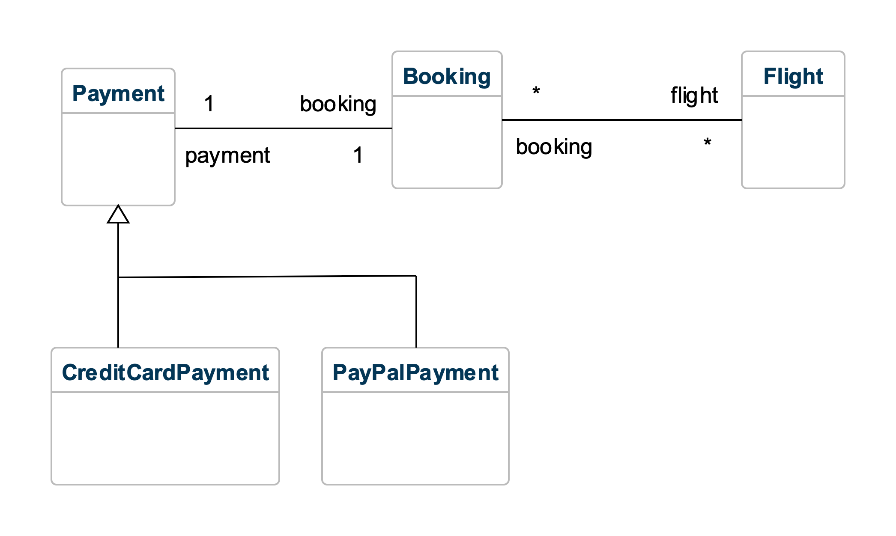

Slide 26
Noun-Phrase Analysis
VISA/MC/PayPal
User
Booking
Flight DVD
Seating (aisle or window)
In-Flight Meal/Drink
Flight
☜
The system should probably store some data about the user and keep track of which bookings are theirs

Slide 27
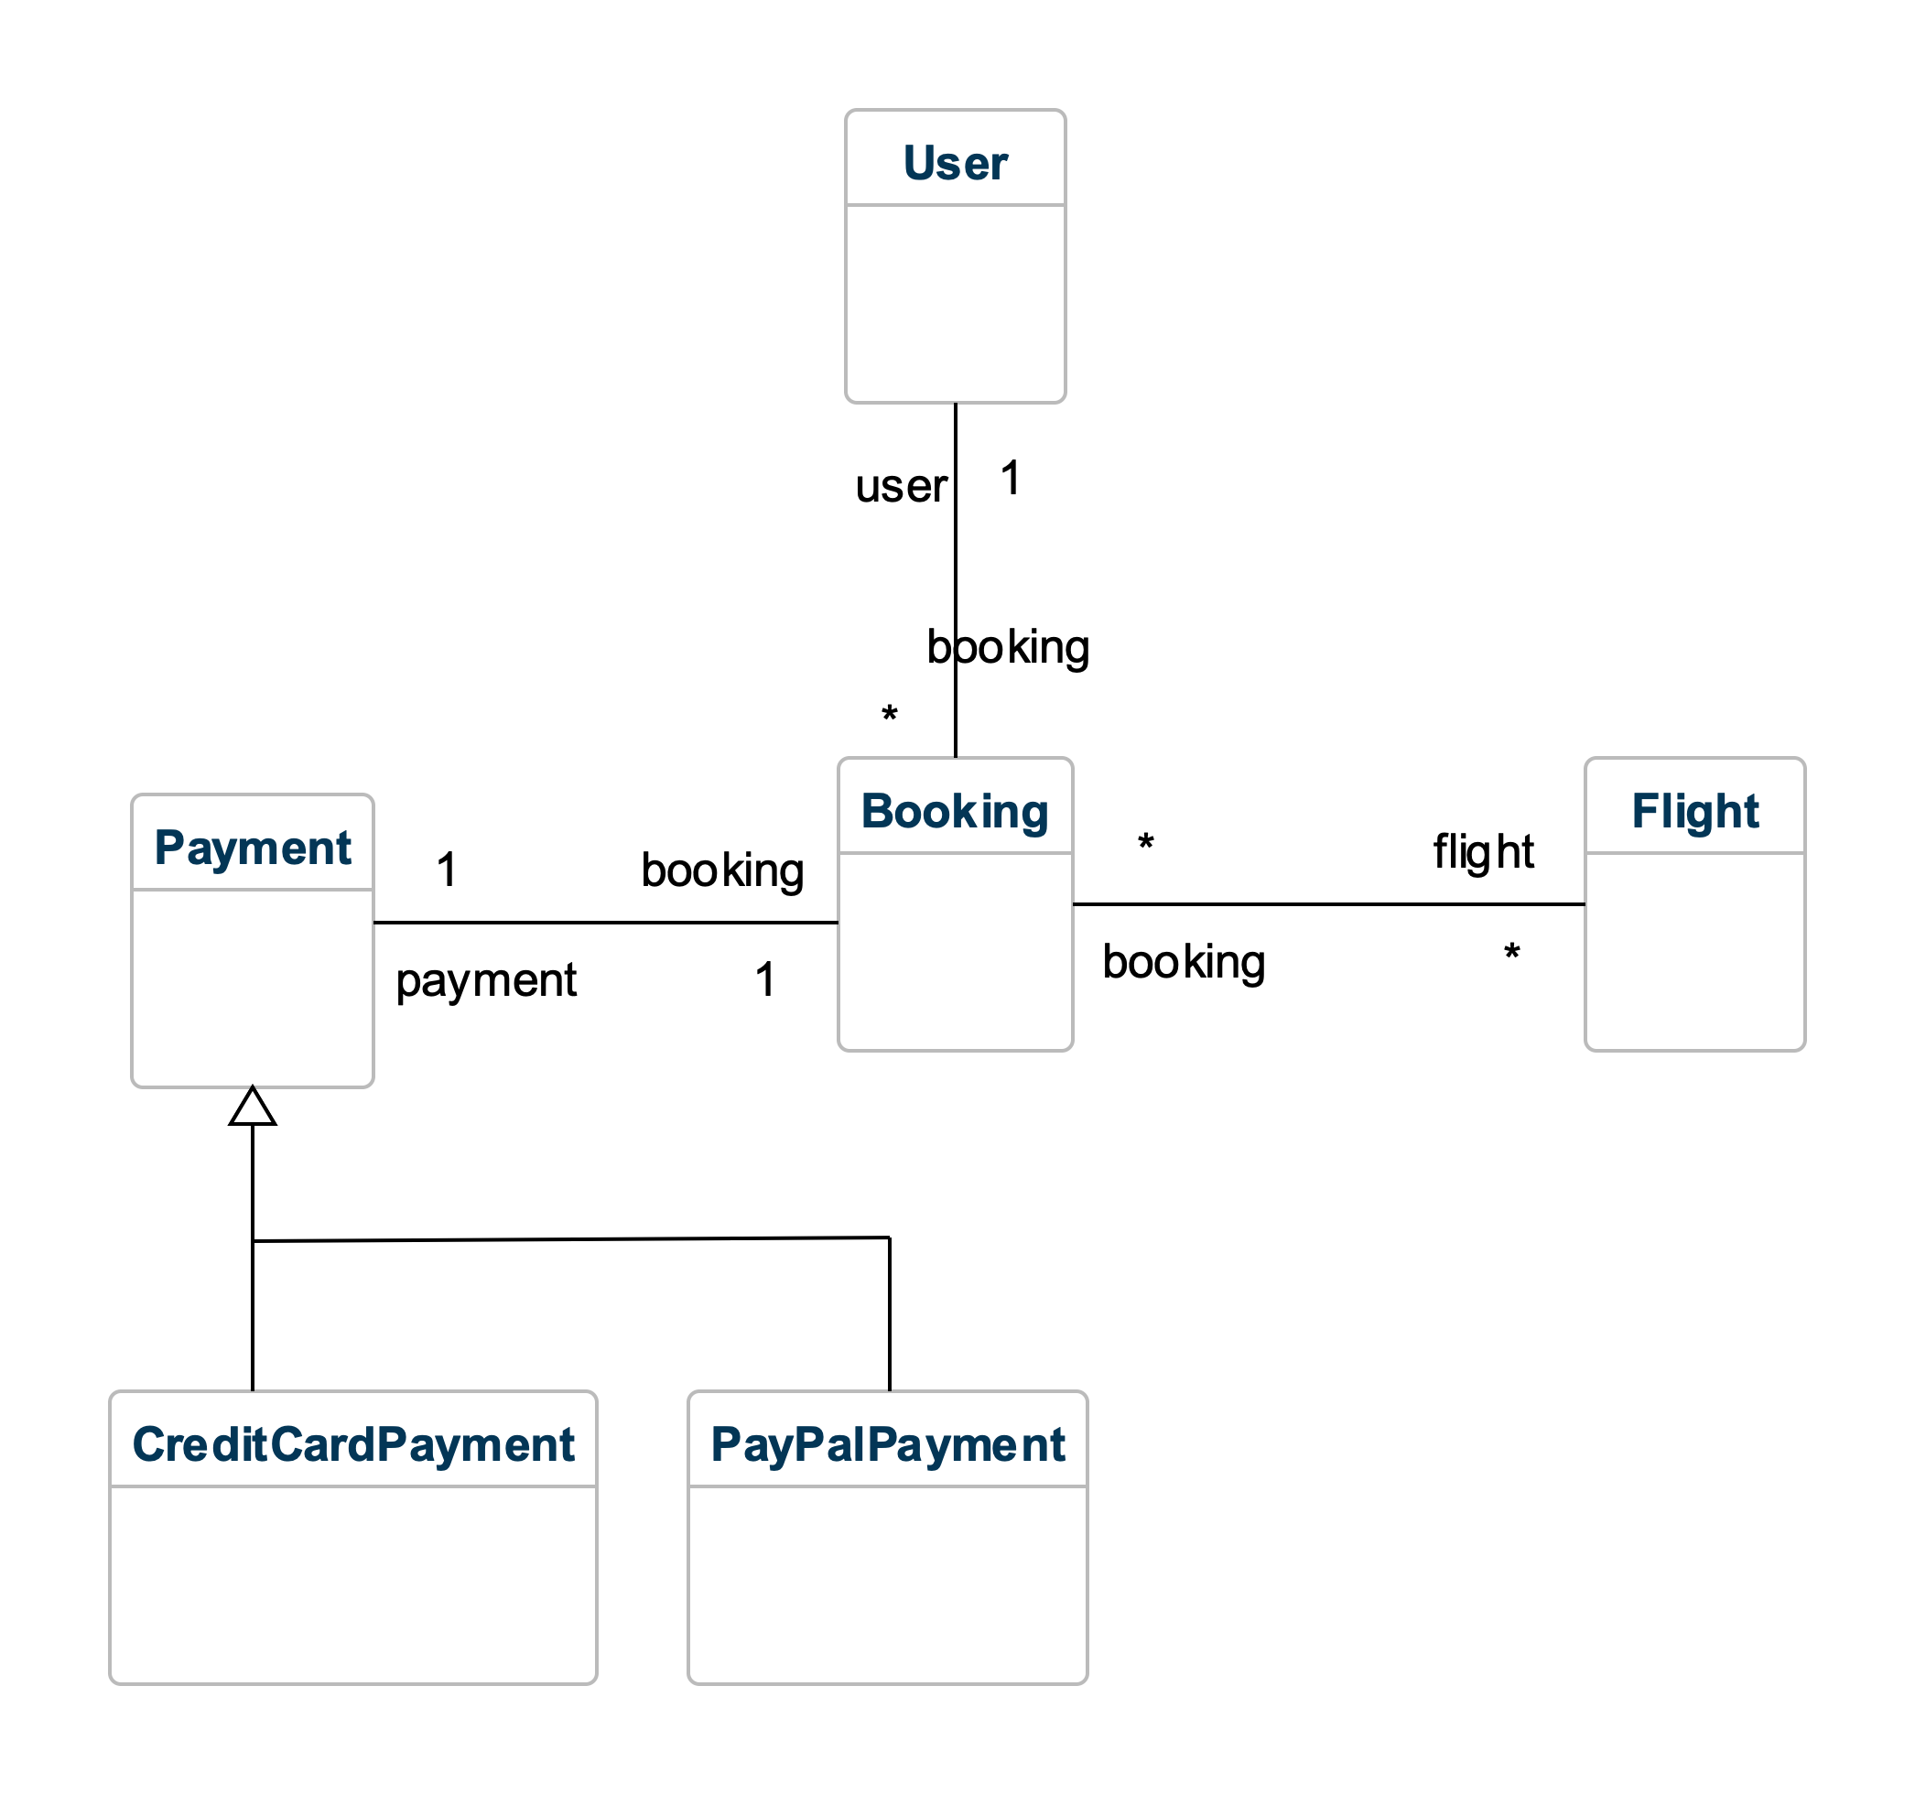

Slide 28
Noun-Phrase Analysis
VISA/MC/PayPal
User
Booking
Flight DVD
Seating (aisle or window)
In-Flight Meal/Drink
Flight
☜
These two seem like user preferences for a particular flight booking
☜

Slide 29
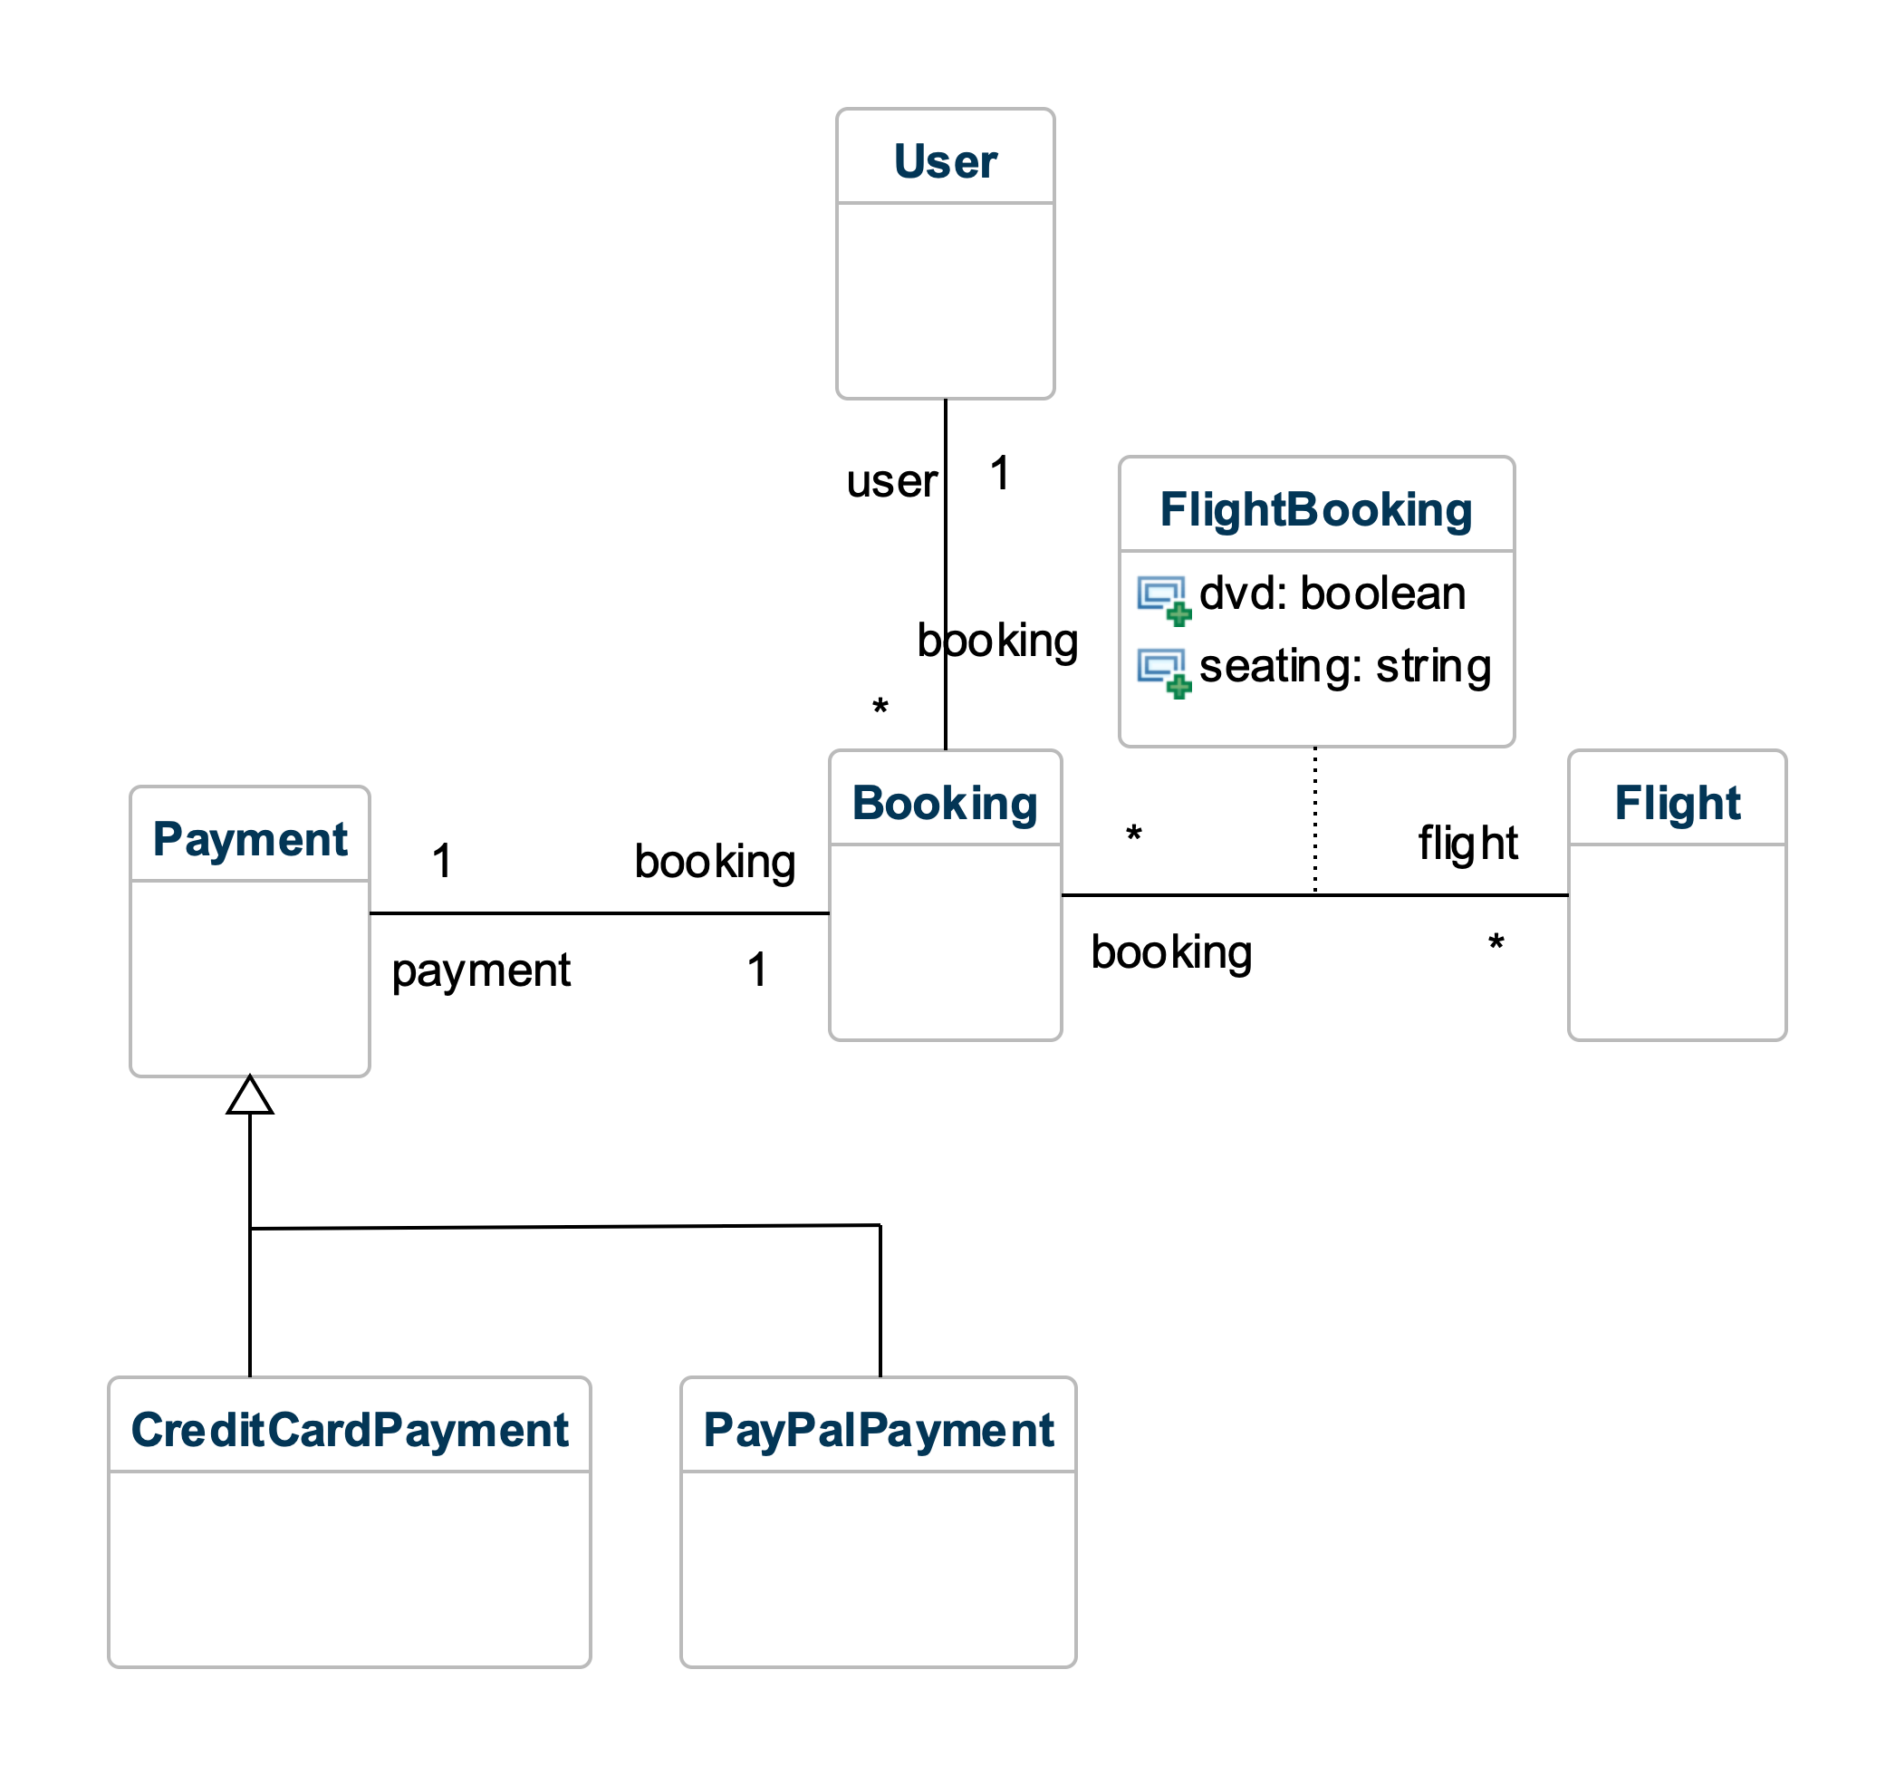

Slide 30
Noun-Phrase Analysis
VISA/MC/PayPal
User
Booking
Flight DVD
Seating (aisle or window)
In-Flight Meal/Drink
Flight
Skipping. Probably involves a class associated with FlightBooking, but not enough info to model right now. What are meal selections like? Do they vary by flight? Etc...
☜

Slide 31
Clearly, there are still missing attributes, etc., but this is a good start!

Slide 32
Doing the analysis was not only useful for creating a design, but the exercise also revealed key missing details and things that need clarification

Slide 33

Summary
Generalization relationships
Analysis (as related to design)
OO Data Modeling
Noun-phrase identification technique
http://flic.kr/p/aCLor3

Slide 34
Appendix: When to use generalization?

Slide 35
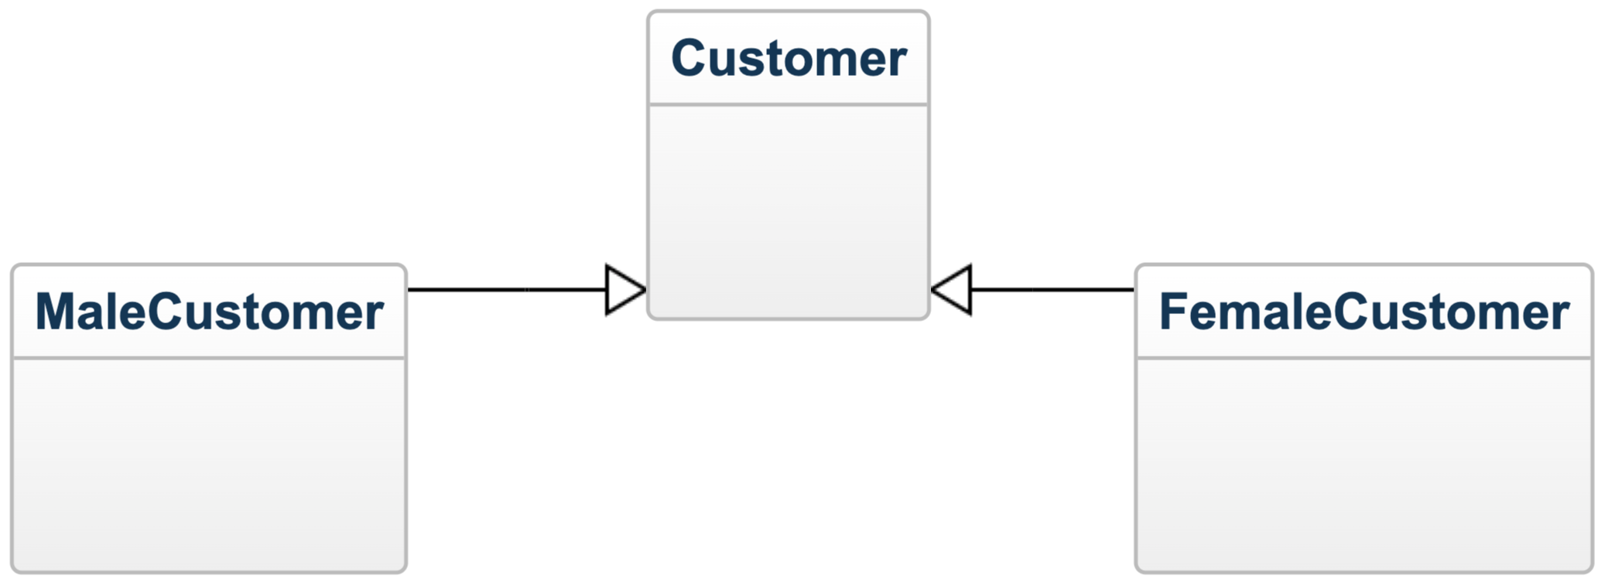
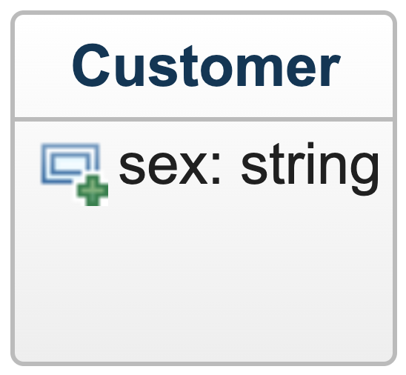
When to use generalization?
vs
Which way?
How to decide?

Slide 36
Guideline: Model a subclass when…
subclass has additional attributes of interest
AND/OR
subclass has additional associations of interest
AND/OR
subclass is operated on, handled, reacted to, or manipulated differently in ways that are of interest

Slide 37
Appendix: Classes vs Attributes

Slide 38
Is It a Class or an Attribute?
Objects have identity
  Two objects w/ same attribute values are still distinct
  Model as classes
Data values do not have identity
  Numbers, strings, dates, etc. with same value are same
  Model as attributes

