Slide 1
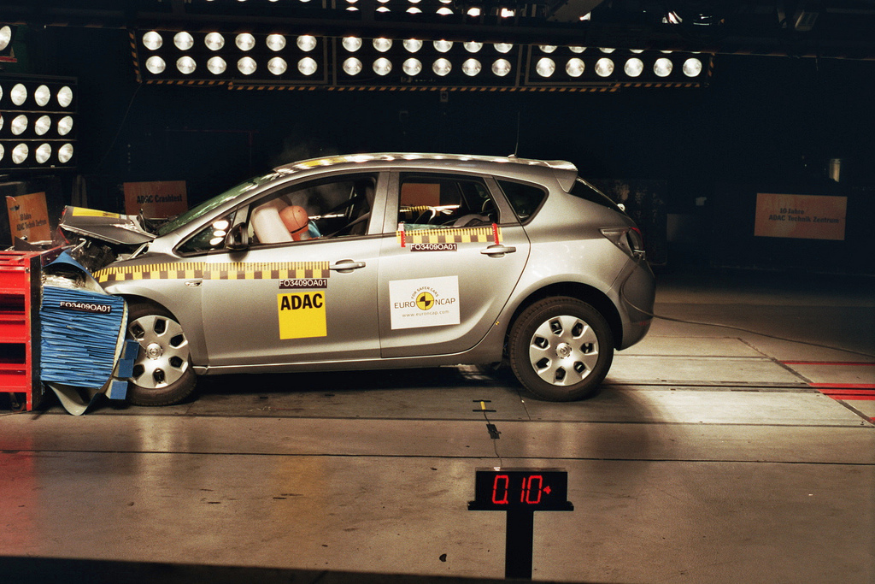
http://flic.kr/p/7iffKj
Software Testing

Slide 2
SWEBOK Knowledge Areas
Software Requirements
Software Design
Software Construction
Software Testing
Software Maintenance
Software Configuration Management
Software Engineering Management
Software Engineering Process
Software Engineering Models and Methods
Software Quality
Software Engineering Professional Practice
Software Engineering Economics
Computing Foundations
Mathematical Foundations
Engineering Foundations
Today’s topic

Slide 3
Can you create bug-free software?
Notes:
In real software, there are hundred of lines so it is very difficult to create a program that is 100% bug free.

Slide 4
Can you create bug-free software?
For practical purposes, no!
Goal: Reduce the number of bugs
Notes:
In real software, there are hundred of lines so it is very difficult to create a program that is 100% bug free.

Slide 5
Can you create bug-free software?
What can you do to discover bugs?
For practical purposes, no!
Goal: Reduce the number of bugs
Notes:
In real software, there are hundred of lines so it is very difficult to create a program that is 100% bug free.

Slide 6
Can you create bug-free software?
What can you do to discover bugs?
For practical purposes, no!
Goal: Reduce the number of bugs
Most common ways in practice:
Software testing
Code reviews
Notes:
In real software, there are hundred of lines so it is very difficult to create a program that is 100% bug free.

Slide 7
Testing-Related Terminology
Testing: Execute code to reveal defects
  Given some input, does it produce expected output?
  Does it behave as expected?
Test/Test Case: One execution of code that may expose bug
Test Suite: Set of test cases
  Often used to group related tests

Slide 8

How do you completely test a program?
Think of simple example:
  UNIX file operation
  Takes file name as argument
  Each character an 8-bit byte

Slide 9
How do you completely test a program?
Think of simple example:
  UNIX file operation
  Takes file name as argument
  Each character an 8-bit byte
Exhaustive Testing: Try all possible inputs

Slide 10
Can exhaustive testing be done in practice?

Slide 11
Can exhaustive testing be done in practice?
No!
How many tests cases to exhaustively test simple UNIX file command?
  If you limit file name to 10 characters, there are 256¹⁰ different test cases
  Even if you can run 1000 tests per second, it would still take over 1013 years!
  And that's just varying the file's name, not its contents!!
  Clearly, exhaustive testing not feasible…
Notes:
=((2^8)^10)/(1000*60*60*24*365)

Slide 12
The Testing Problem:
How to choose set of test cases that reveals all errors?
  Fundamental research problem
  Essentially unsolvable in general case

Slide 13
Design Decisions for Tests
What subset of system to test?
How to choose test cases?

Slide 14
What subset of system to test?
larger subset
System testing: Test the complete system
Integration testing: Test groups of collaborating units
Unit testing: Test modules in isolation; smallest “units” of code
smaller subset

Slide 15
Unit versus Integration Testing
Problem: Definition of “unit” varies (class? method?)
Common distinctions:
Unit test | Integration test
Repeatable (context independent) | May involve system time, machine name, etc.
Deterministic | May involve threads, random numbers, etc.
In memory | May involve file system, DB
Fast (less than 0.5 seconds) | May be slow
Tests one property | May test multiple properties

Slide 16
Design Decisions for Tests
What subset of system to test?
How to choose test cases?

Slide 17
Two common ways to choose test cases
Black-box testing
White-box testing

Slide 18
Black-Box Testing
Choose based on module’s possible inputs and outputs (i.e., its interface)
Do not use internal code
Often test boundary cases
  Example: Values at 0, 1, and -1 (around the zero boundary)

Slide 19
White-Box Testing
Uses internal logic to choose tests
Different levels of code coverage
  Example: Cover all statements
Aka glass box testing, clear box testing

Slide 20
Code Coverage
Degree to which source code of a program is tested by a test suite
Examples:
  Statement coverage
  Branch coverage
  Path coverage
To compute these, you need…
Notes:
There are more types of coverages

Slide 21
Control Flow Graph (CFG)
Represents possible control paths through code:
Given some code:
def create
@profile = profile.new(params)
if @profile.save
redirect_to show_prof_url(@profile)
else
render ‘new’
end
end

Slide 22
How to construct a CFG
Step 1: Identify basic blocks
  Straight-line pieces of code without any jumps or jump targets
def create
@profile = profile.new(params)
if @profile.save
redirect_to show_prof_url(@profile)
else
render ‘new’
end
end
}

Slide 23
How to construct a CFG
Step 2: Model the jumps (control branches) as directed lines
@profile = profile.new(params)
if @profile.save
true
false
redirect_to show_prof_url(@profile)
else
render ‘new’
end

Slide 24
How to construct a CFG
Step 3: Model entry and exit (return) points
@profile = profile.new(params)
if @profile.save
true
false
redirect_to show_prof_url(@profile)
else
render ‘new’
end

Slide 25
How to construct a CFG
Now you have a CFG!
@profile = profile.new(params)
if @profile.save
true
false
redirect_to show_prof_url(@profile)
else
render ‘new’
end

Slide 26
Code Coverage Levels
Statement coverage
Branch coverage
Path coverage

Slide 27
Statement Coverage
Set of test cases such that…
Each program statement (line or basic block) is executed at least once

Slide 28
Define a test suite that provides statement coverage
def foo(x, y)
@z = 0
if x > 0 && y > 0
@z = x
end
return @z
end
@z = 0
if x > 0 && y > 0
@z = x
return @z
true
false
input |  | expected
x | y

Slide 29
Define a test suite that provides statement coverage
def foo(x, y)
@z = 0
if x > 0 && y > 0
@z = x
end
return @z
end
@z = 0
if x > 0 && y > 0
@z = x
return @z
✓
true
✓
false
input |  | expected
x | y
✓
1 1 1

Slide 30
Code Coverage Levels
Statement coverage
Branch coverage
Path coverage

Slide 31
Branch Coverage
Set of test cases such that…
Each boolean expression (in control structures) evaluates to true at least once and to false at least once

Slide 32
Define a test suite that provides branch coverage
def foo(x, y)
@z = 0
if x > 0 && y > 0
@z = x
end
return @z
end
@z = 0
if x > 0 && y > 0
@z = x
return @z
true
false
input |  | expected
x | y

Slide 33
Define a test suite that provides branch coverage
def foo(x, y)
@z = 0
if x > 0 && y > 0
@z = x
end
return @z
end
@z = 0
if x > 0 && y > 0
@z = x
return @z
✓
true
✓
false
input |  | expected
x | y
1 1 1
0 0 0

Slide 34
Code Coverage Levels
Statement coverage
Branch coverage
Path coverage

Slide 35
Path Coverage
Set of test cases such that…
Each possible path through a program’s control flow graph is taken at least once

Slide 36
Define a test suite that provides path coverage
def foo(x, y)
@z = 0
if x > 0 && y > 0
@z = x
end
return @z
end
@z = 0
if x > 0 && y > 0
@z = x
return @z
true
(a)
(c)
false
input |  | expected
x | y
(b)

Slide 37
Define a test suite that provides path coverage
def foo(x, y)
@z = 0
if x > 0 && y > 0
@z = x
end
return @z
end
@z = 0
if x > 0 && y > 0
@z = x
return @z
true
(a)
(c)
false
input |  | expected
x | y
(b)
1 1 1
Paths:
a, b
c
0 0 0
✓
✓

Slide 38
Coverage Support Tools
SimpleCov Ruby Gem

Slide 39
Coverage Support Tools
SimpleCov Ruby Gem

Slide 40
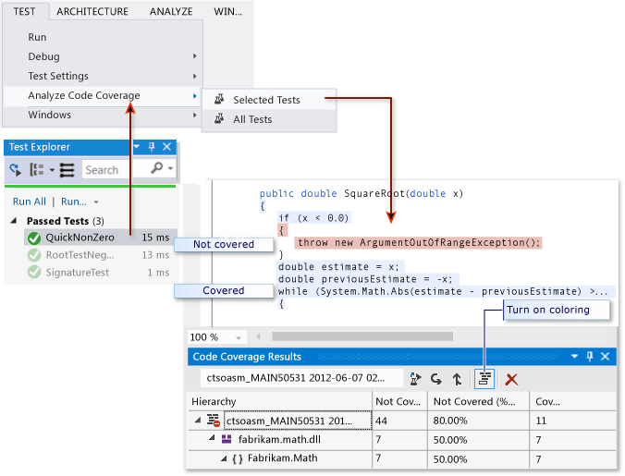
Coverage Support Tools
Visual Studio
https://msdn.microsoft.com/en-us/library/dd537628.aspx

Slide 41

Summary
The testing problem and terminology
Unit, integration, and system testing
Black-box testing and boundary conditions
White-box testing and code coverage
  Control flow graphs
  Statement, condition, and path coverage
http://flic.kr/p/aCLor3

Slide 42
Appendix

Slide 43
QUIZ!

Slide 44
Imagine you are given a compiled application to test. Which of the following would be the correct tests to use?
    Option 1: Blackbox and Unit Testing
    Option 2: Whitebox and Integration Testing
    Option 3: Blackbox and Integration Testing
    Option 4: Whitebox and Unit Testing
True or False? Exhaustive testing generally results in small set of test cases for small programs.

Slide 45
John wants to be able to quickly test individual subcomponents in his grade management system. Which testing should he use to accomplish the task at hand?
    Option 1: Integration Testing
    Option 2: System Testing
    Option 3: Unit Testing
    Option 4: None of the above
Which of the following about Unit testing is NOT correct?
    Option 1: In memory
    Option 2: Deterministic
    Option 3: Involves network I/O
    Option 4: Tests one property

Slide 46
What type of testing were you doing when you wrote tests for your model classes?
    Option 1: Integration Testing
    Option 2: System Testing
    Option 3: Unit Testing
    Option 4: None of the above

Slide 47
Answers
Option 3: Blackbox and Integration Testing
False; Even for small programs, test cases can be large. Refer to file operation example
Option 3: Unit Testing
Option 3: Involves the network I/O
Option 3: Unit Testing

Slide 48
Regression Testing
Prevent working code regressing to broken state
Tests code to detect breakage
  Run frequently or at regular intervals
Might include tests that reveal bugs found in wild
  Circumstances that caused bug may cause it to recur!
May include black-box or white-box tests

Slide 49
More testing techniques
Test-Driven Development
Acceptance Testing
Functional Testing
…

Slide 50
Recall: Common ways to choose test cases
Black-box testing
White-box testing
Regression testing

Slide 51
White-Box Testing
Uses internal logic to choose tests
Different levels of code coverage
  Example: Cover all statements
Aka glass box testing, clear box testing

