Slide 1
Software Design and Design Patterns Part 1
Notes:
St. Paul's Cathedral, London
Photo by Scott Fleming

Slide 2
Design Patterns
Template solutions to common problems
Cupola
Oculus
Pediment
Cornice
Columns
Portico

Slide 3
Benefits
Avoid re-inventing solutions
Promote quality
Reusability, maintainability, etc.
Facilitate communication

Slide 4
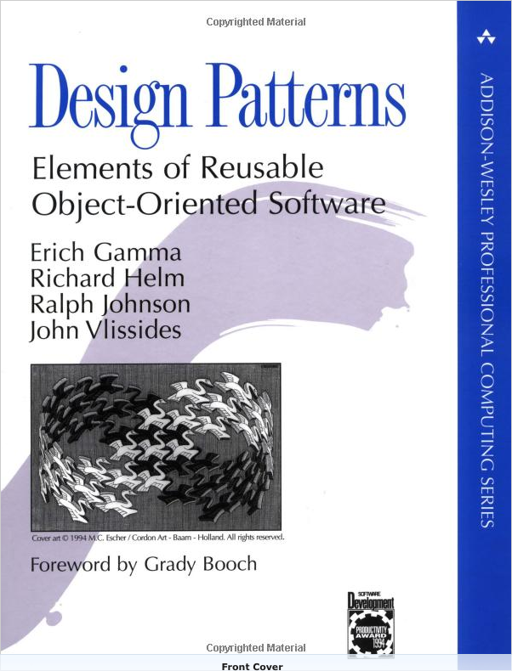
Popularized by the “Gang of Four” Book (GoF)
Catalog of 23 patterns
Many now ubiquitous
Must-read for pro devs
Let's see an example!

Slide 5
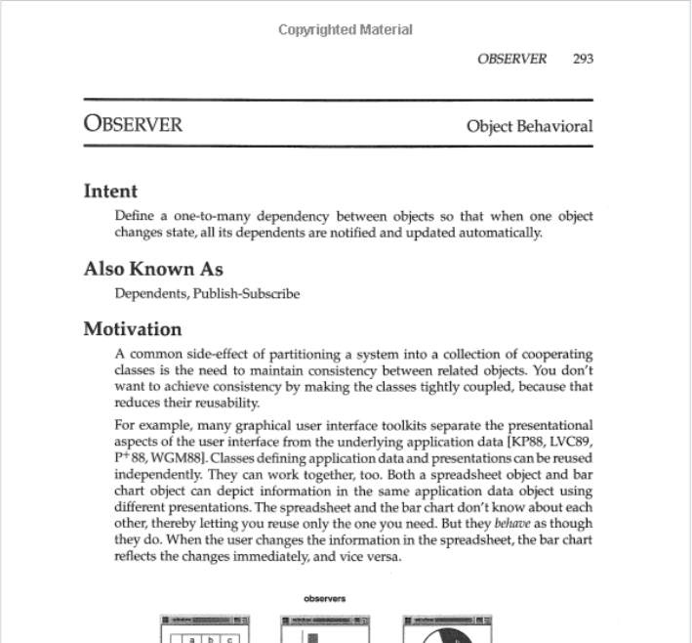
Observer Pattern
From Gamma et al. Design Patterns: Elements of Reusable Object-Oriented Software

Slide 6
Elements of a Design Pattern in GoF
Intent
Also Known As
Motivation
Applicability
Structure
Participants
Collaborations
Consequences
Implementation
Sample Code
Known Uses
Related Patterns
Observer Pattern covers in 11 pages

Slide 7
Observer Pattern Structure
From Gamma et al. Design Patterns: Elements of Reusable Object-Oriented Software
Notes:
GoF uses an outdated version of class diagram notation from OMT (https://en.wikipedia.org/wiki/Object-modeling_technique).

Slide 8
Side Note: Lots of (Minor) Variations Exist for Design Patterns

Slide 9
OODesign.com Variant
http://www.oodesign.com/observer-pattern.html
Notes:
Subject -> Observable
No association b/t ConcreteObserver and ConcreteObservable

Slide 10
Refactoring.Guru Variant
https://refactoring.guru/design-patterns/observer
Notes:
Subject -> Publisher
Observer -> Subscriber
Array of subscribers
update now takes publisher as argument

Slide 11
Wikipedia Variant #1
Actually very similar to the GoF version
https://en.wikipedia.org/wiki/Observer_pattern

Slide 12
Wikipedia Variant #2
https://en.wikipedia.org/wiki/Observer_pattern
Notes:
Nothing about ConcreteSubject
Attach/Detach -> register/unregister

Slide 13
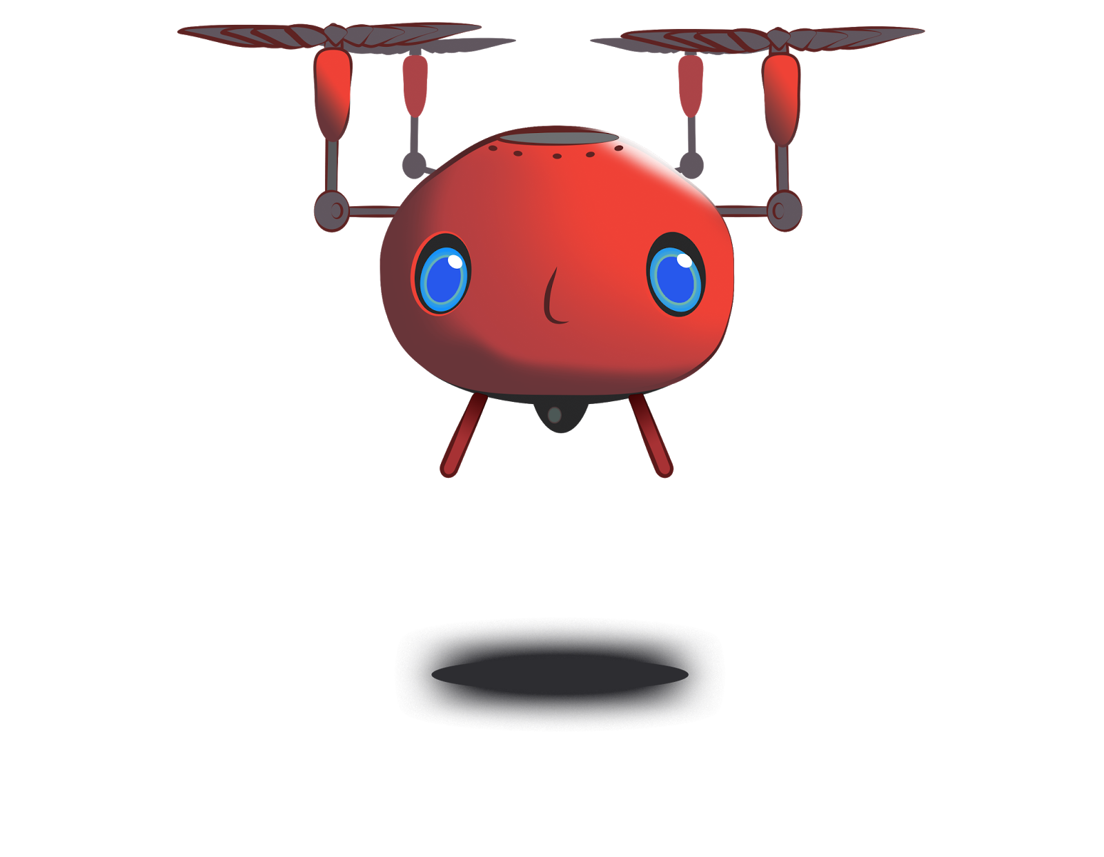
Motivating Example: Tiger Dining
I'm hungry!
https://flic.kr/p/X6PBUC

Slide 14
Tiger Dining Web App

Slide 16
Design Problem: Email Notifications

Slide 17
Chef’s View of Orders
Problem: Send email notifications as orders arrive
Notes:
When orders are placed they show up in the system like this.
Problem: The chef (and others) would like to receive email notifications to let them know when a new order has been placed. That way, they won't have to be constantly monitoring this webpage.

Slide 18
Existing Class: Subscribers List
Notes:
The system already has a subscription list of users who should receive email notifications (as shown in the picture).

Slide 19
Existing Classes
?
OrdersController
...
create()
…
EmailNotifier
...
order_notification()
...

Slide 20
Application of Observer Pattern

Slide 21
Application of Observer Pattern
OrdersController
...
create()
…
EmailNotifier
...
order_notification()
...

Slide 22
Application of Observer Pattern
Subject
...
attach(observer)
detach(observer)
notify()
OrdersController
...
create()
…
EmailNotifier
...
order_notification()
...

Slide 23
Application of Observer Pattern
Subject
...
attach(observer)
detach(observer)
notify()
OrdersController
...
create()
…
EmailNotifier
...
order_notification()
...

Slide 24
Application of Observer Pattern
Subject
...
attach(observer)
detach(observer)
notify()
Observer
update()
OrdersController
...
create()
…
EmailNotifier
...
order_notification()
...

Slide 25
Application of Observer Pattern
Subject
...
attach(observer)
detach(observer)
notify()
Observer
update()
OrdersController
...
create()
…
EmailNotifier
...
order_notification()
...

Slide 26
Application of Observer Pattern
Subject
...
attach(observer)
detach(observer)
notify()
Observer
update()
OrdersController
...
create()
…
EmailNotifier
...
order_notification()
update()
...

Slide 27
Application of Observer Pattern
Subject
...
attach(observer)
detach(observer)
notify()
*
observer
Observer
update()
OrdersController
...
create()
…
EmailNotifier
...
order_notification()
update()
...

Slide 28
Application of Observer Pattern
Subject
...
attach(observer)
detach(observer)
notify()
*
observer
Observer
update()
OrdersController
...
create()
…
EmailNotifier
...
order_notification()
update()
...
subject

Slide 29
Application of Observer Pattern
Subject
...
attach(observer)
detach(observer)
notify()
*
observer
Observer
update()
OrdersController
...
create()
…
EmailNotifier
...
order_notification()
update()
...
subject

Slide 30
Scenario: Create Order and Send Email
: OrdersController
: EmailNotifier
create()
<<create>>
: Order
save()
Saved to DB
notify()
update()
order_notification()
Email Sent

Slide 31
Common Uses of Observer Pattern
GUI programs
Used to respond to user input (e.g., button presses)
Sometimes referred to as callback
Server software
Used to listen for/respond to requests (e.g., HTTP requests)

Slide 32
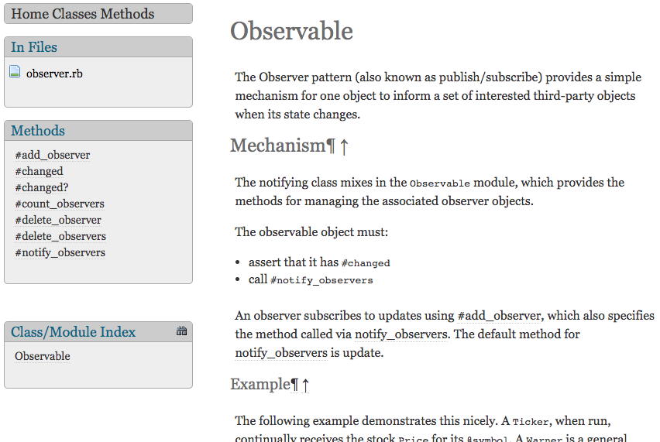
Observer Support in Ruby Std-lib
https://ruby-doc.org/stdlib-2.6.3/libdoc/observer/rdoc/Observable.html

Slide 33
Summary
Design Patterns – what and why
GoF Book
Observer Pattern
http://flic.kr/p/aCLor3

