Slide 1
http://flic.kr/p/7iffKj
Software Testing: Statement Coverage

Slide 2
The Testing Problem
How to choose set of test cases that reveals all errors?
Fundamental research problem
Essentially unsolvable in general case

Slide 3
Two common ways to choose test cases
Black-box testing
White-box testing

Slide 4
Black-Box Testing
Choose based on module’s possible inputs and outputs (i.e., its interface)
Do not use internal code
Often test boundary cases
Example: Values at 0, 1, and -1 (around the zero boundary)

Slide 5
White-Box Testing Aka glass box testing, clear box testing
Uses internal logic to choose tests
Different levels of code coverage
Degree to which source code of a program is tested by a test suite

Slide 6
Statement Coverage
Set of test cases such that each program statement is executed at least once

Slide 7
Coverage Support Tools
SimpleCov Ruby Gem

Slide 8
Coverage Support Tools
SimpleCov Ruby Gem

Slide 9
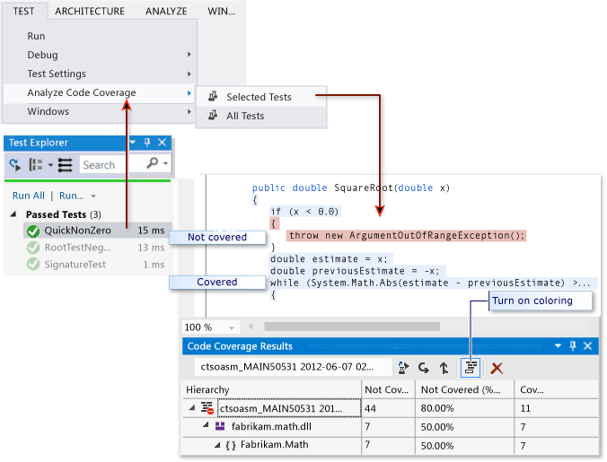
Coverage Support Tools
Visual Studio
https://msdn.microsoft.com/en-us/library/dd537628.aspx

Slide 10
Summary
The testing problem
Black-box testing and boundary conditions
White-box testing and code coverage
Statement coverage
http://flic.kr/p/aCLor3

