Slide 1
Design Patterns
Notes:
St. Paul's Cathedral, London
Photo by Scott Fleming

Slide 2
SWEBOK KAs covered so far
Software Requirements
Software Design
Software Construction
Software Testing
Software Maintenance
Software Configuration Management
Software Engineering Management
Software Engineering Process
Software Engineering Models and Methods
Software Quality
Software Engineering Professional Practice
Software Engineering Economics
Computing Foundations
Mathematical Foundations
Engineering Foundations
Today’s topic

Slide 3
Design Patterns
Template solutions to common problems
Cupola
Oculus
Pediment
Cornice
Columns
Portico

Slide 4
Benefits
Avoid re-inventing solutions
Promote quality
Reusability, maintainability, etc.
Facilitate communication

Slide 5
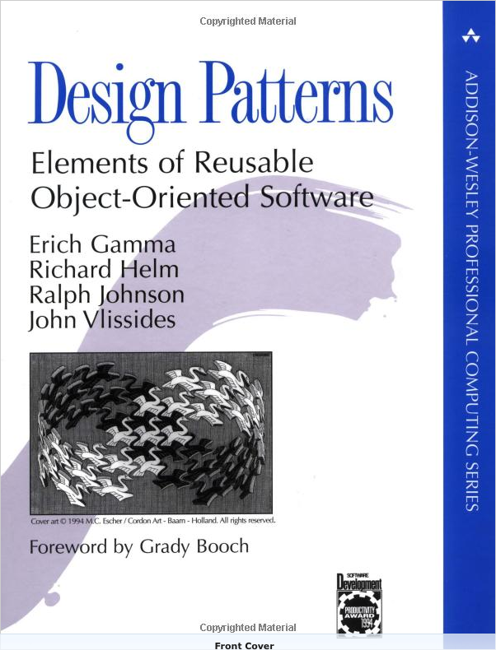
Popularized by the “Gang of Four” Book (GoF)
Catalog of 23 patterns
Many now ubiquitous
Must-read for pro devs
Let's see an example!

Slide 6
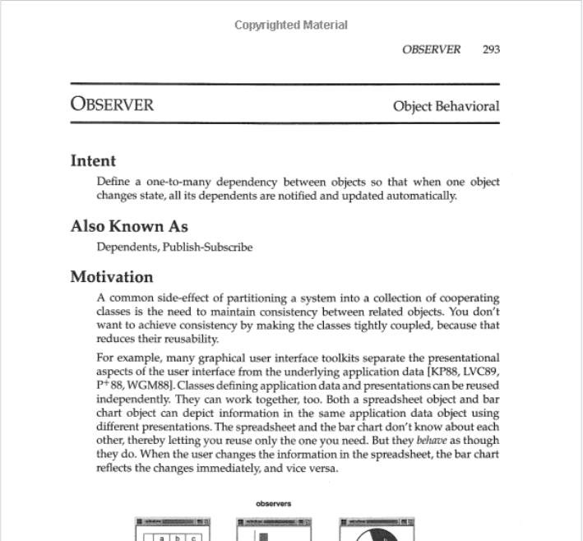
Observer Pattern
From Gamma et al. Design Patterns: Elements of Reusable Object-Oriented Software
Notes:
Needs to add an observer for the food order activity
Define one-to-many dependency

Slide 7
Elements of a Design Pattern in GoF
Intent
Also Known As
Motivation
Applicability
Structure
Participants
Collaborations
Consequences
Implementation
Sample Code
Known Uses
Related Patterns
Observer Pattern covers in 11 pages

Slide 8
Observer Pattern Structure
From Gamma et al. Design Patterns: Elements of Reusable Object-Oriented Software
Notes:
Needs to add an observer for the food order activity
Define one-to-many dependency

Slide 9
Side Note: Lots of (Minor) Variations Exist for Design Patterns

Slide 10
OODesign.com Variant
http://www.oodesign.com/observer-pattern.html
Notes:
Subject -> Observable
No association b/t ConcreteObserver and ConcreteObservable

Slide 11
Refactoring.Guru Variant
https://refactoring.guru/design-patterns/observer
Notes:
Subject -> Publisher
Observer -> Subscriber
Array of subscribers
update now takes publisher as argument

Slide 12
Wikipedia Variant #1
Actually very similar to the GoF version
https://en.wikipedia.org/wiki/Observer_pattern

Slide 13
Wikipedia Variant #2
https://en.wikipedia.org/wiki/Observer_pattern
Notes:
Nothing about ConcreteSubject
Attach/Detach -> register/unregister

Slide 14
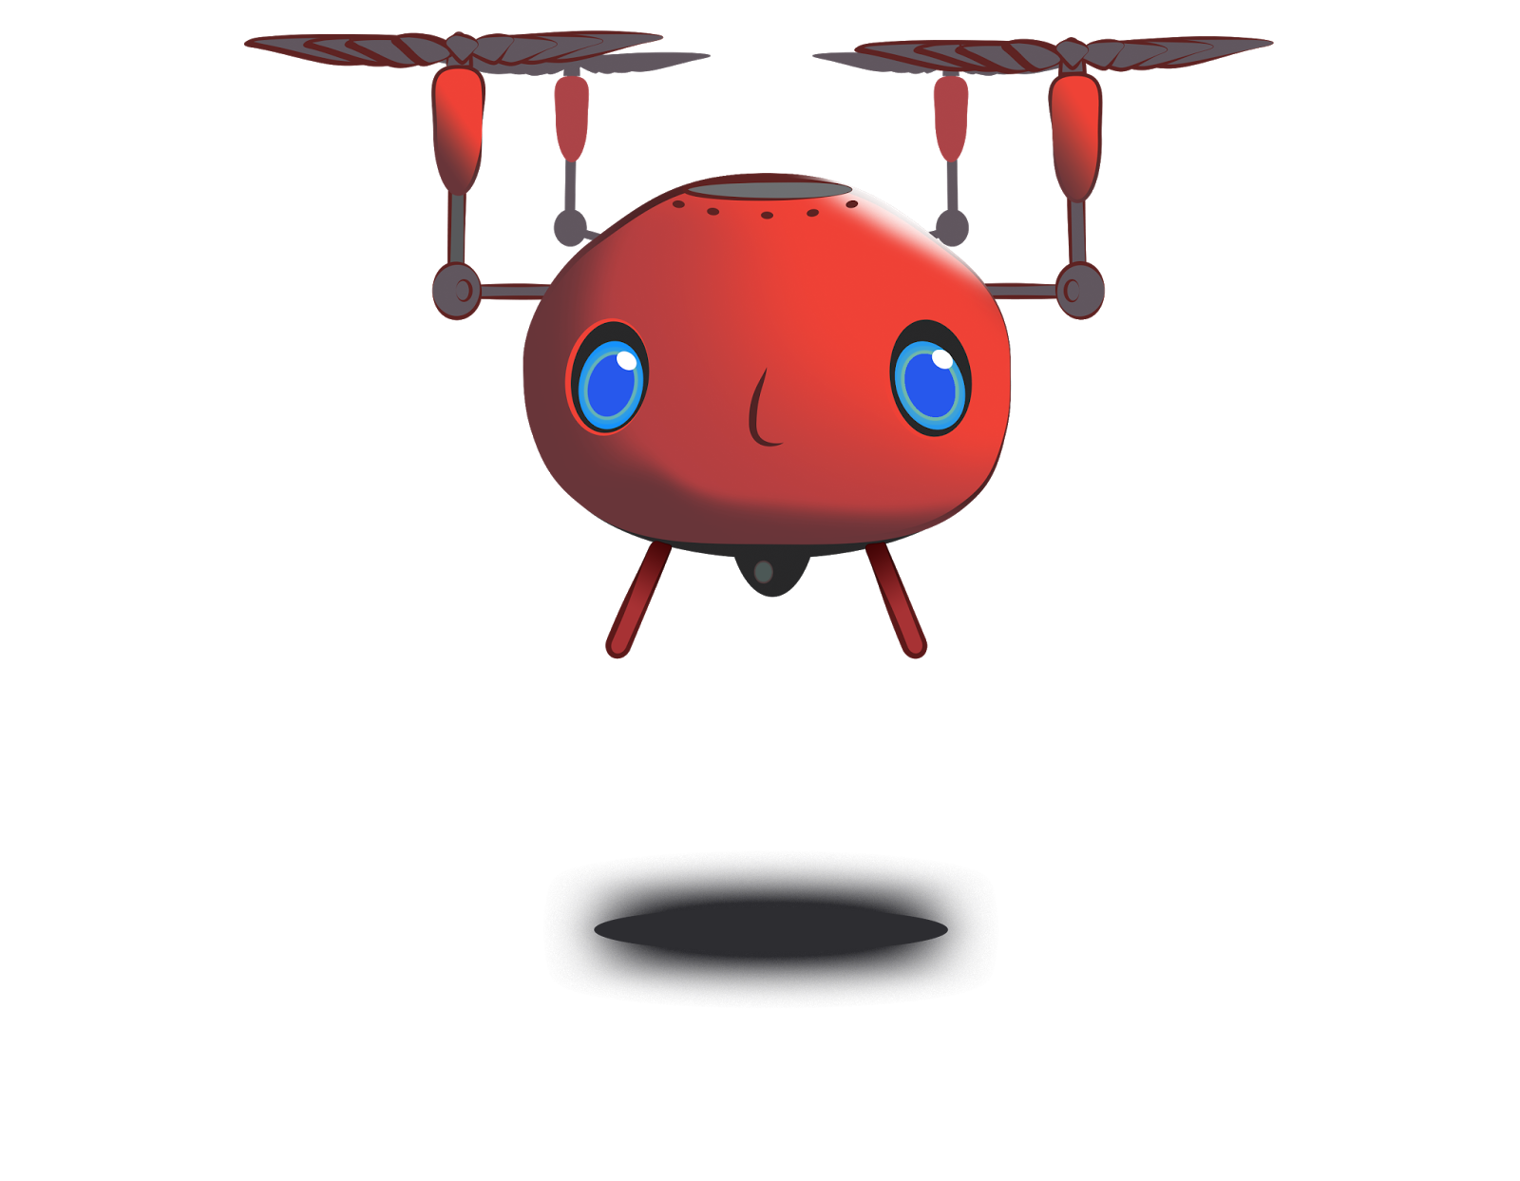
Motivating Example: Tiger Dining
I'm hungry!
https://flic.kr/p/X6PBUC

Slide 15
Tiger Dining Web App

Slide 17
Design Problem: Email Notifications

Slide 18
Chef’s View of Orders
Problem: Send email notifications as orders arrive
Notes:
When orders are placed they show up in the system like this.
Problem: The chef (and others) would like to receive email notifications to let them know when a new order has been placed. That way, they won't have to be constantly monitoring this webpage.

Slide 19
Existing Class: Subscribers List
Notes:
The system already has a subscription list of users who should receive email notifications (as shown in the picture).

Slide 20
Existing Classes
?
OrdersController
...
create()
…
EmailNotifier
...
order_notification()
...

Slide 21
Application of Observer Pattern

Slide 22
Application of Observer Pattern
OrdersController
...
create()
…
EmailNotifier
...
order_notification()
...

Slide 23
Application of Observer Pattern
Subject
...
attach(observer)
detach(observer)
notify()
OrdersController
...
create()
…
EmailNotifier
...
order_notification()
...

Slide 24
Application of Observer Pattern
Subject
...
attach(observer)
detach(observer)
notify()
OrdersController
...
create()
…
EmailNotifier
...
order_notification()
...

Slide 25
Application of Observer Pattern
Subject
...
attach(observer)
detach(observer)
notify()
Observer
update()
OrdersController
...
create()
…
EmailNotifier
...
order_notification()
...

Slide 26
Application of Observer Pattern
Subject
...
attach(observer)
detach(observer)
notify()
Observer
update()
OrdersController
...
create()
…
EmailNotifier
...
order_notification()
...

Slide 27
Application of Observer Pattern
Subject
...
attach(observer)
detach(observer)
notify()
Observer
update()
OrdersController
...
create()
…
EmailNotifier
...
order_notification()
update()
...

Slide 28
Application of Observer Pattern
Subject
...
attach(observer)
detach(observer)
notify()
*
observer
Observer
update()
OrdersController
...
create()
…
EmailNotifier
...
order_notification()
update()
...

Slide 29
Application of Observer Pattern
Subject
...
attach(observer)
detach(observer)
notify()
*
observer
Observer
update()
OrdersController
...
create()
…
EmailNotifier
...
order_notification()
update()
...
subject

Slide 30
Application of Observer Pattern
Subject
...
attach(observer)
detach(observer)
notify()
*
observer
Observer
update()
OrdersController
...
create()
…
EmailNotifier
...
order_notification()
update()
...
subject

Slide 31
Scenario: Create Order and Send Email
: OrdersController
: EmailNotifier
create()
<<create>>
: Order
save()
Saved to DB
notify()
update()
order_notification()
Email Sent

Slide 32
Other Observer Pattern Examples
Spreadsheet
Employee payroll
GUI program (callback)

Slide 33
Summary
Design Patterns – what and why
GoF Book
Observer Pattern
http://flic.kr/p/aCLor3

Slide 34
Appendix

Slide 35
This Lecture
Design patterns: what & why
When and how to apply
Several popular patterns:
Observer
Singleton
Adapter
Builder
Memento

Slide 36
Running Example: Tiger Dining
I'm hungry!
https://flic.kr/p/X6PBUC

Slide 37
Tiger Dining Web App

Slide 39
Design Problem 1: Email Notifications

Slide 40
Chef’s View of Orders
Problem: Send email notifications as orders arrive
Notes:
When orders are placed they show up in the system like this.
Problem: The chef (and others) would like to receive email notifications to let them know when a new order has been placed. That way, they won't have to be constantly monitoring this webpage.

Slide 41
Existing Class: Subscribers List
Notes:
The system already has a subscription list of users who should receive email notifications (as shown in the picture).

Slide 42
Existing Classes
?
OrdersController
...
create()
…
EmailNotifier
...
order_notification()
...

Slide 43
Solution: Observer Pattern
From Gamma et al. Design Patterns: Elements of Reusable Object-Oriented Software
Notes:
Needs to add an observer for the food order activity
Define one-to-many dependency

Slide 44
Side Note: Lots of (Minor) Variations Exist for Design Patterns

Slide 45
OODesign.com Variant
http://www.oodesign.com/observer-pattern.html

Slide 46
Refactoring.Guru Variant
https://refactoring.guru/design-patterns/observer

Slide 47
Wikipedia Variant #1
Actually very similar to the GoF version
https://en.wikipedia.org/wiki/Observer_pattern

Slide 48
Wikipedia Variant #2
https://en.wikipedia.org/wiki/Observer_pattern

Slide 49
Application of Observer Pattern

Slide 50
Application of Observer Pattern
OrdersController
...
create()
…
EmailNotifier
...
order_notification()
...

Slide 51
Application of Observer Pattern
Subject
...
attach(observer)
detach(observer)
notify()
OrdersController
...
create()
…
EmailNotifier
...
order_notification()
...

Slide 52
Application of Observer Pattern
Subject
...
attach(observer)
detach(observer)
notify()
OrdersController
...
create()
…
EmailNotifier
...
order_notification()
...

Slide 53
Application of Observer Pattern
Subject
...
attach(observer)
detach(observer)
notify()
Observer
update()
OrdersController
...
create()
…
EmailNotifier
...
order_notification()
...

Slide 54
Application of Observer Pattern
Subject
...
attach(observer)
detach(observer)
notify()
Observer
update()
OrdersController
...
create()
…
EmailNotifier
...
order_notification()
...

Slide 55
Application of Observer Pattern
Subject
...
attach(observer)
detach(observer)
notify()
Observer
update()
OrdersController
...
create()
…
EmailNotifier
...
order_notification()
update()
...

Slide 56
Application of Observer Pattern
Subject
...
attach(observer)
detach(observer)
notify()
*
observer
Observer
update()
OrdersController
...
create()
…
EmailNotifier
...
order_notification()
update()
...

Slide 57
Application of Observer Pattern
Subject
...
attach(observer)
detach(observer)
notify()
*
observer
Observer
update()
OrdersController
...
create()
…
EmailNotifier
...
order_notification()
update()
...
subject

Slide 58
Application of Observer Pattern
Subject
...
attach(observer)
detach(observer)
notify()
*
observer
Observer
update()
OrdersController
...
create()
…
EmailNotifier
...
order_notification()
update()
...
subject

Slide 59
Scenario: Create Order and Send Email
: OrdersController
: EmailNotifier
create()
<<create>>
: Order
save()
Saved to DB
notify_observers()
update()
Email Sent

Slide 60
How to Apply Observer Pattern
Modify OrdersController (Subject)
include Observable
Add observer using add_observer()
After saving order, call notify_observers()
Modify EmailNotifier (Observer)
Add update method that xxx
Notes:
Add code snippet

Slide 61
Example OrdersController
...
...

Slide 62
Example EmailNotifier

Slide 63
Goal: Implement Observer pattern
Notes:
** ExampleMailer is a goofy name, and this is not consistent with the class diagram.
** Probably should show Notification class in class diagrams
** Emailer gem would be good know about here

Slide 64
Other Examples
Spreadsheet
Employee payroll
GUI program (callback)

Slide 65
Design problem:
Sales Logging

Slide 66
Problem
Saves records of transactions as backup
Sales logging for transaction failure

Slide 67
Existing Class
SalesLogger
initialize(file)
formatter
log(message)

Slide 68
Solution: Singleton Pattern
From Gamma et al. Design Patterns: Elements of Reusable Object-Oriented Software

Slide 69
Application of Singleton Pattern
SalesLogger
inst : SalesLogger
initialize(file)
formatter
log(message)
instance() : SalesLogger
**Static Association???

Slide 70
Solution: Singleton
Single file to log all the sales information
Easy to look up
Singleton
inst: Singleton
instance(): Singleton
…
if inst == nil
inst = Singleton.new
end
return inst

Slide 71
Making class Singleton
Steps of making a class Singleton:
Creating the class variable
@@instance
Initializing it with the single instance
@@instance = SimpleLogger.new
Creating the class level instance method
Making new private

Slide 72
Goal: Implement Singleton pattern
SalesLogger class
include “Singleton”
SalesController
call instance
call log(message)

Slide 73
Goal: Implement Singleton pattern
Notes:
** This example is a mess

Slide 74
Singleton Examples
In Rails:
development.log
test.log
Webrick in rake
Outside Rails:
tomcat
ant

Slide 75
Design problem:
New Payment method

Slide 76
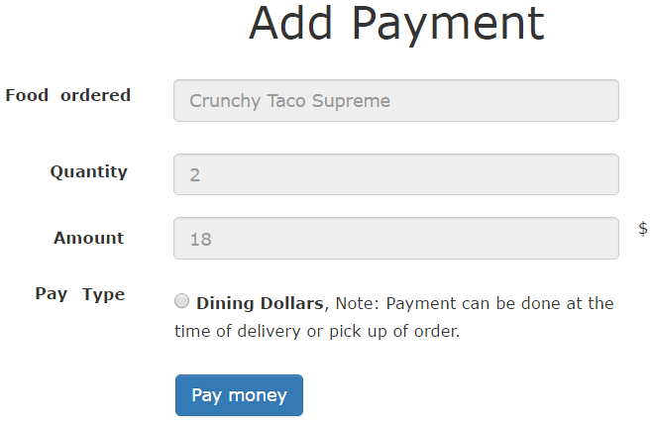
Goal: To Add Visa Debit Card and Paypal

Slide 77
Goal: To add VisaPay
PaymentsController
new
create
…
DiningDollars
charge(uid)
…

Slide 78
Solution: Adapter
Interface which bridge a gap in payment methods
Key objects are Target, Adapter and Adaptee
Client
Target
Request()
Adapter
Request()
Adaptee
SpecificRequest()

Slide 79
PaymentsController
PaymentProcessor
process_payment()
DiningDollarsAdapter
process_payment()
VisaPayAdapter
process_payment()
…
…
DiningDollars
charge(uid)
VisaPay
pay(debitcard, cvv, exp)
…
…

Slide 80
Control Flow
PaymentsController
VisaPayAdapter
VisaPay
create
process_payment
pay
Visa processes the payment

Slide 81
Goal: Implement Adapter Pattern
PaymentsController
“create” method call the adapter based on the input type
VisaPayAdapter
defines “process_payments” inherited from the PaymentProcessor
VisaPay
defines pay(creditcard, cvv, exp) saves the information

Slide 82
Adapter: Example in Rails
Active Records
Contains adapters for several databases (PostgreSQL or MySQL)
Wraps them up in common interface
AbstractAdapter implements common functionality
PostgreSQLAdapter
AbstractMysqlAdapter

Slide 83
Running Example: Tiger Dining

Slide 84
Recall: Adapter Pattern Solution to Support Multiple Payment Methods

Slide 85
Goal: To add additional payment methods
PaymentsController
new
create
…
DiningDollars
charge(uid)
…

Slide 86
Solution: Adapter
Interface which bridge a gap in payment methods
Key objects are Target, Adapter and Adaptee
Client
Target
request()
Adapter
request()
Adaptee
specificrequest()

Slide 87
PaymentsController
PaymentProcessor
process_payment()
…
DiningDollarsAdapter
process_payment()
VisaPayAdapter
process_payment()
DiningDollars
charge(uid)
VisaPay
pay(debitcard, cvv, exp)

Slide 88
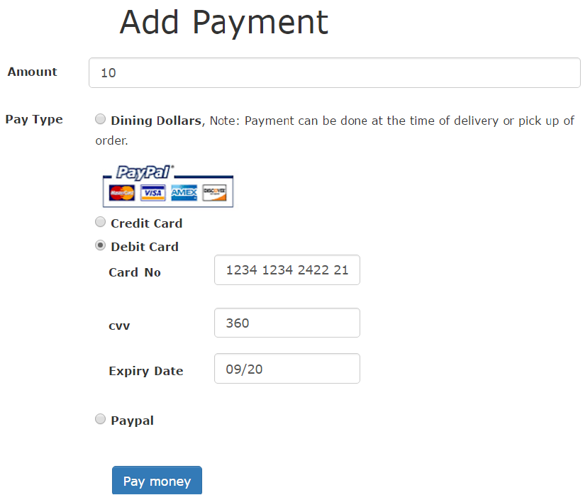

Slide 89
Control Flow
PaymentsController
create

Slide 90
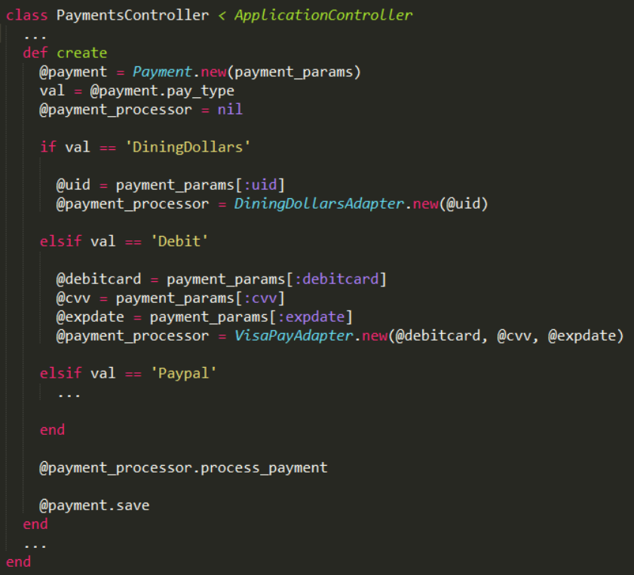

Slide 94
Control Flow
PaymentsController
create
new
vpa:VisaPayAdapter

Slide 97
Control Flow
PaymentsController
create
new
vpa:VisaPayAdapter
new
vp:VisaPay

Slide 99
Control Flow
PaymentsController
create
new
vpa:VisaPayAdapter
new
vp:VisaPay
process_payment

Slide 102
Control Flow
PaymentsController
create
new
vpa:VisaPayAdapter
new
vp:VisaPay
process_payment
pay
Visa processes the payment

Slide 103
Yuck!

Slide 104
Design problem:
Clean up payment initialization

Slide 105
Solution: Separate construction code
Needs to separate construction of a complex object
Same construction interface creates different representation

Slide 106
Solution: Builder
Director
construct()
Builder
build()
ConcreteBuilder
build()
Product

Slide 107
PaymentsController
create()
PaymentProcessorBuilder
build(params)
…
DiningDollarsAdapterBuilder
build(params)
VisaPayAdapterBuilder
build(params)
DiningDollarsAdapter
VisaPayAdapter

Slide 108
Goal: Implement Builder pattern
Step 1: Create Builder Classes
Step 2: Move constructor code out of controller inside build
Step 3: instantiate build class inside construct

Slide 109
Goal: Implement Builder pattern
Step 1: Create Builder Classes
Step 2: Move constructor code out of controller inside build
Step 3: instantiate build class inside construct

Slide 111
Goal: Implement Builder pattern
Step 1: Create Builder Classes
Step 2: Move constructor code out of controller inside build
Step 3: instantiate build class inside construct

Slide 115
Goal: Implement Builder pattern
Step 1: Create Builder Classes
Step 2: Move constructor code out of controller inside build
Step 3: instantiate build class inside construct

Slide 117
Control Flow
: PaymentsController
create
new
vpab:VisaPayAdapterBuilder
build

Slide 118
Control Flow
: PaymentsController
create
new
vpab:VisaPayAdapterBuilder
build
new
vpa:VisaPayAdapter
process_payment

Slide 119
Design problem:
Delete from cart and Undo

Slide 121
Cannot retrieve back

Slide 122
OrdersController
new
create
…
destroy

Slide 123
Solution: Memento
Needs to store the state of the order
Originator
state …
create_memento(): Memento
set_memento(memento)
Memento
state …
getters and setters …
Caretaker

Slide 124
Originator
state …
create_memento(): Memento
set_memento(memento)
Memento
state …
getters and setters …
Caretaker
Order
…
create_memento
set_memento(version)
OrderMemento
order …
initialize
OrderMementoCaretaker

Slide 125
Control Flow: destroy
: OrdersController
destroy

Slide 126
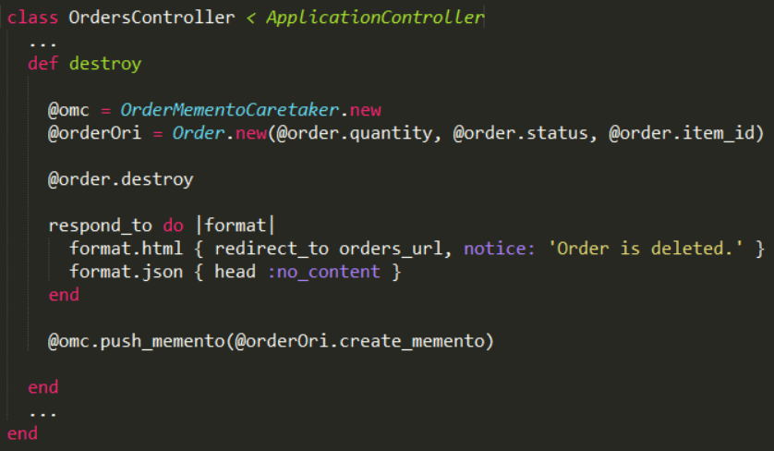
Goal: Implement Memento pattern

Slide 127
Control Flow: destroy
: OrdersController
destroy
omc: OrderMementoCaretaker
or: Order

Slide 128
Goal: Implement Memento pattern

Slide 129
Goal: Implement Memento pattern

Slide 130
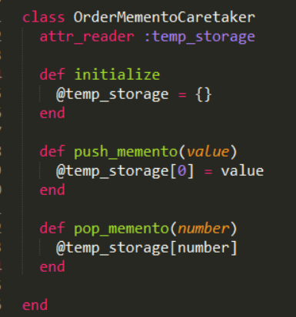
Goal: Implement Memento pattern

Slide 131
Control Flow: destroy
: OrdersController
destroy
omc: OrderMemento
Caretaker
new
new
or: Order
destroy

Slide 132
Goal: Implement Memento pattern

Slide 133
Goal: Implement Memento pattern

Slide 134
Control Flow: destroy
: OrdersController
destroy
omc: OrderMemento
Caretaker
new
new
or: Order
destroy
create_memento
new
om:OrderMemento

Slide 135
Goal: Implement Memento pattern

Slide 136
Goal: Implement Memento pattern

Slide 138
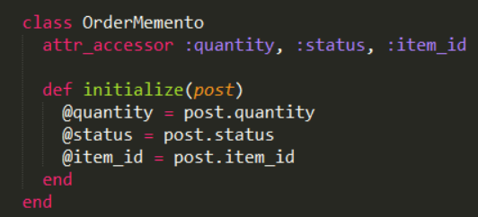
Goal: Implement Memento pattern

Slide 139
Control Flow: destroy
: OrdersController
destroy
omc: OrderMemento
Caretaker
new
new
or: Order
destroy
create_memento
new
om:OrderMemento
push_memento

Slide 140
Goal: Implement Memento pattern

Slide 141
Goal: Implement Memento pattern

Slide 142
Control Flow: undo
: OrdersController
undo
omc: OrderMemento
Caretaker
new
or: Order
pop_memento
set_memento
new
om:OrderMemento
save

Slide 143
Goal: Implement memento pattern
Order
“create_memento” and “set_memento”
OrderMemento
initialize
OrderMementoCaretaker
“push_memento” and “pop_memento”

Slide 144
Memento : Examples
Editor (Notepad, Sublime, Notepad++)
Provides features of undo and redo

