Slide 1

https://flic.kr/p/hcgHcm
Planning and Estimation

Slide 2
SWEBOK Knowledge Areas
Software Requirements
Software Design
Software Construction
Software Testing
Software Maintenance
Software Configuration Management
Software Engineering Management
Software Engineering Process
Software Engineering Models and Methods
Software Quality
Software Engineering Professional Practice
Software Engineering Economics
Computing Foundations
Mathematical Foundations
Engineering Foundations
Today’s topic

Slide 3
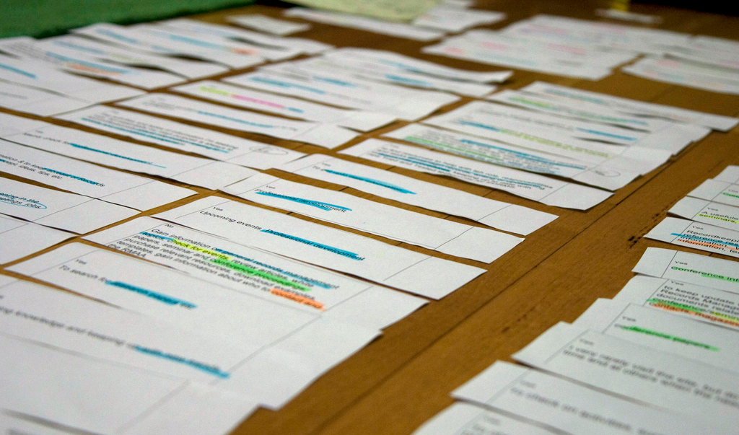
Now you have a bunch of user stories,
so what’s next?

Slide 4
Iterative Development Process
We are here
Analysis
Design
Implementation
Requirements
Planning
Initial
Planning
Testing
Evaluation
Deployment

Slide 5
Developer
Customer
Requirements
Create USs
USs
Check USs
Corrections/Clarifications
Fix USs
Add Estimates
USs + Estimates
Add Priorities
USs + Estimates + Priorities
Choose USs for Iteration
Divide Chosen USs into Tasks
Estimate Tasks
Assign Tasks to Workers
Get to Work!

Slide 6
Developer
Customer
Requirements
Create USs
USs
Check USs
Corrections/Clarifications
Fix USs
Add Estimates
USs + Estimates
Add Priorities
USs + Estimates + Priorities
Choose USs for Iteration
Divide Chosen USs into Tasks
Estimate Tasks
Assign Tasks to Workers
Get to Work!

Slide 7
Estimating Time
http://xkcd.com/1658/

Slide 8
Hofstadter's Law
It always takes longer than you expect, even when you take into account Hofstadter's Law.
— Douglas Hofstadter, Gödel, Escher, Bach

Slide 9
Principles for Estimation
Principle: Past performance is the best indicator of future performance
  Approach: Track your outcomes; refine your estimates
Principle: Wisdom of the crowd
  Goal: Predict how events will unfold
    Think event planning
  Problem: Easy to miss something
  Solution: More brains = more opportunities to catch eventualities

Slide 10
Principles for Estimation
Principle: Past performance is the best indicator of future performance
  Approach: Track your outcomes; refine your estimates
Principle: Wisdom of the crowd
  Goal: Predict how events will unfold
    Think event planning
  Problem: Easy to miss something
  Solution: More brains = more opportunities to catch eventualities
No past performance yet, so…

Slide 11
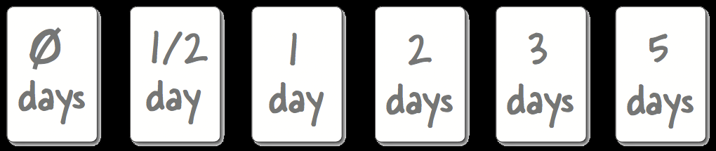
Estimation with Planning Poker
Cards with units of work: 1, 3, 5, 8, 13, 20, 40
  Assume team can do 20 units in an iteration
For each US:
  Discuss work involved
  Flip cards
  Repeat until consensus
Efficiency in estimating is important
  Don’t expect your estimates to be super accurate

Slide 12
Let’s watch this video to find out
what planning poker is all about:
http://youtu.be/0FbnCWWg_NY

Slide 13
More Estimation Principles
Engineers refine estimates;
customers refine expectations
  Estimates are basis for customer’s cost assessment
Give honest estimates that customers can trust
  Don’t do this: https://youtu.be/t9SVhg6ZENw
Work at a sustainable pace
  No heroes, no all-nighters, no super-human feats
  Either you get the code done like a human being, or you don’t

Slide 14
Developer
Customer
Requirements
Create USs
USs
Check USs
Corrections/Clarifications
Fix USs
Add Estimates
USs + Estimates
Add Priorities
USs + Estimates + Priorities
Choose USs for Iteration
Divide Chosen USs into Tasks
Estimate Tasks
Assign Tasks to Workers
Get to Work!

Slide 15
Principle: Customer sets priorities
Ensures alignment with customer goals
Helps customer feel in control
  Project isn’t going “off the rails”
Estimates help customer maximize cost-benefit

Slide 16
Priority Numbering Scheme
Multiples of 10:
  10 - Highest priority
  20
  30
  40
  50
  … - Lowest priority
Non-multiples of 10 may be used if helpful

Slide 17
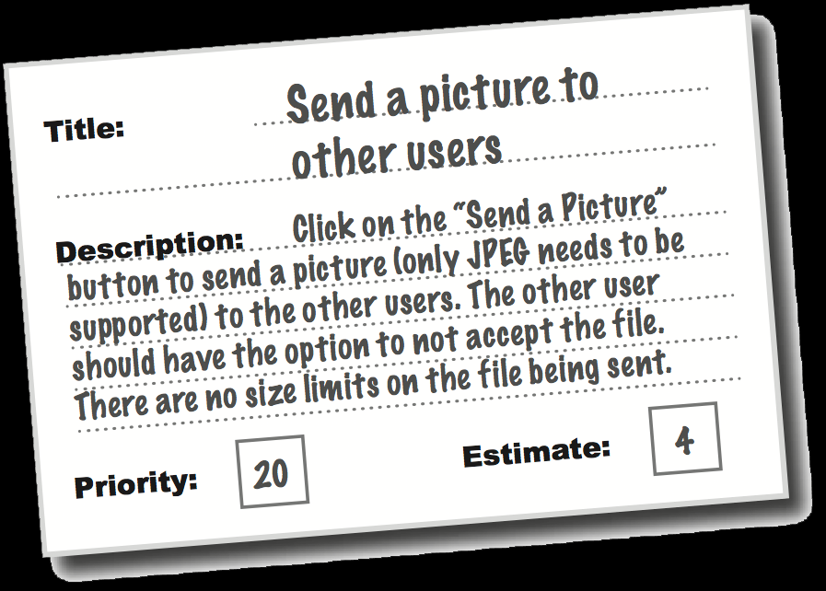
So now you have…
Collection of user stories
  With estimates
  And customer priorities
What’s next?

Slide 18
Developer
Customer
Requirements
Create USs
USs
Check USs
Corrections/Clarifications
Fix USs
Add Estimates
USs + Estimates
Add Priorities
USs + Estimates + Priorities
Choose USs for Iteration
Divide Chosen USs into Tasks
Estimate Tasks
Assign Tasks to Workers
Get to Work!

Slide 19

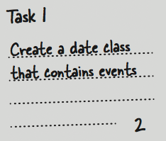
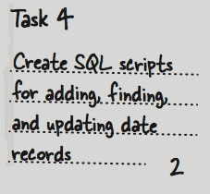
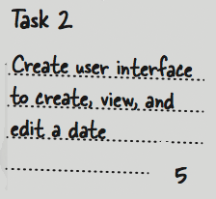
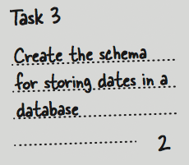
From USs to Tasks
User Story
Estimate

Slide 20
Incremental Development Principle
Each task produces running code
  Unit tests count

Slide 21
Task design strategy
Make tasks build upon one another
  First task makes subset of US work (e.g., partial form)
  Second task makes bit more work (e.g., add persistence)
  Etc…

Slide 22
Next Steps
Part 1: Estimate USs
  Use Planning Poker
  Start designing
Part 2: Collect customer priorities
  Assign number each US
  Also note any corrections/clarifications
Part 3:
  Choose USs for Development Iteration 1
    3 weeks worth of work
  Fill out iteration plan with what each team member will do
    Everyone codes
    Tasks must be verifiable and executable
    Printouts due by class on Mon and dropbox submission too

