Slide 1
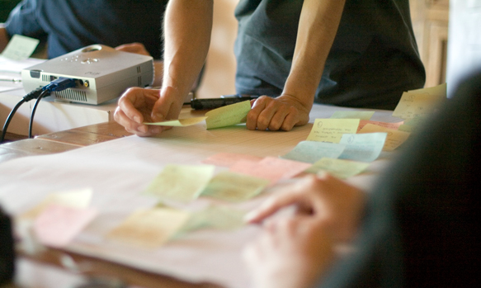
http://flic.kr/p/6sdZDR
Software Requirements

Slide 2
SWEBOK Knowledge Areas
Today’s topic
Software Requirements
Software Design
Software Construction
Software Testing
Software Maintenance
Software Configuration Management
Software Engineering Management
Software Engineering Process
Software Engineering Models and Methods
Software Quality
Software Engineering Professional Practice
Software Engineering Economics
Computing Foundations
Mathematical Foundations
Engineering Foundations

Slide 3
Iterative Development Process
We are here
Analysis
Design
Implementation
Requirements
Planning
Initial Planning
Testing
Evaluation
Deployment

Slide 4
Problems
Need to figure out what customer wants
Not make false/incorrect assumptions
Need to chunk work into bite-sized pieces
So work can be divided up
So system can be built incrementally
So estimates are remotely accurate

Slide 5
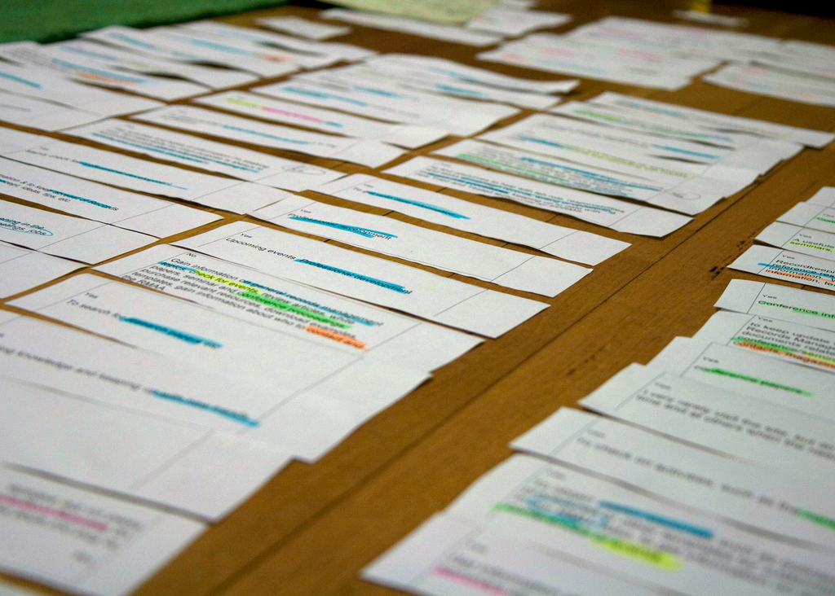
User stories (USs)
“Plan using units of customer-visible functionality.”
http://flic.kr/p/884GBP
Notes:
Quote from Kent Beck’s Extreme Programming Explained (2005).

Slide 6
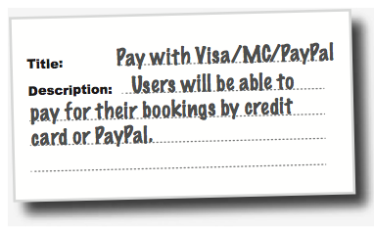
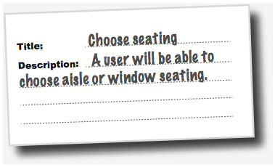
Flight-Booking System Example
Two parts: title and description

Slide 7
User Story Dos and Don’ts
USs should …
USs should not …
describe one thing that the software needs to do for the customer
be written using language that the customer understands
be written by the customer (figuratively speaking)
be short. Aim for no more than three sentences
be a long essay
use technical terms that are unfamiliar to the customer
mention specific technologies
Principle: Keep requirements customer-oriented

Slide 8
Helpful US-Description Template
Template: “As a <who>, I want <what> <why>.”
Can be rearranged as long as it includes who, what, why
Example: “As a dog, I want to order food online, so I don’t have to rely on people anymore.”
“Why” is optional, but helpful
Don’t be afraid to have multiple whos, each with their own why

Slide 9
US-Description Examples: Who and What

Slide 10
Helpful US-Title Template: Verb + Noun

Slide 11
Let’s write some user stories!
Title: <verb> <noun>
Description: As a <who>, I want <what> <why>.

