Slide 1
https://flic.kr/p/dxGXD
MVC Model Associations
Notes:
Painted Shadows - Not Allowed
Taken from Alexander Calder's mobile room at the National Gallery of Art, Washington DC.

Slide 2
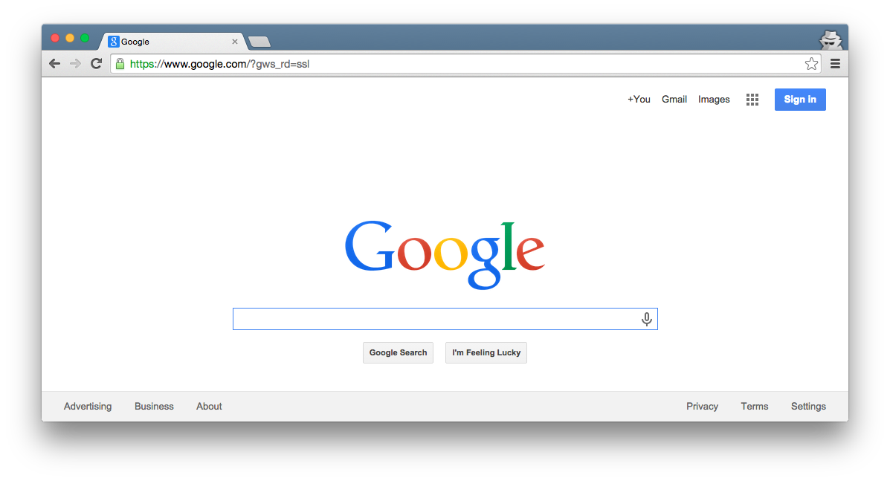
Browser
Migrations
Ye Olde Internet
Tests
DB
Server
View
Router
Controller
Model

Slide 3
Browser
Migrations
Ye Olde Internet
Tests
DB
Server
View
Router
Controller
Model

Slide 4
MVC Model Review
Browser
What key capability do Rails model classes provide?
Ye Olde Internet
DB
Server
View
Router
Controller
Model

Slide 5
MVC Model Review
Browser
What key capability do Rails model classes provide?
CRUD persistent data
Ye Olde Internet
DB
Server
View
Router
Controller
Model

Slide 6
MVC Model Review
Browser
How do you create Rails model classes?
Ye Olde Internet
DB
Server
View
Router
Controller
Model

Slide 7
MVC Model Review
Browser
How do you create Rails model classes?
Generate DB migrations and model classes with “rails g model …” then customize
Ye Olde Internet
DB
Server
View
Router
Controller
Model

Slide 8
MVC Model Review
Browser
What purpose do migrations serve?
Ye Olde Internet
DB
Server
View
Router
Controller
Model

Slide 9
MVC Model Review
Browser
What purpose do migrations serve?
Setup tables in DB via, e.g., “rake db:migrate” command
Ye Olde Internet
DB
Server
View
Router
Controller
Model

Slide 10
MVC Model Review
What DB table would go with this model class?
Model Class:
Database Table:
Author
???
first_name : string
last_name : string
year : integer

Slide 11
MVC Model Review
What DB table would go with this model class?
Model Class:
Database Table:
authors
Author
id | first_name | last_name | year
1 | Ayn | Rand | 1905
2 | Peter | Benchley | 1940
first_name : string
last_name : string
year : integer

Slide 12
MVC Model Review
What DB table would go with this model class?
Model Class:
Database Table:
authors
Author
id | first_name | last_name | year
1 | Ayn | Rand | 1905
2 | Peter | Benchley | 1940
first_name : string
last_name : string
year : integer
Recall Rails ORM (Object-Relational Mapping)

Slide 13
MVC Model Review
What Author methods does Rails provide “for free”?
Model Class:
Author
first_name : string
last_name : string
year : integer

Slide 14
MVC Model Review
What Author methods does Rails provide “for free”?
Model Class:
Many methods:
Author.create/Author.create!
Author.find
Author.find_by
Author.all
Getters/Setters for attributes
Author#first_name
Author#first_name=
Author#save/Author#save!
Author#destroy
Author#valid?
Author
first_name : string
last_name : string
year : integer

Slide 15
MVC Model Review
What customizations might you add to Author?
Model Class:
Author
first_name : string
last_name : string
year : integer

Slide 16
MVC Model Review
What customizations might you add to Author?
Model Class:
Only customization covered so far is data validation
Author
first_name : string
last_name : string
year : integer

Slide 17
Limitation so far: Insular model classes/tables
Model Class:
Database Table:
authors
Author
id | first_name | last_name | year
1 | Ayn | Rand | 1905
2 | Peter | Benchley | 1940
first_name : string
last_name : string
year : integer

Slide 18
Imagine an author-profile class
Model Class:
Database Table:
authors
Author
id | first_name | last_name | year
1 | Ayn | Rand | 1905
2 | Peter | Benchley | 1940
first_name : string
last_name : string
year : integer
AuthorProfile
author_profiles
birthplace : string
bio : text
awards : text
id | birthplace | bio | awards
23 | Saint Petersburg | Rand was born… | Prometheus Award, …
42 | New York City | He was the son of… | Shark Conservation, …

Slide 19
What if you want inter-class relationships?
Author
???
AuthorProfile
first_name : string
last_name : string
year : integer
birthplace : string
bio : text
awards : text
For example, you might want to say:

Slide 20
Requires inter-table references
authors
id | first_name | last_name | year
1 | Ayn | Rand | 1905
2 | Peter | Benchley | 1940
author_profiles
id | birthplace | bio | awards
23 | Saint Petersburg | Rand was born… | Prometheus Award, …
42 | New York City | He was the son of… | Shark Conservation, …

Slide 21
Rails Relationship Support
has one / belongs to one
has many / belongs to one
has and belongs to many
join table
Easiest to learn, but narrow in focus
Most complex, but also most flexible

Slide 22
Rails Relationship Support
has one / belongs to one
has many / belongs to one
has and belongs to many
join table

Slide 23
Has One / Belongs To One Example
Author
AuthorProfile
1
author
has
1
profile
first_name : string
last_name : string
year : integer
birthplace : string
bio : text
awards : text

Slide 24
Has One / Belongs To One Example
Author
AuthorProfile
1
author
has
1
profile
first_name : string
last_name : string
year : integer
birthplace : string
bio : text
awards : text
Class Association

Slide 25
Has One / Belongs To One Example
Author
AuthorProfile
1
author
has
1
profile
first_name : string
last_name : string
year : integer
birthplace : string
bio : text
awards : text
Association Name Triangle indicates reading direction (i.e., Author has AuthorProfile)

Slide 26
Has One / Belongs To One Example
Author
AuthorProfile
1
author
has
1
profile
first_name : string
last_name : string
year : integer
birthplace : string
bio : text
awards : text
Role Names
Like attribute/method name
Enables this method call:
@author.profile.birthplace

Slide 27
Has One / Belongs To One Example
Author
AuthorProfile
1
author
has
1
profile
first_name : string
last_name : string
year : integer
birthplace : string
bio : text
awards : text
Multiplicities

Slide 28
Has One / Belongs To One Example
Author
AuthorProfile
1
author
has
1
profile
first_name : string
last_name : string
year : integer
birthplace : string
bio : text
awards : text
Multiplicities
Each Author has 1 AuthorProfile

Slide 29
Has One / Belongs To One Example
Author
AuthorProfile
1
author
has
1
profile
first_name : string
last_name : string
year : integer
birthplace : string
bio : text
awards : text
Multiplicities
Each Author has 1 AuthorProfile
Each AuthorProfile is had by 1 Author

Slide 30
Has One / Belongs To One Example
Author
AuthorProfile
1
author
has
1
profile
first_name : string
last_name : string
year : integer
birthplace : string
bio : text
awards : text
Multiplicities
Each Author has 1 AuthorProfile
Each AuthorProfile is had by 1 Author
More Multiplicities:
A
has
*
B
Each A has 0 or more Bs
A
has
0..*
B
Each A has 0 or more Bs
A
has
1..*
B
Each A has 1 or more Bs

Slide 31
Has One / Belongs To One Example
Author
AuthorProfile
1
author
has
1
profile
first_name : string
last_name : string
year : integer
birthplace : string
bio : text
awards : text
Associated DB Tables
authors
id | first_name | last_name | year
1 | Ayn | Rand | 1905
2 | Peter | Benchley | 1940
author_profiles
id | author _id | birthplace | bio | awards
23 | 1 | Saint Petersburg | Rand was born… | Prometheus Award, …
42 | 2 | New York City | He was the son of… | Shark Conservation, …

Slide 32
Has One / Belongs To One Example
Author
AuthorProfile
1
author
has
1
profile
first_name : string
last_name : string
year : integer
birthplace : string
bio : text
awards : text
Associated DB Tables
authors
id | first_name | last_name | year
1 | Ayn | Rand | 1905
2 | Peter | Benchley | 1940
references
author_profiles
id | author _id | birthplace | bio | awards
23 | 1 | Saint Petersburg | Rand was born… | Prometheus Award, …
42 | 2 | New York City | He was the son of… | Shark Conservation, …

Slide 33
Primary versus Foreign Keys
Primary Key: Uniquely identifies each record in table
authors
id | first_name | last_name | year
1 | Ayn | Rand | 1905
2 | Peter | Benchley | 1940
author_profiles
id | author _id | birthplace | bio | awards
23 | 1 | Saint Petersburg | Rand was born… | Prometheus Award, …
42 | 2 | New York City | He was the son of… | Shark Conservation, …

Slide 34
Primary versus Foreign Keys
Primary Key: Uniquely identifies each record in table
Foreign Key: Field in table A such that the field is a primary key in one other table B
authors
id | first_name | last_name | year
1 | Ayn | Rand | 1905
2 | Peter | Benchley | 1940
author_profiles
id | author _id | birthplace | bio | awards
23 | 1 | Saint Petersburg | Rand was born… | Prometheus Award, …
42 | 2 | New York City | He was the son of… | Shark Conservation, …

Slide 35
Primary versus Foreign Keys
Primary Key: Uniquely identifies each record in table
Foreign Key: Field in table A such that the field is a primary key in one other table B
authors
id | first_name | last_name | year
1 | Ayn | Rand | 1905
2 | Peter | Benchley | 1940
author_profiles
id | author _id | birthplace | bio | awards
23 | 1 | Saint Petersburg | Rand was born… | Prometheus Award, …
42 | 2 | New York City | He was the son of… | Shark Conservation, …

Slide 36
Rails Relationship Support
has one / belongs to one
has many / belongs to one
has and belongs to many
join table

Slide 37
Has Many / Belongs to One Example
Author
AuthorProfile
1
author
has
1
profile
first_name : string
last_name : string
year : integer
birthplace : string
bio : text
awards : text
Book
How to model authorship? (assume 1 author per book)
title : string
year : integer
summary : text

Slide 38
Has Many / Belongs to One Example
Author
AuthorProfile
1
author
has
1
profile
first_name : string
last_name : string
year : integer
birthplace : string
bio : text
awards : text
1 author
has
* book
Book
How to model authorship? (assume 1 author per book)
title : string
year : integer
summary : text

Slide 39
Has Many / Belongs to One Example
What should the ORM be?
(hint: authors table unchanged)
Author
first_name : string
last_name : string
year : integer
authors
1 author
id | first_name | last_name | year
1 | Ayn | Rand | 1905
2 | Peter | Benchley | 1940
has
* book
Book
title : string
year : integer
summary : text

Slide 40
Has Many / Belongs to One Example
What should the ORM be?
(hint: authors table unchanged)
Author
first_name : string
last_name : string
year : integer
authors
1 author
id | first_name | last_name | year
1 | Ayn | Rand | 1905
2 | Peter | Benchley | 1940
has
* book
Book
title : string
year : integer
summary : text
books
id | title | year | summary | author_id
72 | The Fountainhead | 1943 | Individualistic architect… | 1
98 | Atlas Shrugged | 1957 | Dystopian USA… | 1
99 | Jaws | 1974 | Shark!... | 2

Slide 41
Has Many / Belongs to One Example
What should the ORM be?
(hint: authors table unchanged)
Author
first_name : string
last_name : string
year : integer
authors
1 author
id | first_name | last_name | year
1 | Ayn | Rand | 1905
2 | Peter | Benchley | 1940
has
* book
Book
title : string
year : integer
summary : text
books
id | title | year | summary | author_id
72 | The Fountainhead | 1943 | Individualistic architect… | 1
98 | Atlas Shrugged | 1957 | Dystopian USA… | 1
99 | Jaws | 1974 | Shark!... | 2

Slide 42
Has Many / Belongs to One Example
Rails generates “books” method that returns list of books
Author
first_name : string
last_name : string
year : integer
authors
1 author
id | first_name | last_name | year
1 | Ayn | Rand | 1905
2 | Peter | Benchley | 1940
has
* book
Book
title : string
year : integer
summary : text
books
id | title | year | summary | author_id
72 | The Fountainhead | 1943 | Individualistic architect… | 1
98 | Atlas Shrugged | 1957 | Dystopian USA… | 1
99 | Jaws | 1974 | Shark!... | 2

Slide 43
Rails Relationship Support
has one / belongs to one
has many / belongs to one
has and belongs to many
join table

Slide 44
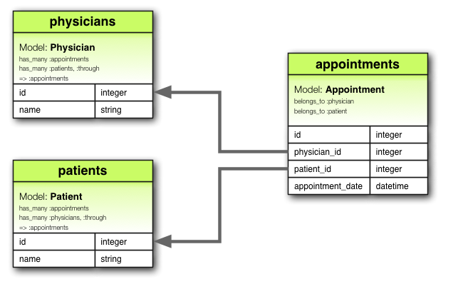
Join Table Example
From http://guides.rubyonrails.org/v4.2.0/association_basics.html

Slide 45
Join Table Example
Join table
From http://guides.rubyonrails.org/v4.2.0/association_basics.html

Slide 46
Join Table Example
References (aka foreign keys)
From http://guides.rubyonrails.org/v4.2.0/association_basics.html

Slide 47
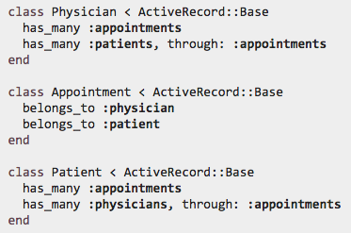
Join Table Example: Model Class
“through” enables this sort of thing:
From http://guides.rubyonrails.org/v4.2.0/association_basics.html

Slide 48
Rails Relationship Support
has one / belongs to one
has many / belongs to one
has and belongs to many
join table
For more info, see…
Rails Guide Chapter:
http://guides.rubyonrails.org/v5.2.1/association_basics.html
API Documentation:
http://api.rubyonrails.org/v5.2.1/classes/ActiveRecord/Associations/ClassMethods.html

Slide 49
Appendix

Slide 50
Browser
Migrations
Ye Olde Internet
Tests
DB
Server
View
Router
Controller
Model

Slide 51
Has One / Belongs To One Example
Author
AuthorProfile
1
author
has
1
profile
first_name : string
last_name : string
year : integer
birthplace : string
bio : text
awards : text
Associated DB Tables
authors
id | first_name | last_name | year
1 | Ayn | Rand | 1905
2 | Peter | Benchley | 1940
references
author_profiles
id | author _id | birthplace | bio | awards
23 | 1 | Saint Petersburg | Rand was born… | Prometheus Award, …
42 | 2 | New York City | He was the son of… | Shark Conservation, …

Slide 52
Has Many / Belongs to One Example
Author
first_name : string
last_name : string
year : integer
authors
1 author
id | first_name | last_name | year
1 | Ayn | Rand | 1905
2 | Peter | Benchley | 1940
has
* book
references
Book
title : string
year : integer
summary : text
books
id | title | year | summary | author_id
72 | The Fountainhead | 1943 | Individualistic architect… | 1
98 | Atlas Shrugged | 1957 | Dystopian USA… | 1
99 | Jaws | 1974 | Shark!... | 2

Slide 53
Has Many / Belongs to One Example
Author
first_name : string
last_name : string
year : integer
authors
1 creator
id | first_name | last_name | year
1 | Ayn | Rand | 1905
2 | Peter | Benchley | 1940
has
* creation
references
Book
title : string
year : integer
summary : text
books
id | title | year | summary | author_id
72 | The Fountainhead | 1943 | Individualistic architect… | 1
98 | Atlas Shrugged | 1957 | Dystopian USA… | 1
99 | Jaws | 1974 | Shark!... | 2

Slide 54
Author
first_name : string
last_name : string
year : integer
1 author
has
* book
Book
Publisher
title : string
year : integer
summary : text
*
title
has
1
imprint
name : string
url: string

Slide 55
Author
AuthorProfile
1
author
has
1
profile
first_name : string
last_name : string
year : integer
birthplace : string
bio : text
awards : text
1 author
has
* book
Book
Publisher
title : string
year : integer
summary : text
*
title
has
1
imprint
name : string
url: string

