Slide 1
Design Patterns

Slide 2
Learning Objectives
Design patterns: what & why
When and how to apply
Familiarity with several popular patterns:
Observer
Singleton
Adapter

Slide 3
What is a Design Pattern?
Template solutions to common problems
Benefits:
Avoid re-inventing solutions
Promotes software quality
Reusability, maintainability, etc.
Facilitate communication

Slide 4
Running Example: Tiger Dining

Slide 5
Tiger Dining Web App

Slide 7
Design problem:
Email notification

Slide 8
Chef’s view

Slide 9
Manager’s view: To see subscribed users

Slide 10
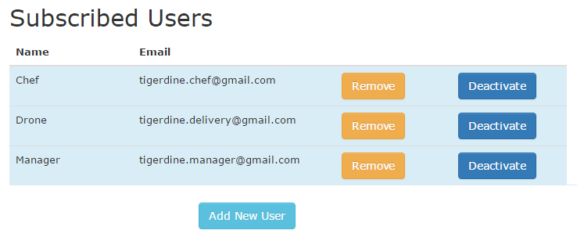
How to connect?
Orders
Email notification

Slide 11
OrdersController
new()
create()
…
EmailNotifier
order_notification()
?

Slide 12
Solution: Observer Pattern
Subject
attach(observer)
detach(observer)
notify()
Observer
update()
observes *
Notes:
Needs to add an observer for the food order activity
Define one-to-many dependency

Slide 13
Subject
attach(observer)
detach(observer)
notify()
Observer
update()
observes *
OrdersController
new()
create()
add_observer()
notify_observers()
EmailNotifier
order_notification()
update()
observes *

Slide 14
Control Flow
OrdersController
Order
EmailNotifier
create
save
notify_observers
update
Send Email
Notes:
Left to right

Slide 15
Goal: Implement Observer pattern
Modify OrdersController (Subject)
include “Observable”
adds observer using “add_observer”
Uses “notify_observers”
Modify EmailNotifier (Observer)
Observer has “update” method
Notes:
Add code snippet

Slide 16
Goal: Implement Observer pattern

Slide 17
Goal: Implement Observer pattern

Slide 18
Other Examples
Spreadsheet
Employee payroll
GUI program (callback)

Slide 19
Classroom Activity

Slide 20
Design problem:
Sales Logging

Slide 21
Problem
Saves records of transactions as backup
Sales logging for transaction failure

Slide 22
SalesLogger
initialize(file)
formatter
log(message)

Slide 23
Solution: Singleton
Single file to log all the sales information
Easy to look up
Singleton
inst: Singleton
instance(): Singleton
…
if inst == nil
inst = Singleton.new
end
return inst

Slide 24
Making class Singleton
Steps of making a class Singleton:
Creating the class variable
@@instance
Initializing it with the single instance
@@instance = SimpleLogger.new
Creating the class level instance method
Making a new private

Slide 25
Goal: Implement Singleton pattern
SalesLogger class
include “Singleton”
SalesController
call instance
call log(message)

Slide 26
Goal: Implement Singleton pattern

Slide 27
Singleton Examples
In Rails:
development.log
test.log
Webrick in rake
Outside Rails:
tomcat
ant

Slide 28
Design problem:
New Payment method

Slide 29
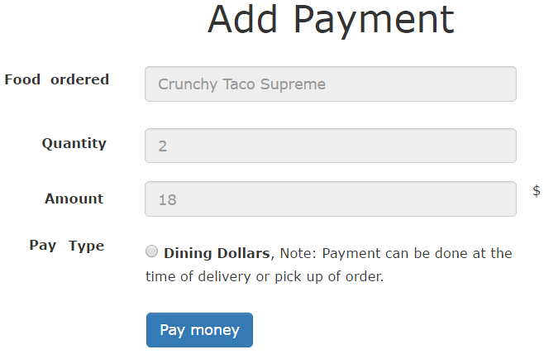
Goal: To Add Visa Debit Card and Paypal

Slide 30
Goal: To add VisaPay
PaymentsController
new
create
…
DiningDollars
charge(uid)
…

Slide 31
Solution: Adapter
Interface which bridge a gap in payment methods
Key objects are Target, Adapter and Adaptee
Client
Target
Request()
Adapter
Request()
Adaptee
SpecificRequest()

Slide 32
PaymentsController
PaymentProcessor
process_payment()
DiningDollarsAdapter
process_payment()
VisaPayAdapter
process_payment()
…
…
DiningDollars
charge(uid)
VisaPay
pay(debitcard, cvv, exp)
…
…

Slide 33
Control Flow
PaymentsController
VisaPayAdapter
VisaPay
create
process_payment
pay
Visa processes the payment

Slide 34
Goal: Implement Adapter Pattern
PaymentsController
“create” method call the adapter based on the input type
VisaPayAdapter
defines “process_payments” inherited from the PaymentProcessor
VisaPay
defines pay(creditcard, cvv, exp) saves the information

Slide 35
Adapter: Example in Rails
Active Records
Contains adapters for several databases (PostgreSQL or MySQL)
Wraps them up in common interface
AbstractAdapter implements common functionality
PostgreSQLAdapter
AbstractMysqlAdapter

Slide 36
Summary
Singleton:
Making Sure There Is Only one
Observer:
Keeping Up with the Times
Adapter:
Filling the gaps

Slide 37
Practice Quiz

