Slide 1
http://flic.kr/p/6oP7x7
Version Control with Git

Slide 2
Why track/manage different versions of code?

Slide 3
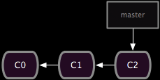
Backup: Undo or refer to old stuff
http://git-scm.com/book/en/Git-Branching-Basic-Branching-and-Merging

Slide 4
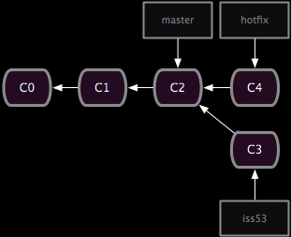
Branch: Maintain old release while working on new
http://git-scm.com/book/en/Git-Branching-Basic-Branching-and-Merging

Slide 5
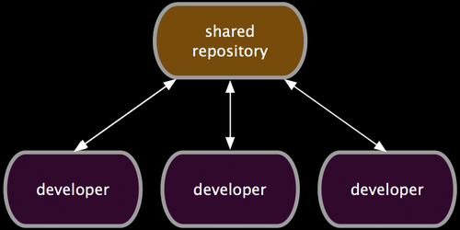
Collaborate: Work in parallel with teammates
http://git-scm.com/book/en/Distributed-Git-Distributed-Workflows

Slide 6
Version Control Systems (VCSs)
Help you track/manage/distribute revisions
Standard in modern development
Examples:
Revision Control System (RCS)
Concurrent Versions System (CVS)
Subversion (SVN)
Git
older
newer
Our focus

Slide 7
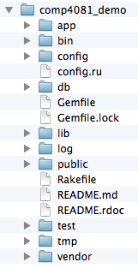
GitHub-User Perspective
You
GitHub
Working Dir

Slide 8
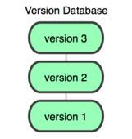
GitHub-User Perspective
You
GitHub
Working Dir
Local Repos

Slide 9
GitHub-User Perspective
You
GitHub
Working Dir
Local Repos
Remote Repos

Slide 10
Questions to answer
How organized?
You
GitHub
Working Dir
Local Repos
Remote Repos
What operations?

Slide 11
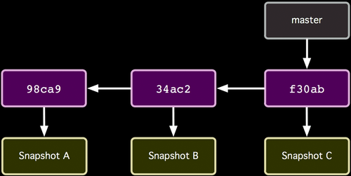
Repo Organization
http://git-scm.com/book/

Slide 12
Repo Organization
Commits (from oldest to newest; hashes as commit IDs)
http://git-scm.com/book/

Slide 13
Repo Organization
Snapshot of all files at each commit
http://git-scm.com/book/

Slide 14
Repo Organization
Branch (last commit)
http://git-scm.com/book/

Slide 15
Local Repo Operations
You
init
status
add/commit
log
checkout
…
Working Dir
Local Repos

Slide 16
How commit works
Before
http://git-scm.com/book/

Slide 17
How commit works
After
http://git-scm.com/book/

