Slide 1
Notes:
destroy function = delete http request invokes the destroy action and get the id for the car that is getting destroyed.

Slide 2
QUIZ!

Slide 3
True or False? Controllers simulate web requests and then provides only HTML pages as its output.
In this edit controller test image, we want to see if the page will error out or not. Which assertion would you use?
Option 1: assert_redirected_to
Option 2: assert_response
Option 3: assert_difference
Option 4: None of the above
Notes:
Don’t forget redirects

Slide 4
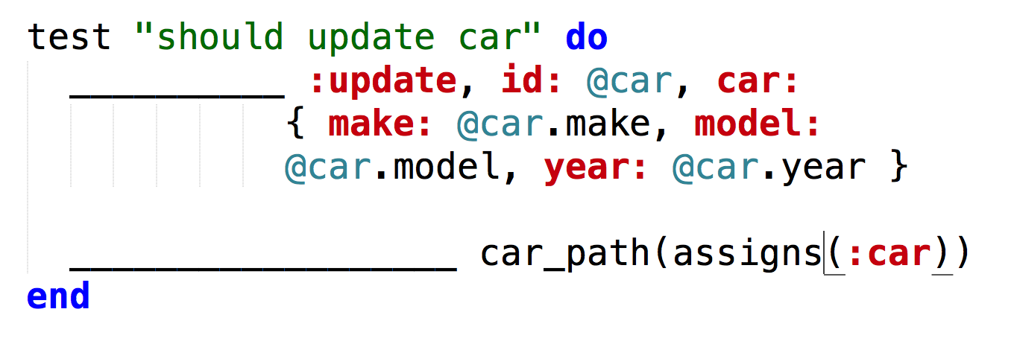
3. This is an update controller test. After clicking the submit button on the edit page, we want to update the database. Fill in the blank to update as well as redirect yourself to the index.
Option 1: patch, assert_redirected_to
Option 2: post, assert_redirected_to
Option 3: put, assert_response
Option 4: None of the above

Slide 5
4. Given the three subsets of testing (Unit, Integration, System), which subset do you think functional testing belong under? Explain your reasoning
5. Morgan is given a gaming software that includes the code. (S)he is asked to test it. Which of the following is the type of testing (s)he is most likely to use?
Option 1: Blackbox Testing
Option 2: Blackbox and Unit Testing
Option 3: Whitebox Testing
Option 4: None of the above

Slide 6
6. Which of the following is true of exhaustive testing?
Option 1: Results in large test cases even for small programs
Option 2: Test all possible inputs
Option 3: Generally infeasible in practice
Option 4: All of the above

Slide 7
Answers
False; It can also provide redirects
Option 2: assert_response
Option 1: patch, assert_redirected_to
Functional testing can belong under functional or system. It really depends on how you view it. Functional testing is all about the integration but it can also be tested from the interface.
Option 3: Whitebox Testing
Option 4: All of the above

Slide 8
What We Covered
What is testing?
Types of testing:
Blackbox, whitebox, etc.
Functional Testing

Slide 9
Next Class: Whitebox Testing
https://flic.kr/p/9AWLK

