Slide 1
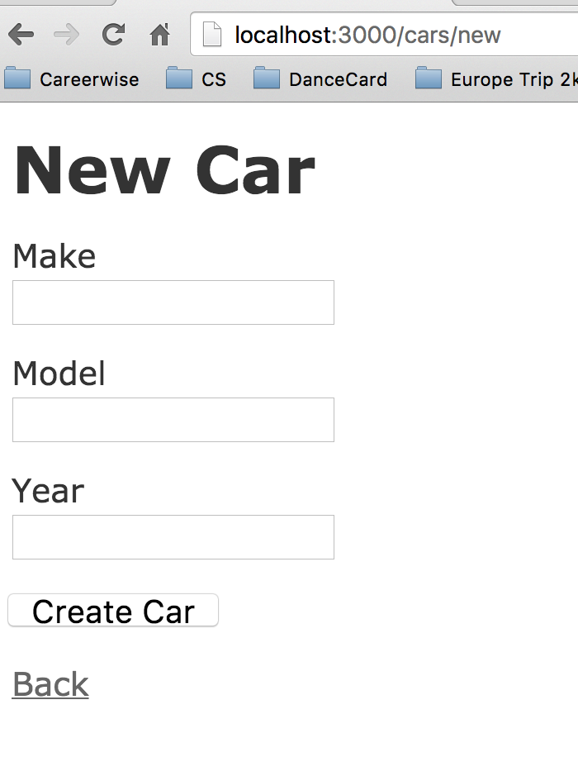
Notes:
example with the controller actions new and create. With the new action, an html is rendered thus a new form .

Slide 2
Notes:
check response doesn’t err out and that the correct rendering is done.

Slide 3
Notes:
Create car button will send a post request to the create method and render a http redirect with a bunch of parameters from the form.

Slide 4
Notes:
Create a car need a post request, the create action and then the car variable with the parameters from the form.
Setup at the top so that we have a variable to contain the form info.

