Slide 1
https://flic.kr/p/7yahjU
Functional Testing

Slide 2
15 Knowledge Areas of SWEBOK
Software Requirements
Software Design
Software Construction
Software Testing
Software Maintenance
Software Configuration Management
Software Engineering Management
Software Engineering Process
Software Engineering Models and Methods
Software Quality
Software Engineering Professional Practice
Software Engineering Economics
Computing Foundations
Mathematical Foundations
Engineering Foundations

Slide 3
Can you create a bug-free software?
No!
Goal: Reduce the number of bugs
What can you do to discover bugs?
Software testing
Notes:
In real software, there are hundred of lines so it is very difficult to create a program that is 100% bug free.

Slide 4
Testing-Related Terminology
Testing: Execute code to reveal defects
Does it behave as expected?
Test/Test Case: One execution of code that may expose bug
Test Suite: Set of test cases
Often used to group related tests

Slide 5
How do you completely test a program?
Try all possible inputs = Exhaustive Testing
Can exhaustive testing be done in practice?
No….

Slide 6
Example: File operation
Takes file name as argument
Each character an 8-bit byte
How many tests cases to exhaustively test?
If you limit file name to 10 characters, there are 256¹⁰ different test cases
Even if you can run 1000 tests per second, it would still take over 10¹³ years!
Clearly, exhaustive testing not feasible…
Notes:
=((2^8)^10)/(1000*60*60*24*365)

Slide 7
The Testing Problem:
How to choose set of test cases that reveals all errors?
Fundamental research problem
Essentially unsolvable in general case

Slide 8
Design Decisions for Tests
What subset of system to test?
How to choose test cases?

Slide 9
What subset of system to test?
larger subset
System testing: Test the complete system
Integration testing: Test groups of collaborating units
Unit testing: Test modules in isolation; smallest “units” of code
smaller subset

Slide 10
Unit versus Integration Testing
Problem: Definition of “unit” varies (class? method?...)
How to distinguish:
Unit test | Integration test
Repeatable (context independent) | May involve system time, machine name, etc.
Deterministic | May involve threads, random numbers, etc.
In memory | May involve file system, DB
Fast (less than 0.5 seconds) | May be slow
Tests one property | May test multiple properties

Slide 11
Design Decisions for Tests
What subset of system to test?
How to choose test cases?

Slide 12
How to choose test cases?
Blackbox testing: Choose based on module’s possible inputs and outputs
Do not use code
Often test boundary cases
Whitebox testing: Uses internal logic to choose tests
Different levels of code coverage
Aka glass box testing, clear box testing

Slide 13
QUIZ!

Slide 14
Imagine you are given a compiled application to test. Which of the following would be the correct tests to use?
Option 1: Blackbox and Unit Testing
Option 2: Whitebox and Integration Testing
Option 3: Blackbox and Integration Testing
Option 4: Whitebox and Unit Testing
True or False? Exhaustive testing generally results in small set of test cases for small programs.

Slide 15
John wants to be able to quickly test individual subcomponents in his grade management system. Which testing should he use to accomplish the task at hand?
Option 1: Integration Testing
Option 2: System Testing
Option 3: Unit Testing
Option 4: None of the above
Which of the following about Unit testing is NOT correct?
Option 1: In memory
Option 2: Deterministic
Option 3: Involves the network I/O
Option 4: Tests one property

Slide 16
What type of testing were you doing when you wrote tests for your model classes?
Option 1: Integration Testing
Option 2: System Testing
Option 3: Unit Testing
Option 4: None of the above

Slide 17
Answers
Option 3: Blackbox and Integration Testing
False; Even for small programs, test cases can be large. Refer to file operation example
Option 3: Unit Testing
Option 3: Involves the network I/O
Option 3: Unit Testing

Slide 19
Notes:
simple web app called Cars. You have the index page, update page, etc.

Slide 20
VIEWS
….
index
show
create
DB
….
index
show
create
CarController
Model
CONTROLLERS
Notes:
Mvc architecture with all the aspects of a car system.

Slide 21
Functional Tests in Ruby
Test controller actions
Input: Controllers simulate web requests
Output: Respond with an HTML/redirect

Slide 22
What to ask?
Errors?
Output?
HTML
Redirect
System State?
Database
“Other states/logic?…”
Notes:
Was the web request successful? So did the system not crash? Did it not error out or throw an exception.
Was the correct output rendered? Was the right html return? Does it redirect to where you need to be?
Was the correct data stored in the database? Session state?

Slide 23
Notes:
check to see if it dies/error out. add the assert:response :success to see, but it doesn’t really tell us much except that it didn’t err out.

Slide 24
Notes:
check to see if the correct view was set for index controller in cars.
assert_template and then the name of view.
Example of failed test

Slide 25
Notes:
check to make sure that a valid instance of car is assigned

Slide 26
QUIZ!

Slide 27
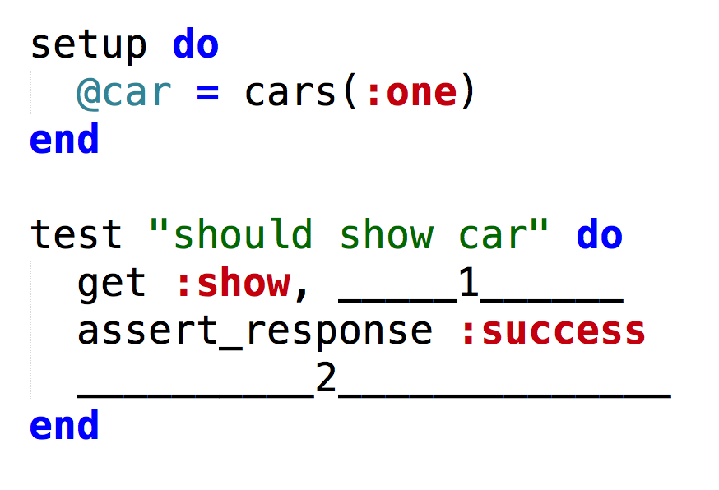
For the first blank (1), what should be done to show the correct car? (Hint: Id)
Using the image from the first question, how would I check to make sure the correct view is rendered for the show action? (Fill in blank #2)
Option 1: assert_not_nil assigns(:cars)
Option 2: assert_template :show
Option 3: assert_response :success
Option 4: assert_difference
Notes:
3. In a previous

Slide 28
True or False? According to the image, a valid instance of model is assigned to the controller action.

Slide 29
Answers
id:@car
Option 2: assert_template :show
False; :model should be a car instance

