Slide 1
Design Patterns
Lecture part 2

Slide 2
Recap of Lecture 1
Design Pattern Definition
Well described solution to recurring problem
Strategy Design Pattern
Make algorithms interchangeable
Observer Design Pattern
Watching for another object to change state

Slide 3
Reference Textbook
“Gang of Four” book

Slide 4
Design Pattern Parts
Pattern Name and Classification
Intent
Also Known As
Motivation
Applicability
Structure
Participants
Collaborations
Consequences
Implementation
Sample Code
Known Uses
Related Patterns

Slide 5
Builder Design Pattern
Intent
Separate the construction of a complex object from its representation so that the same construction process can create different representations.

Slide 6
Motivation
Rich Text Format(RTF) document exchange format reader converts RTF to many text formats.
Problem: Should be able to add new conversion without modifying the reader.

Slide 7
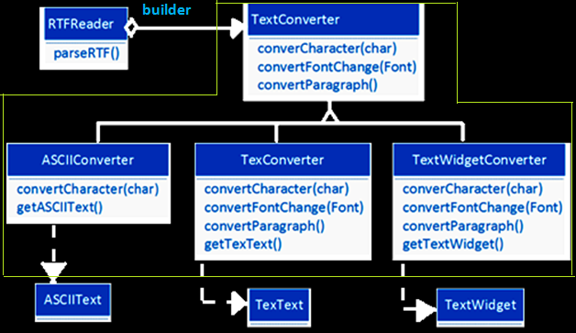
Motivation
builders

Slide 8
Applicability
Hide complex object implementations
Allow different representations

Slide 9
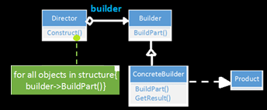
Structure

Slide 10
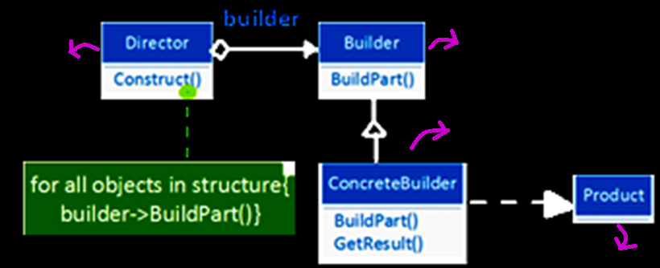
Participants
abstract interface
Constructs
object
Implements Builder
final result

Slide 11
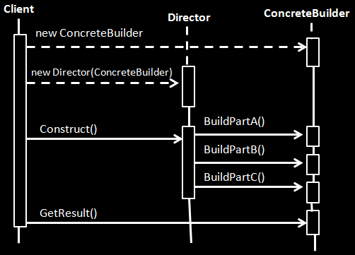
Collaborations

Slide 12
Consequences
Vary product’s internal representation
Isolates code for construction and representation

Slide 13
Implementation
Builder – defines operation for each component
Concrete Builder – overrides operations for components
Issues:
Assembly and construction interface
Why no abstract class for products
Empty methods as default in Builder

Slide 14
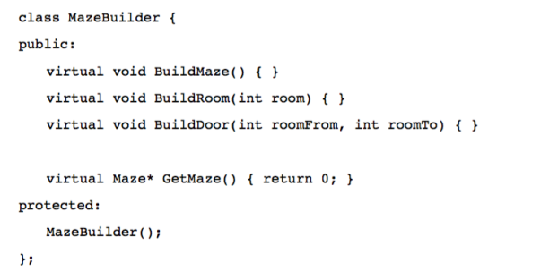
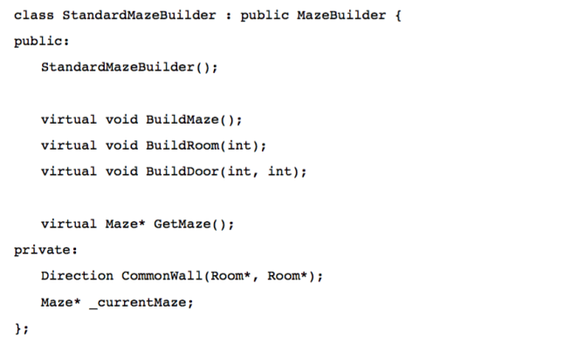
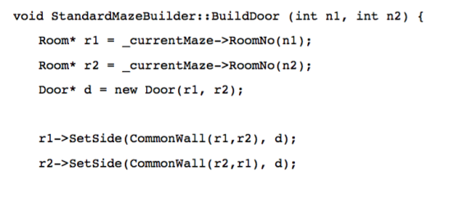
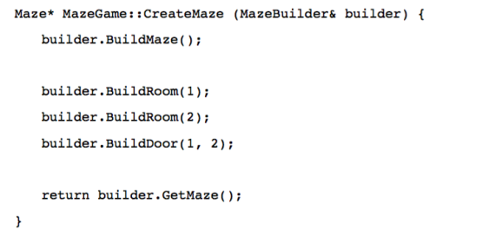
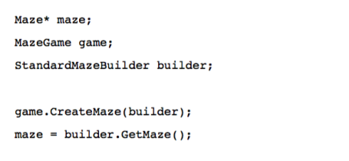
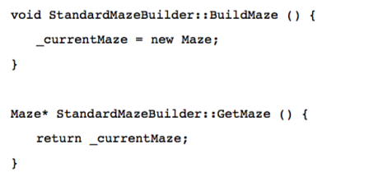
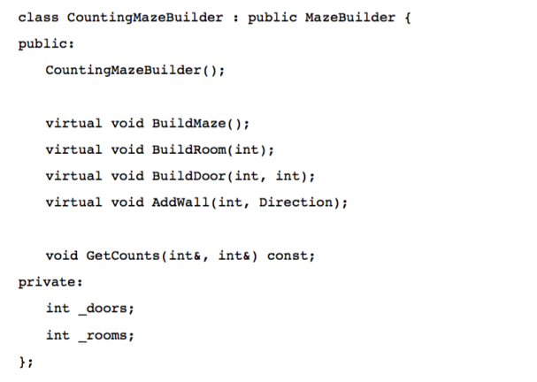
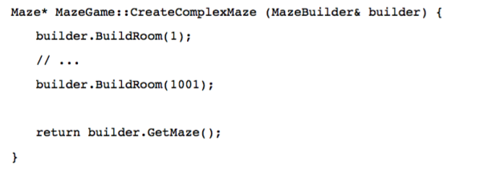
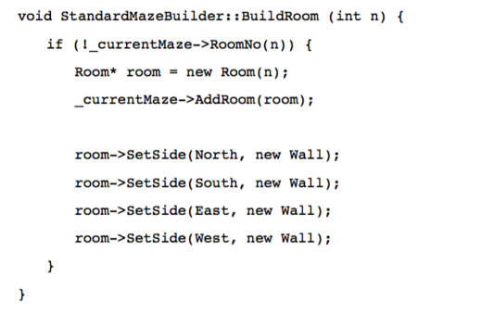
Sample Code

Slide 15
Known Uses
Parser class from Smalltalk
ClassBuilder from Smalltalk

Slide 16
Related Patterns
Abstract Factory
Composite

Slide 17
Here’s another design pattern…

Slide 18
Case study

Slide 19
Object oriented adapters
Incorporate new vendor class library into existing software system
Requirement: Do not change existing code

Slide 20
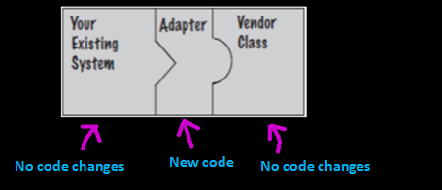
Solution
Write a class that adapts the new vendor interface into the expecting one.

Slide 21
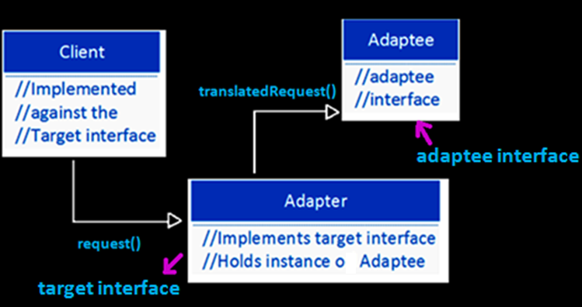
Adapter - Functionality
f

Slide 22
Adapter Pattern
Design Principle
Converts the interface of a class into another interface the clients expect
Use to overcome incompatibility

Slide 23
Object Adapter Pattern

Slide 24
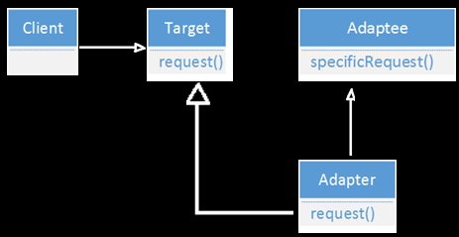
Class Adapter Pattern

Slide 25
Let’s learn about a more complicated problem…

Slide 26
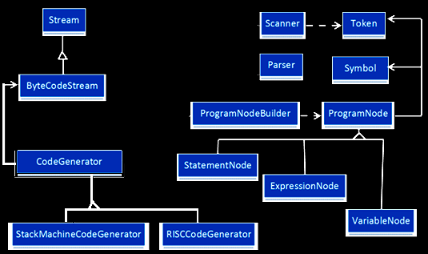
Motivation
Problem: Minimize the dependencies between subsystems.

Slide 27
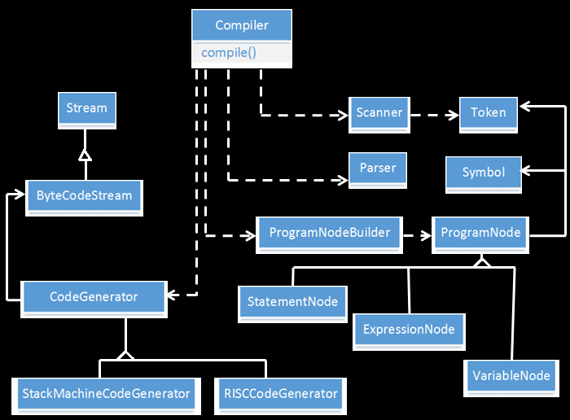
Design Pattern solving the problem
Compiler subsystem classes

Slide 28
Solution
Compiler class –
Offers single, simple interface to subsystem
Combines classes implementing compiler functionality without hiding them

Slide 29
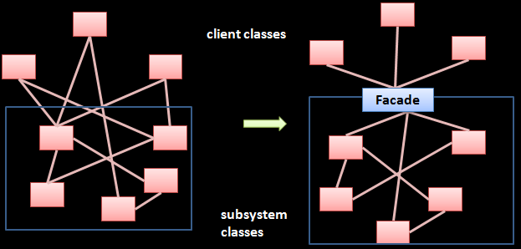
Facade Pattern defined
Design Principle
Provide a unified interface to a set of interfaces in a subsystem.

Slide 30
Design patterns catalog based on purpose
Creational
Structural
Behavioral
Adapter
Bridge
Composite
Decorator
Facade
Flyweight
Proxy
Interpreter
Template Method
Chain of Responsibility
Command
Iterator
Mediator
Memento
Observer
State
Strategy
Visitor
Factory Method
Abstract Factory
Builder
Prototype
Singleton

Slide 31
Summary
Defined Design Patterns
Structure of Design Patterns
Example Patterns
Strategy
Observer
Builder
Adapter
Facade
Catalog of Design Patterns
Thank you!

