Slide 1
Design Patterns
Lecture part 1

Slide 2
Motivation
Want to decorate a room? How?
Build a house following different methods?

Slide 3
Analogy to Software Design Patterns

Slide 10
Design Pattern defined
A design pattern is a well described solution to a recurring software problem.

Slide 11
Why Design Patterns?
Critical to make design decisions
Evaluate costs and benefits of applying patterns

Slide 12
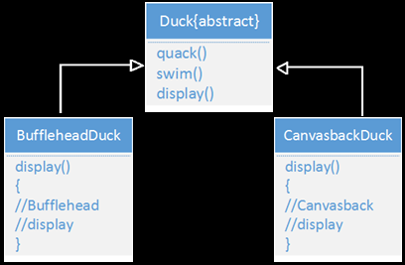
SimUDuck - A simulation game
New requirement: We need ducks to fly
Joe

Slide 13
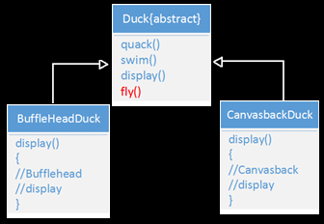
Solution Proposed

Slide 14
Problem with this Approach
Not all Duck subclasses should fly.

Slide 15
Another solution
Make Flyable() interface with a fly() method.
Only the flying duck classes will implement the Flyable interface.

Slide 16
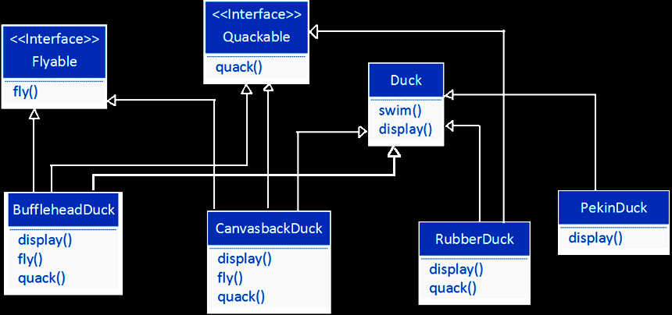
Solution 2 insight

Slide 17
Problem with this Approach
Change all the Duck subclasses whenever Flying behaviour has to be modified.
No code reuse.

Slide 18
Activity
Q- If you were Joe, how will you make the Ducks to fly?
Think-pair-share

Slide 19
Think pair Share
Think for yourself about the possible solutions
Pair up with the student sitting beside
Share your response in the application – One from each pair can submit

Slide 20
Here’s the design pattern solving the problem!

Slide 22
Strategy Design Pattern
Design Principle
Identify the aspects of your application that vary and separate them from what stays the same.

Slide 23
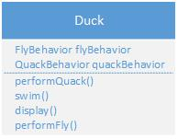
Benefits
Other objects can reuse fly and quack behaviors
New behaviors can be added without modifying any of the existing behavior classes

Slide 24
Let’s look at a different design problem

Slide 25
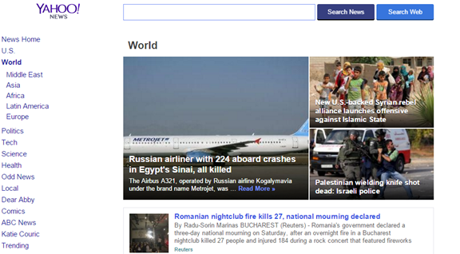
Another Example System
Yahoo subscribers should receive notification of new event

Slide 26
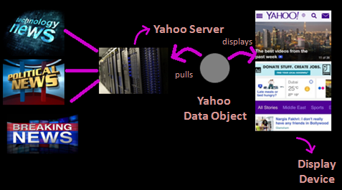
SMS/ email

Slide 27
Requirements
Need to implement all the display elements .
Display has to be updated upon occurrence of new event.
System must be expandable, users can add or remove more display elements.

Slide 28
Here’s the design pattern solving the problem!

Slide 29
Observer Design Pattern
Design Principle
Define a one-to-many dependency between objects so that when one object changes state, all of its dependents are notified and updated automatically.

Slide 30
Structure

Slide 31
Consequences
Loose coupling between Subject and Observer.
Support for broadcast communication.

Slide 32
Preview of next lecture
Design Patterns Description
Some Design Patterns
Catalog of Design Patterns
Thank you!

